Slide 1
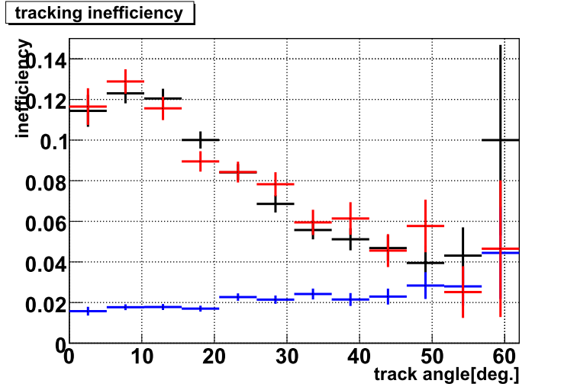
―: MC(after tuning)
―: MC(before tuning)
―: data

