Slide 1
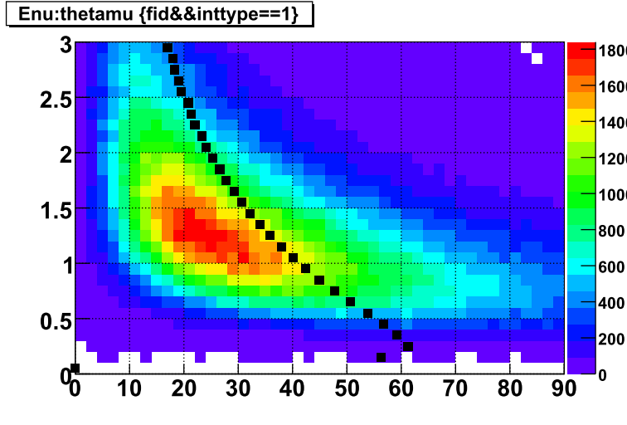
Mean
Eν[GeV]
θ_{μ}[deg.]

