Slide 1
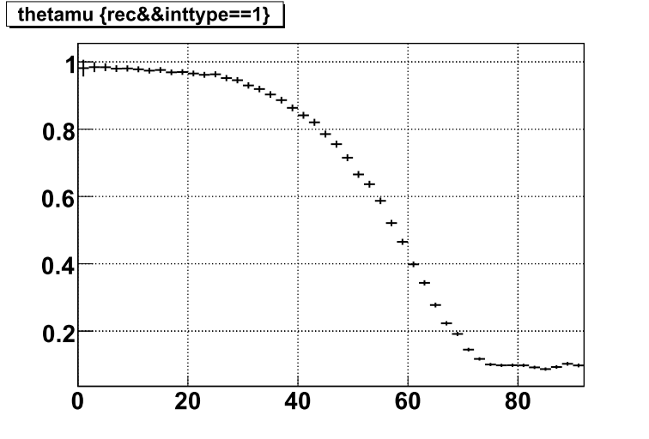
Selection efficiency
θ_{μ}[deg.]

