Slide 1
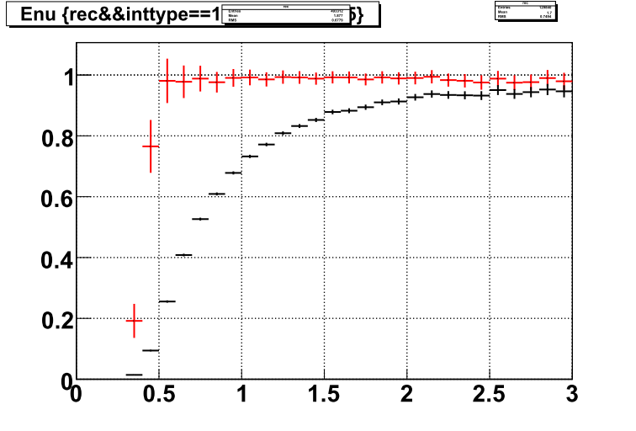
―: no angle cut
―: θμ < 15deg.
Selection efficiency
Eν[GeV]

