Slide 1
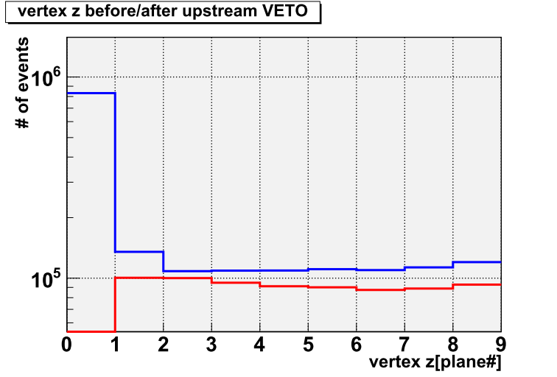
Blue: before upstream VETO cut Red : after upstream VETO cut

