Slide 1
INGRID Official plot candidate ~ part one ~ A.Murakami

Slide 2
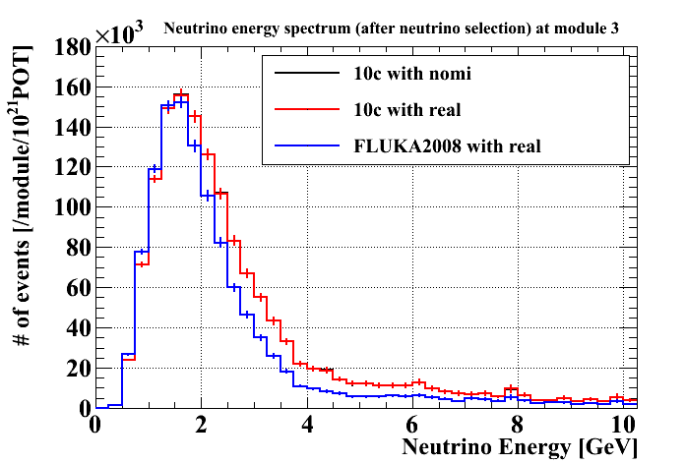
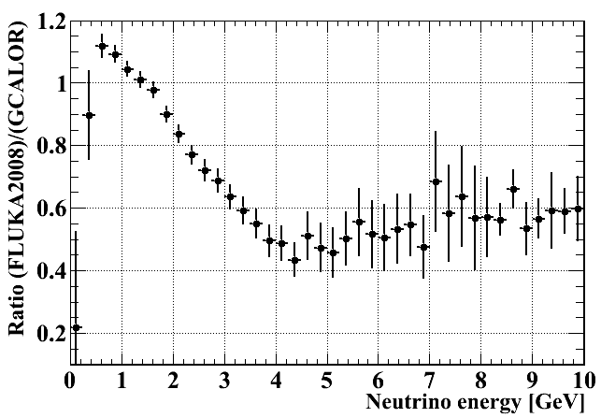
Comparison between GCALOR and FLUKA2008
Neutrino energy spectrum (numu) after neutrino event selection.
Energy spectrum at module 3
Ratio of energy spectrum (FLUKA2008)/(GCALOR)
GCALOR (jnubeam10c)
FLUKA2008
The ratio of number of events after neutrino event selection at INGRID = (FLUKA2008)/(GCALOR) ~ 79%
Including numu and numubar. To be updated with nue, nuebar soon.

Slide 3
DATA taking efficiency
Summary of # of good spills and protons
99.9% data taking efficiency (# of INGRID good spills = 1005887 / 1006982) Total number of protons for analysis 3.26 x 10¹⁹
3

Slide 4
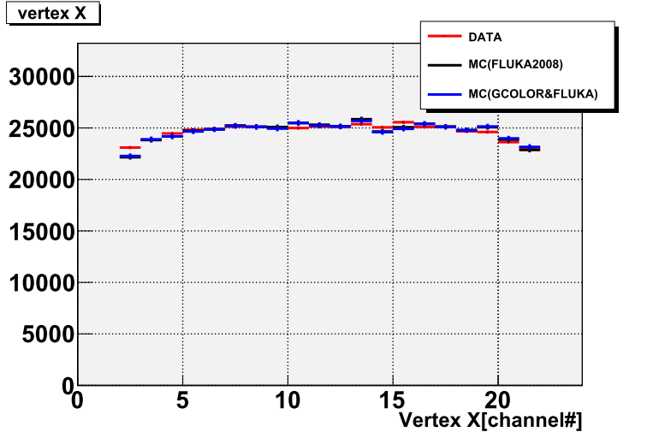
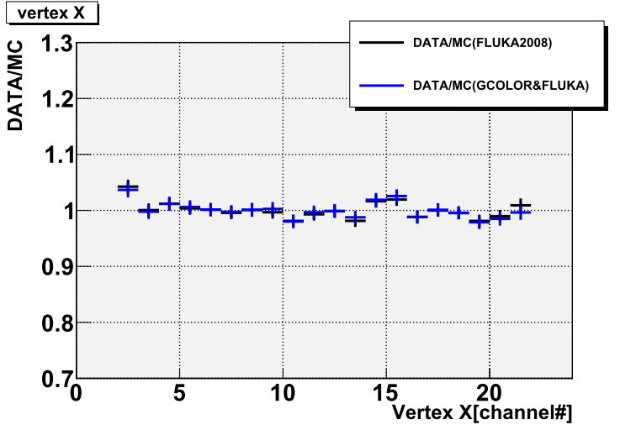
Vertex X
At all modules
DATA(Run29-34)
MC(GCALOR)
MC(FLUKA2008)
DATA/MC(GCALOR)
DATA/MC(FLUKA2008)
4

Slide 5
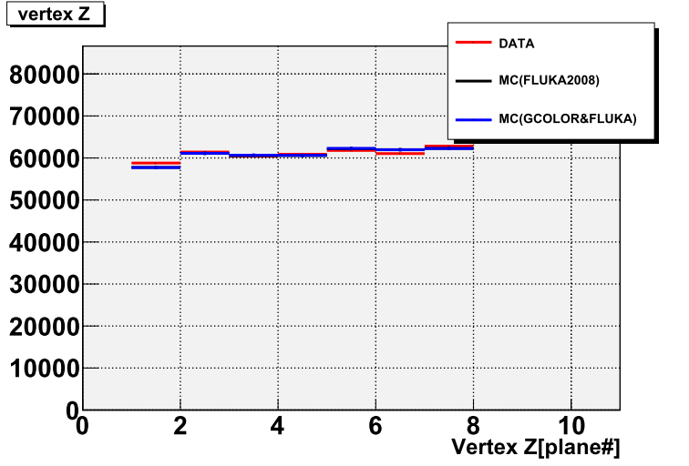
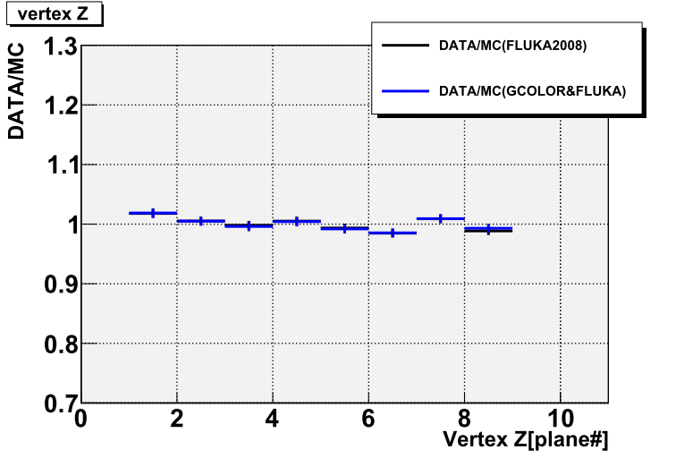
Vertex Z
At all modules
DATA(Run29-34)
MC(GCALOR)
MC(FLUKA2008)
DATA/MC(GCALOR)
DATA/MC(FLUKA2008)
5

Slide 6
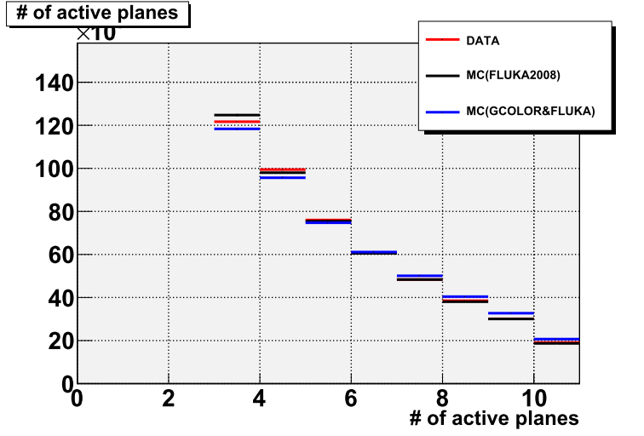
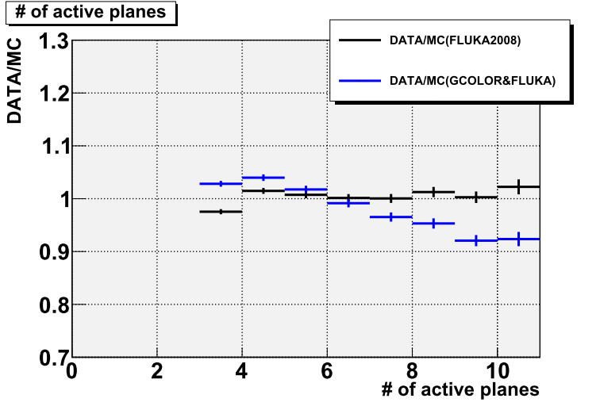
# of active planes
At all modules
DATA(Run29-34)
MC(GCALOR)
MC(FLUKA2008)
DATA/MC(GCALOR)
DATA/MC(FLUKA2008)
6

Slide 7
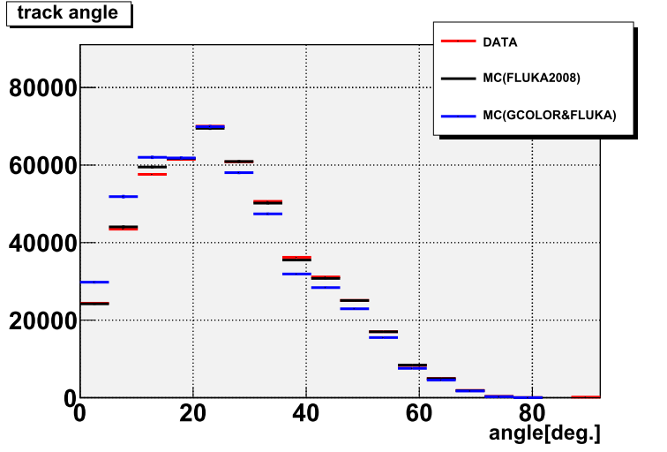
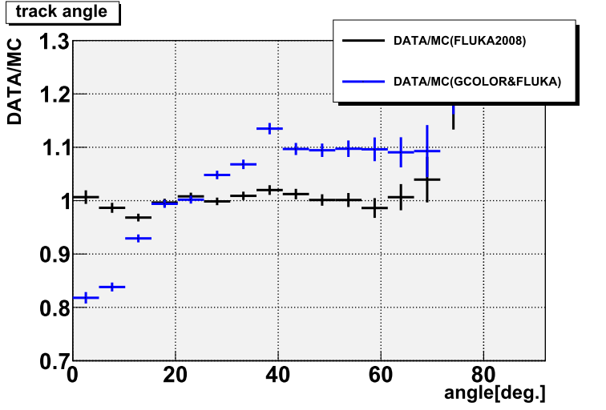
Track angle
At all modules
DATA(Run29-34)
MC(GCALOR)
MC(FLUKA2008)
DATA/MC(GCALOR)
DATA/MC(FLUKA2008)
Shape of FLUKA2008 is better agreement with DATA than GCALOR
7

Slide 8
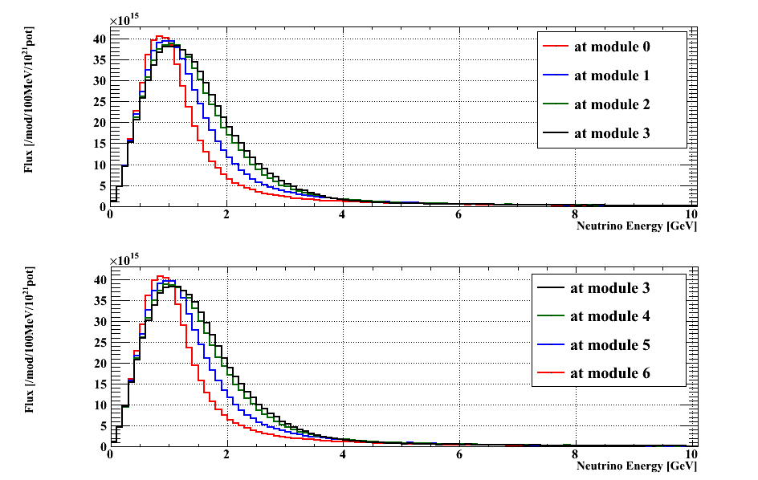
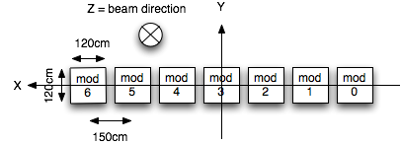
Energy spectrum of ν into INGRID
Jnubeam 10c(GCALOR) Flux
Only numu energy spectrum.
At horizontal modules
Horizontal modules
2
6
Flux [/module/100MeV/10^21POT]
From the edge to center module, the peak energy region is shifted higher and wider.
2
6
Neutrino energy [GeV]

Slide 9
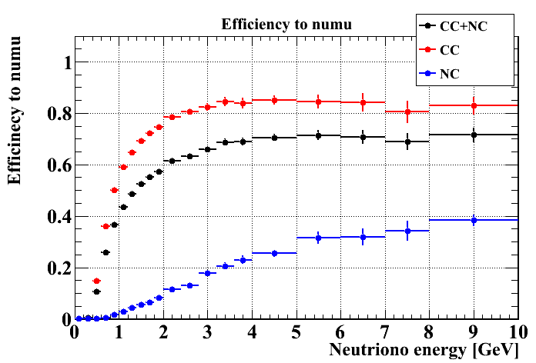
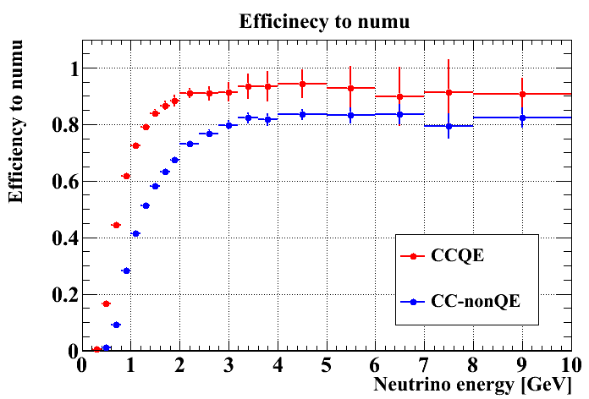
Selection efficiency
Efficiency curve to numu at each interaction mode
Mean efficiency at each module.
Flux averaged efficiency for each module (jnubeam 10c (GCALOR) )
Module# | 0 | 1 | 2 | 3 | 4 | 5 | 6
Efficiency [%] | 51.7 | 54.0 | 55.1 | 55.1 | 55.0 | 54.2 | 51.2
Module# | 7 | 8 | 9 | 10 | 11 | 12 | 13
Efficiency [%] | 52.6 | 54.4 | 55.1 | 55.0 | 54.6 | 54.1 | 51.8
To be updated with FLUKA2008 flux
9

