Slide 1
INGRID update
Murakami
2010/8/20
Monte Carlo simulation
Summary of 10a beam DATA

Slide 2
MC updates from last CM.
Implement Real scintillator dimension
Box shape -> octagon shape (from measurement)
detail is on back up.
Consider interaction in scintillator
Ratio of scintillator mass to Fe is about ~4%
Temporarily, all interactions are simulated with Fe nucleus.
Will implement interactions with scintillator soon.
Add MPPC noise.
Implement bad channels.
jnubeam 10c (GCALOR) and FLUKA2008 (re-weighted)
detail is on back up.
2

Slide 3
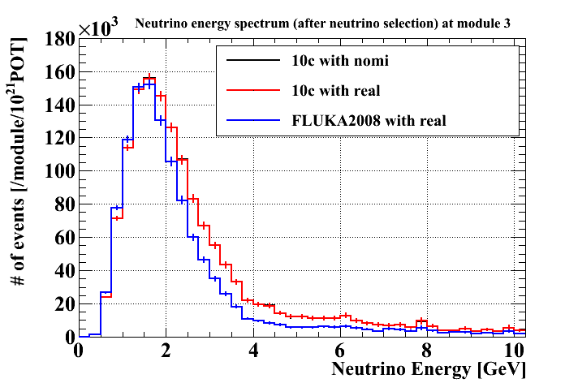
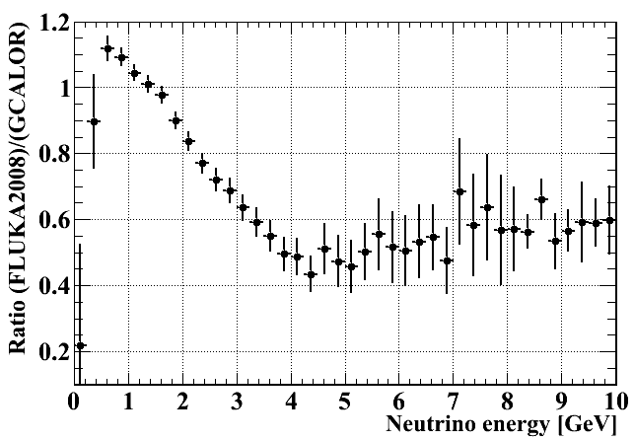
Comparison between GCALOR and FLUKA2008
Neutrino energy spectrum (numu) after neutrino event selection.
Energy spectrum at module 3
Ratio of energy spectrum (FLUKA2008)/(GCALOR)
GCALOR (jnubeam10c)
FLUKA2008
The ratio of number of events after neutrino event selection at INGRID = (FLUKA2008)/(GCALOR) ~ 71%
Including numu and numubar. To be updated with nue, nuebar soon.

Slide 4
Summary of 10a beam DATA
4

Slide 5
DATA taking efficiency
Summary of # of good spills and protons
99.9% data taking efficiency (# of INGRID good spills = 1005887 / 1006982) Total number of protons for analysis 3.26 x 10¹⁹
5

Slide 6
Comparison between Data and MC
Comparison at some distributions after neutrino selection
Reconstructed vertex
# of active planes
Reconstructed track angle
Data set
Data : Run 29-34
MC : Jnubeam10c(GCALOR) and FLUKA2008
Neutrino interaction : NEUT
All distributions are normalized with # of events

Slide 7
Event selection
Reported at last collaboration meeting
Make timing cluster(more than 4 hits within 100nsec)
# of active planes > 2 && p.e./active layer > 6.5
Tracking
Track matching
On time
Upstream VETO
Fiducial volume
neutrino event
7

Slide 8
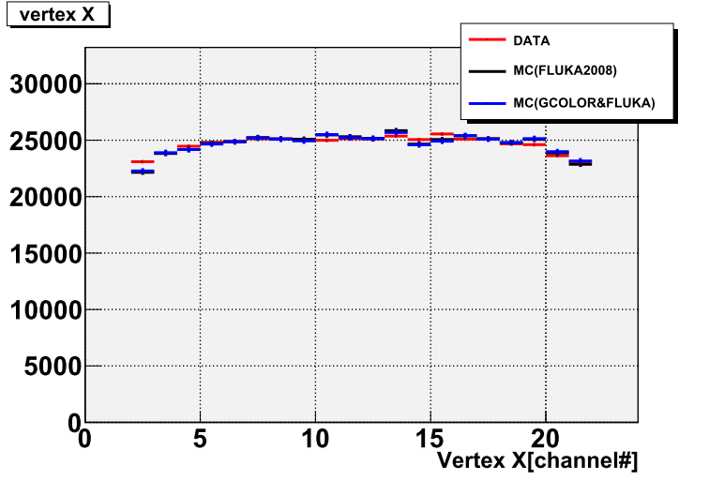
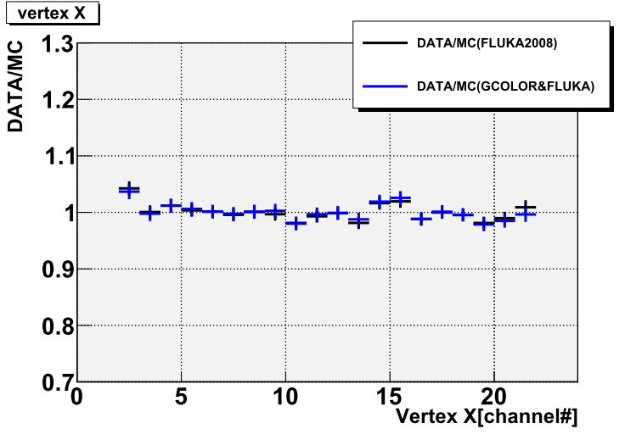
Vertex X
At all modules
DATA(Run29-34)
MC(GCALOR)
MC(FLUKA2008)
DATA/MC(GCALOR)
DATA/MC(FLUKA2008)
8

Slide 9
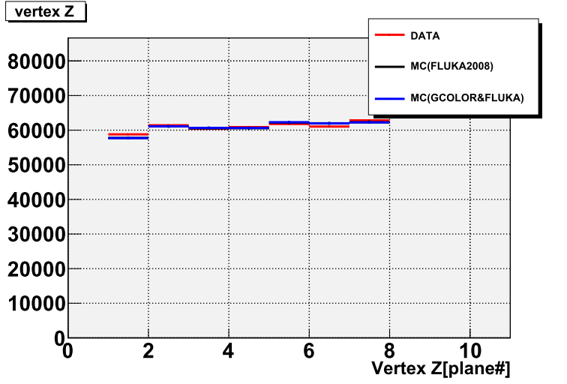
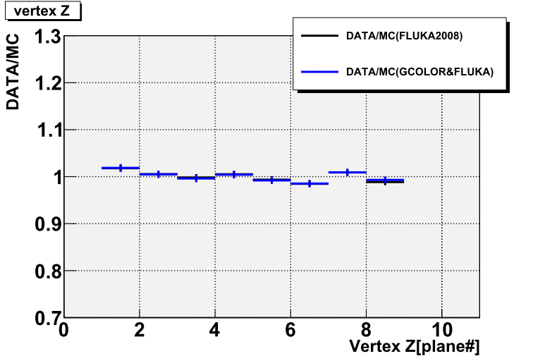
Vertex Z
At all modules
DATA(Run29-34)
MC(GCALOR)
MC(FLUKA2008)
DATA/MC(GCALOR)
DATA/MC(FLUKA2008)
9

Slide 10
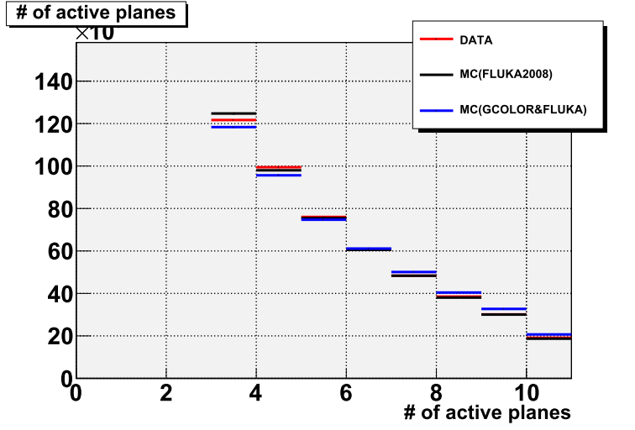
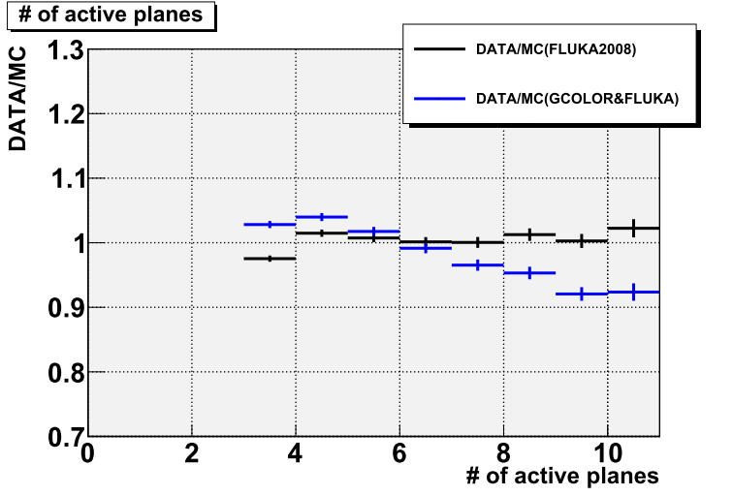
# of active planes
At all modules
DATA(Run29-34)
MC(GCALOR)
MC(FLUKA2008)
DATA/MC(GCALOR)
DATA/MC(FLUKA2008)
10

Slide 11
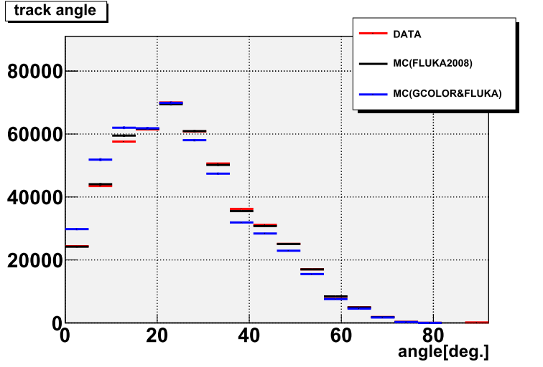
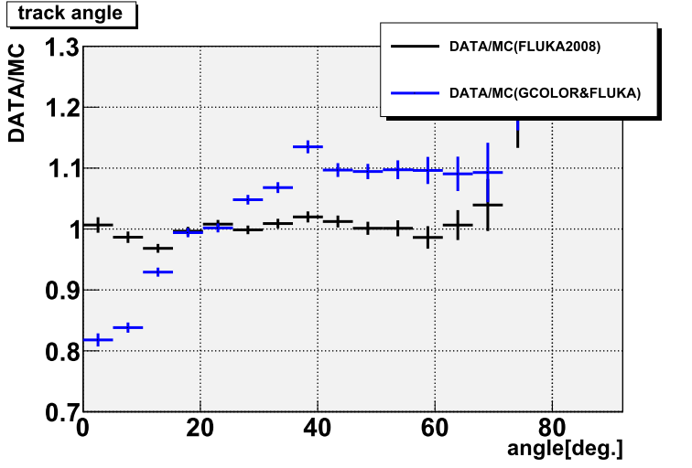
Track angle
At all modules
DATA(Run29-34)
MC(GCALOR)
MC(FLUKA2008)
DATA/MC(GCALOR)
DATA/MC(FLUKA2008)
Shape of FLUKA2008 is better agreement with DATA than GCALOR
11

Slide 12
Selection efficiency
Calculate the efficiency of the neutrino event selection with MC.
Efficiency = (# of events after neutrino event selection) / (# of generated interaction in Fiducial volume).

Slide 13
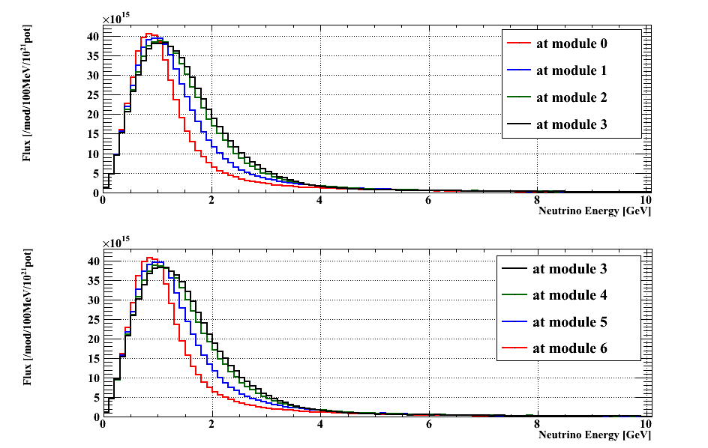
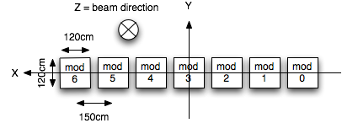
Energy spectrum of ν into INGRID
Jnubeam 10c(GCALOR) Flux
Only numu energy spectrum.
At horizontal modules
Horizontal modules
2
6
Flux [/module/100MeV/10^21POT]
From the edge to center module, the peak energy region is shifted higher and wider.
2
6
Neutrino energy [GeV]

Slide 14
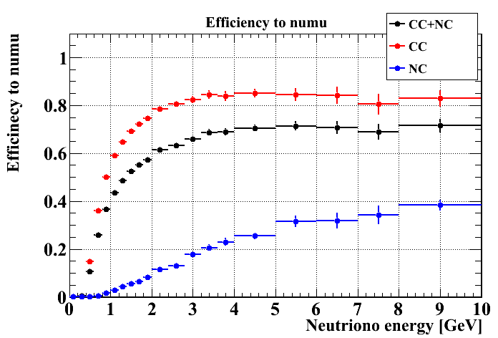
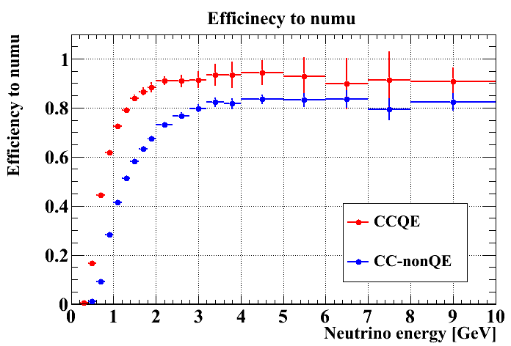
Selection efficiency
Efficiency curve to numu at each interaction mode
Mean efficiency at each module.
Flux averaged efficiency for each module (jnubeam 10c (GCALOR) )
Module# | 0 | 1 | 2 | 3 | 4 | 5 | 6
Efficiency [%] | 51.7 | 54.0 | 55.1 | 55.1 | 55.0 | 54.2 | 51.2
Module# | 7 | 8 | 9 | 10 | 11 | 12 | 13
Efficiency [%] | 52.6 | 54.4 | 55.1 | 55.0 | 54.6 | 54.1 | 51.8
To be updated with FLUKA2008 flux
14

Slide 15
Summary of my part
Update INGRID MC from last CM.
Good data taking efficiency (~99.9%)
Better agreement of distributions between data and MC with FLUKA2008 than GCALOR
Neutrino selection efficiency estimated by MC(GCALOR flux).

Slide 16
Back up

Slide 17
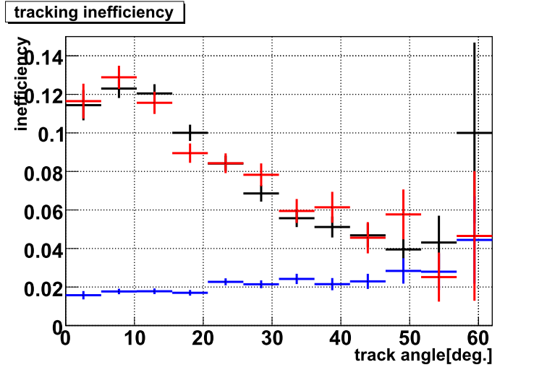
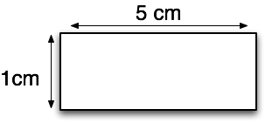
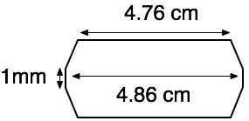
Dimension of scintillator bar for MC
The edge area is reflective material -> the area is not efficient.
Due to this inefficient area, the hit efficiency is dependent on track angle (studied by Christophe, Matsumura-san, Otani-san).
After change MC, reproduce the angle dependency.
Photo : surface of scintillator bar
white area : the reflective material.
MC setting
DATA MC(before)
MC(after)
Scintillator bar
Previous MC
(simple box)
New MC (octagon)

Slide 18
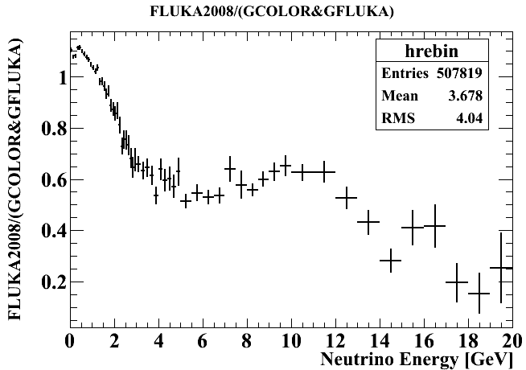
Re-weighting method
Re-weighting from Jnubeam10c (nominal proton beam profile ) to FLUKA2008 (real proton beam profile)
Re-weighting factor is neutrino energy spectrum ratio : (FLUKA2008 with real beam) / (Jnubeam 10c with nominal beam)
Including diff. of hadron production model and diff. of beam profile
Diff. between GCALOR and FLUKA2008
Diff. between nominal proton beam profile (gaussian, σ=4.343 mm) and real beam profile (below)
Re-Weighting from Jnubeam10c(nominal) to FLUKA2008(real) at each neutrino energy.
Real beam parameters
Weighting factor
Reported by Kakuno-san

