Slide 1
Temp
Otani
Murakami
2010/8/17
Monte Carlo simulation
Summary of 10a beam DATA
Comparison DATA and MC
Syst. error study

Slide 2
Overview of MC
Component
Jnubeam 10c (GCOLOR/GFLUKA,nominal beam)-> Estimate Neutrino Flux to INGRID
NEUT -> Simulate neutrino interaction at the target in INGRID MC
GEANT4 -> Detector MC
2

Slide 3
Updates from last collabo. meeting
Reflect Real scintillator demension
Consider interaction vertex in scintillator
From ratio of scintillator to Fe is about 4~5%
Use the NEUT file of the Fe target at scintillator vertex (not consider the diff. of cross-section currently).
Add MPPC noise on MC data
Install bad channel
Not consider the hit at bad channel in MC
Use Jnubeam 10c and weighting with neutrino energy spectrum ratio (FLUKA2008 with real beam)/(Jnubeam 10c with nominal beam).
3

Slide 4
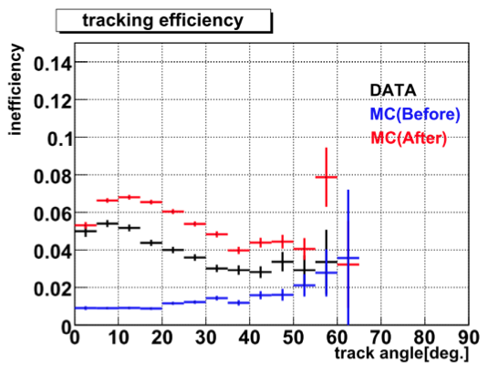
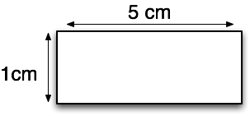
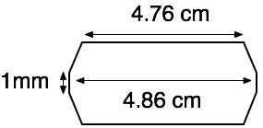
Dimension of scintillator bar of MC
Photo : surface of scintillator bar
The efficient area of a scintillator bar is whole scintillator bar.
In fact, the edge area is reflective material. So the area is not efficient.
Due to this inefficient area, the hit efficiency is dependent on track angle (studied by Christophe, Matsumura-san, Otani-san).
white area : the reflective material.

Slide 5
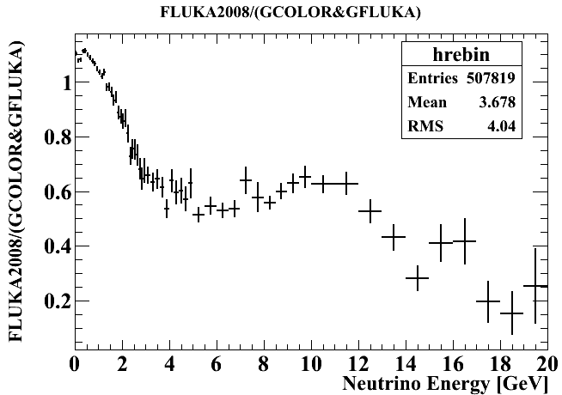
Weighting with Neutrino energy
Use energy spectrum ratio (FLUKA2008 with real beam) / (Jnubeam 10c with nominal beam) at each energy bin.
The estimation of FLUKA 2008 is good consistent to NA610-result
The real beam : accumulated beam parameta @target measured at Run29-34

Slide 6
Summary of 10a beam DATA
6

Slide 7
DATA taking efficiency
Summary of # of good spills and protons
99.9% data taking efficiency (# of good spills = 1005887 / 1006982) Total delivered protons 3.26 x 10¹⁹
7

Slide 8
Event selection
Make timing cluster(more than 4 hits within 100nsec)
# of active planes > 2 && p.e./active layer > 6.5
Tracking
Track matching
On time
Upstream VETO
Fiducial volume
neutrino event
8

Slide 9
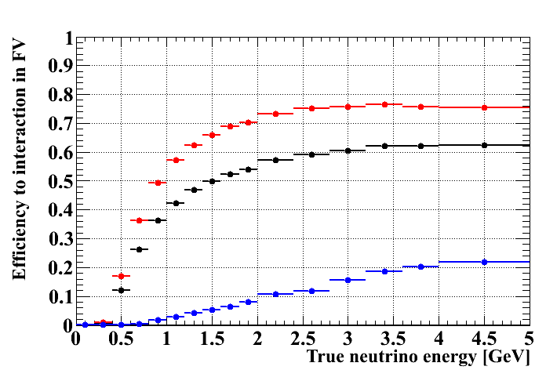
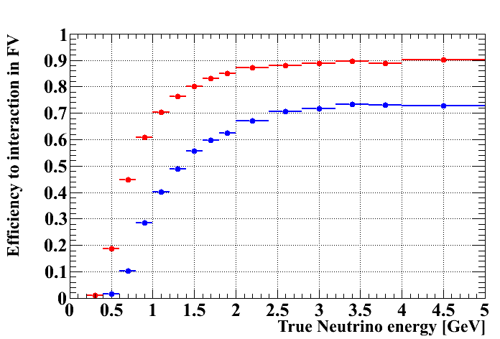
Selection efficiency
CC+NC
CC
NC
CCQE
CC other
9

Slide 10
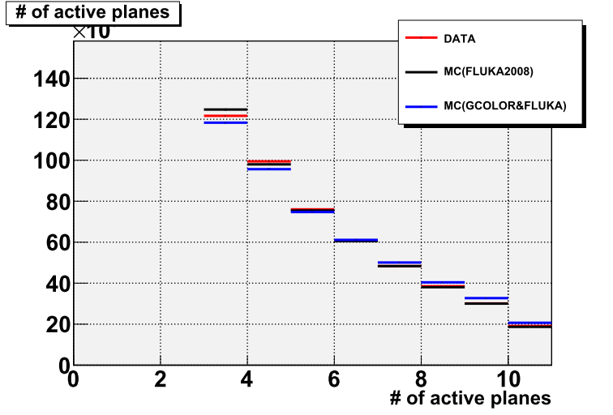
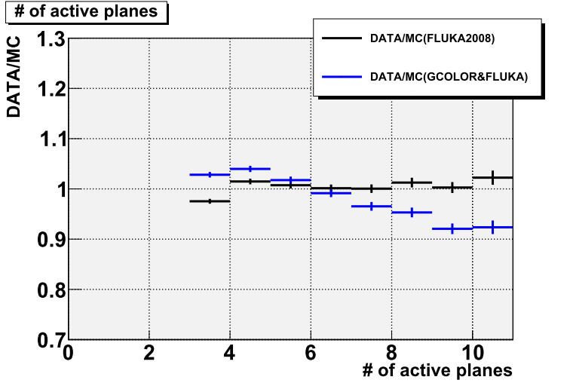
# of active planes
10

Slide 11
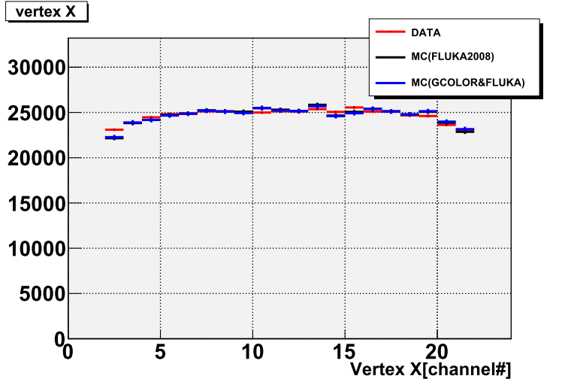
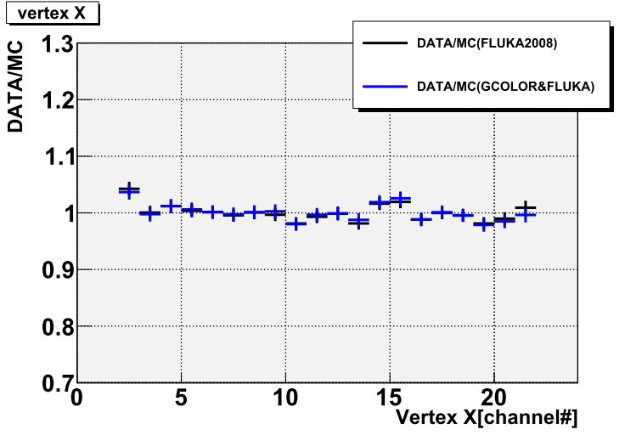
Vertex X
11

Slide 12
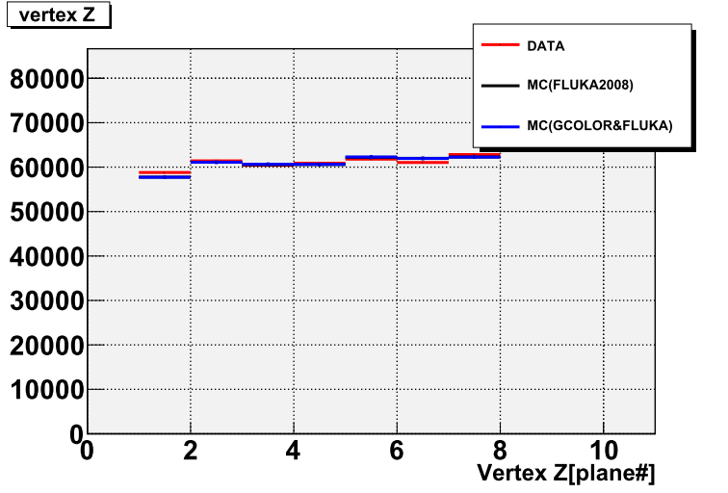
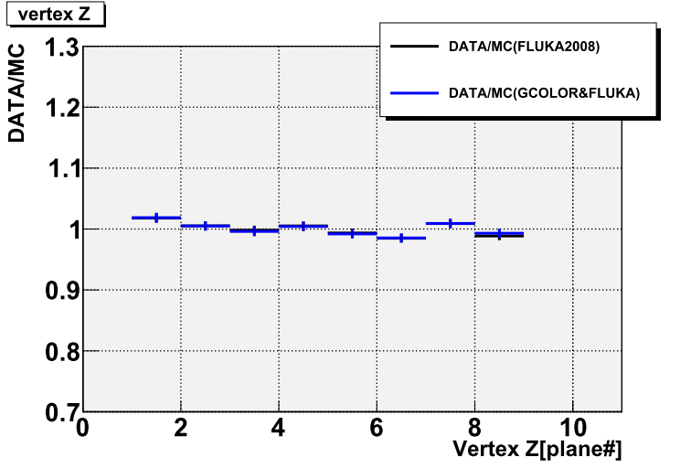
Vertex Z
12

Slide 13
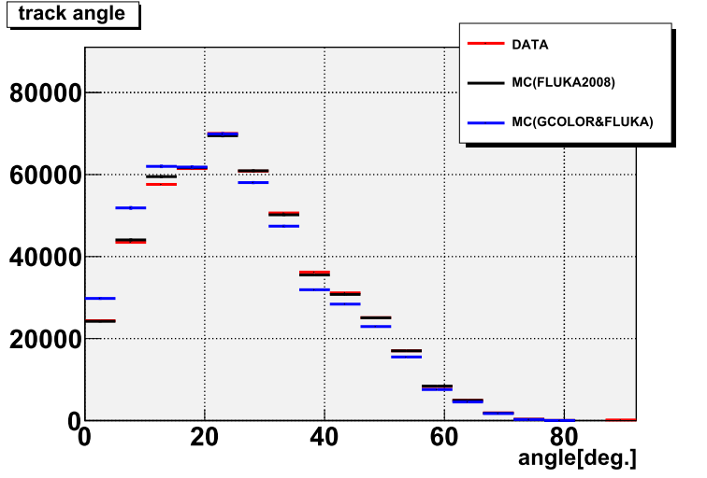
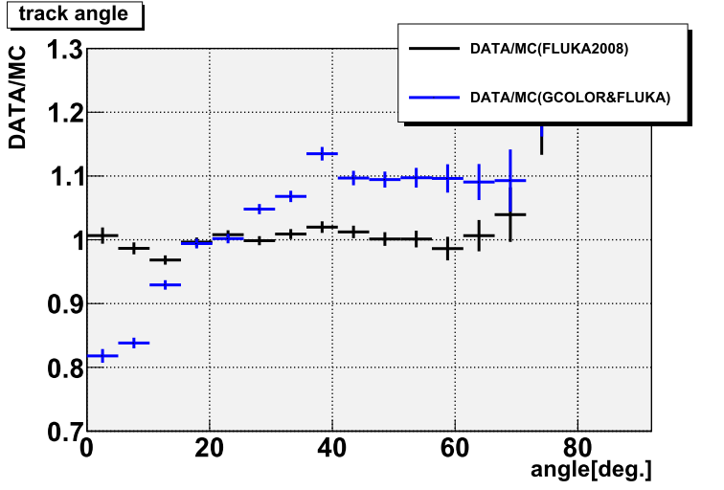
Track angle
13

Slide 14
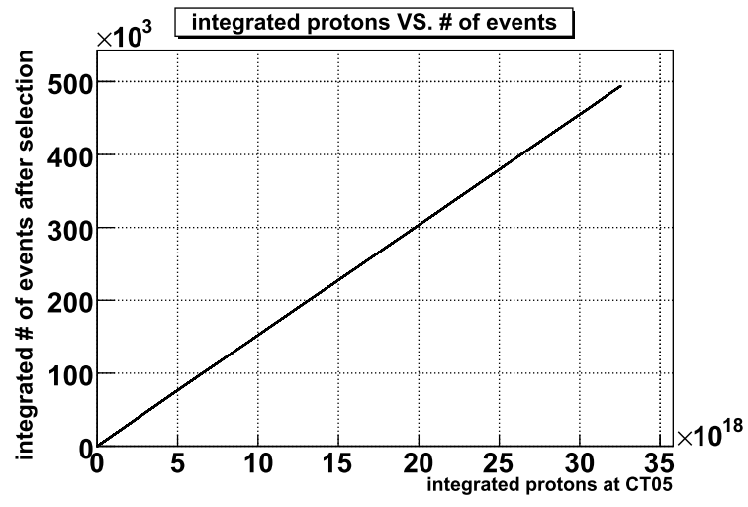
Accumulated protons and N_{obs.}
Delivered protons ~ 3 x 10¹⁹, Total N_{obs.} ~ 5 x 10⁵
14

Slide 15
Event rate stability
Event rate is stable within statistical error
15

Slide 16
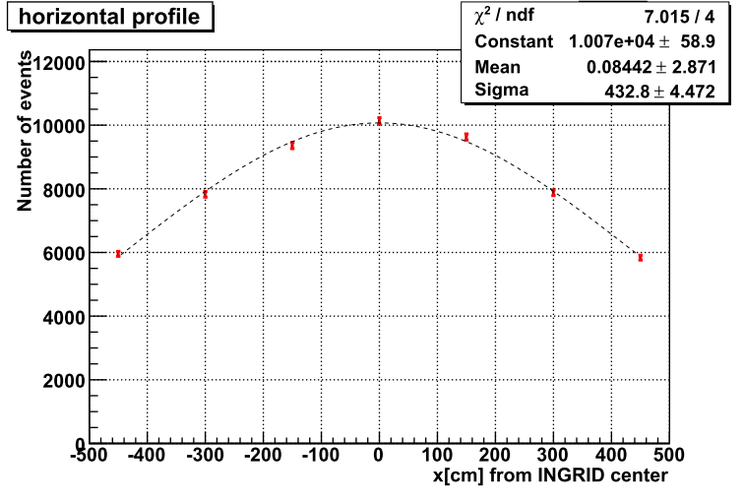
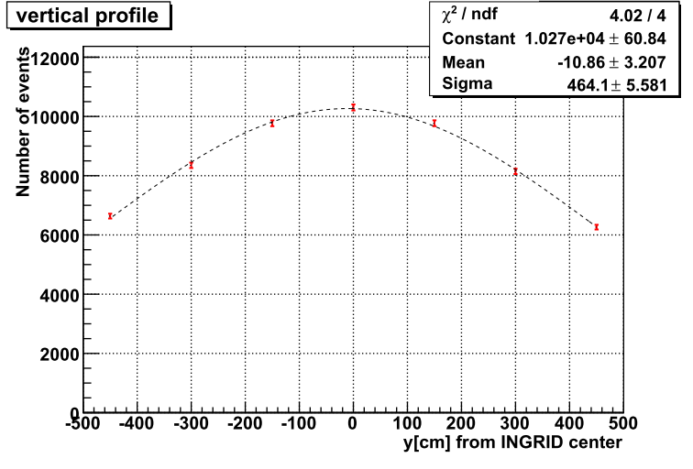
Beam profile
Run32(April) data
Horizontal
Vertical
N_{obs.}
N_{obs.}
※statistical error only
※statistical error only
north
sourth
center: 0.1 +- 2.9 cm σ :433 +- 4 cm
center: -10.9 +- 3.2 cm σ :464 +- 6 cm
Clear beam profile was observed
16

Slide 17
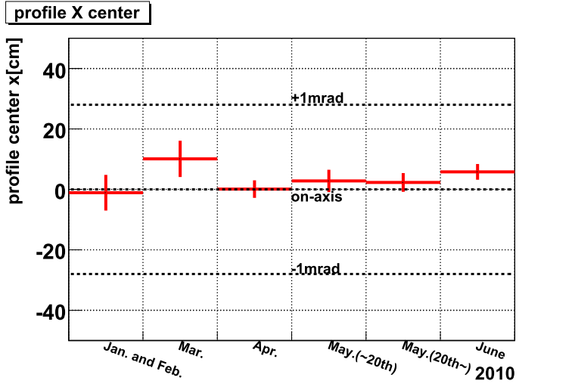
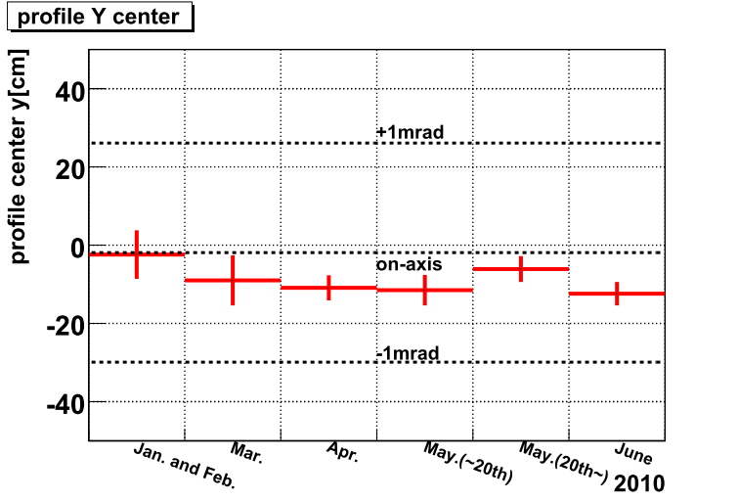
Profile center stability
Horizontal
Vertical
※ Because of mistake with beam line alignment, beam was tuned downward slightly
Now we are estimating systematic error
17

Slide 18
Selection summary of DATA and MC
 | DATA(Run29~34) |  | MC(FLUKA2008) |  | MC(GCOLOR)
 | # of events | ratio | # of events | ratio | # of events | ratio
protons | 3.26E+19 |  | 1.00E+23 |  | 1.00E+23
# of active plane>2 | 1906146 |  | 2.14E+15 |  | 2.70E+09
p.e./active layer>6.5 | 1906078 | 100.0 | 2.14E+15 | 100.0 | 2.70E+09 | 100.0
tracking | 1804796 | 94.7 | 1.99E+15 | 93.0 | 2.51E+09 | 93.0
track matching | 1749548 | 96.9 | 1.92E+15 | 96.5 | 2.41E+09 | 95.9
on time | 1747181 | 99.9
upstream VETO | 745912 | 42.7 | 1.83E+15 | 95.3 | 2.28E+09 | 94.8
fiducial | 493813 | 66.2 | 1.44E+15 | 78.4 | 1.78E+09 | 78.0
Event rate | 1.51E-14(1.) |  | 1.44E-14(0.95) |  | 1.78E-14(1.18)
Comment
MC doesn’t have ν_{e}(~1%), ν_{e}(~0.1%)
DATA contains many beam-induced events from upstream. (Now we are developing BG MC)
18

Slide 19
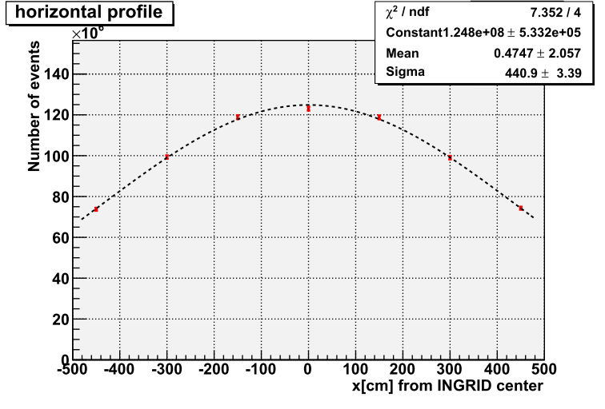
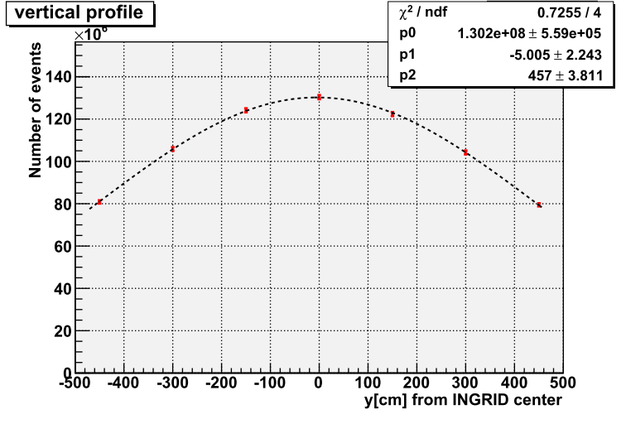
MC profile
Horizontal
Vertical
beam
north
south
center: 0.5 +- 2.1 cm σ :441 +- 3 cm
center: -5.0 +- 2.2 cm σ :457 +- 4 cm
19

Slide 20
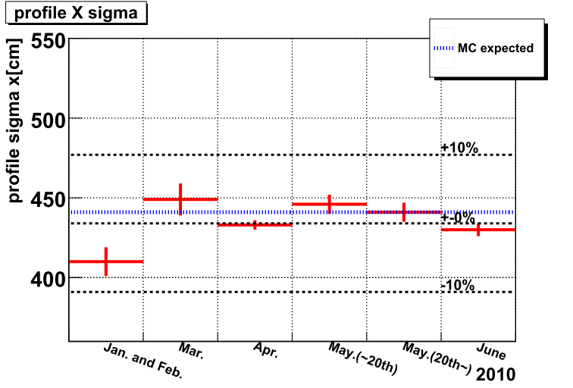
Profile X width comparison
Jan. and Feb. data set is smaller than MC(~30cm).
Other data set is almost consistent with MC within error.
20

Slide 21
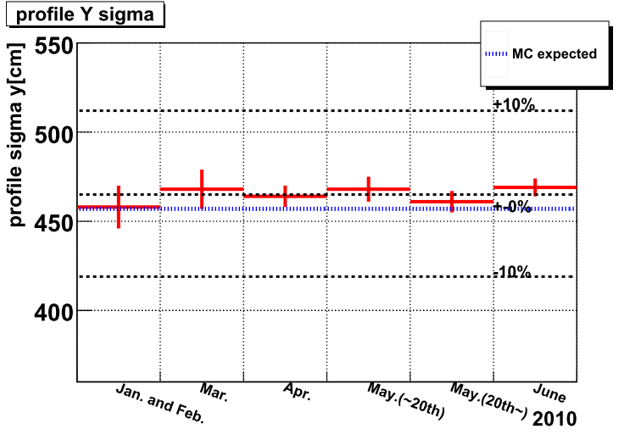
Profile Y width comparison
~10cm
Data is larger than MC(~10cm)
21

Slide 22
Detector syst. error study
Results in this talk were obtained with old flux or detector MC. Result will be updated with current flux and detector MC.
22

Slide 23
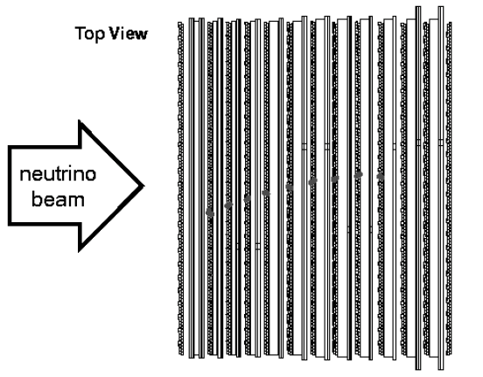
Review: K2K MRD
K2K MRD is one of the near detector of K2K
Sandwich of tracker and iron
tracker
Iron
Almost same as INGRID module
23

Slide 24
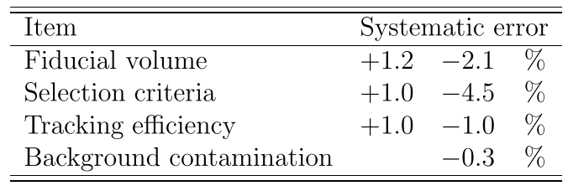
Review: syst. error@K2K MRD
“Selection criteria” breakout
For INGRID case, Fiducial volume and difference of start-point(track matching)
24

Slide 25
Systematic error of fiducial volume
Method
5 additional fiducial volumes are defined and # of events are compared btw DATA(Run29 ~ 34) and MC.
Vertex XY[channel] | Vertex Z[plane#]
2 ~ 21( < 50cm from module center) | 1 ~ 8
3 ~ 20 ( < 45cm ) | 1 ~ 8
4 ~ 19 ( < 40cm ) | 1 ~ 8
2 ~ 21 | 1 ~ 3
2 ~ 21 | 4 ~ 5
2 ~ 21 | 5 ~ 8
nominal
Internal 1
internal 2
upstream
middle
downstream
25

Slide 26
Result
Module #0
Fiducial volume |  | # of events |  | ratio
vertex xy[ch] | vertex z[plane] | DATA | MC | DATA | MC | difference
2 ~ 21 | 1 ~ 8 | 25091 | 93802 | 100 | 100 | 0
3 ~ 20 | 1 ~ 8 | 20488 | 76824 | 81.65 | 81.90 | -0.25
4 ~ 19 | 1 ~ 8 | 16451 | 61005 | 65.57 | 65.04 | 0.53
2 ~ 21 | 1 ~ 3 | 8861 | 33536 | 35.32 | 35.75 | -0.44
2 ~ 21 | 4 ~ 5 | 5698 | 21283 | 22.71 | 22.69 | 0.02
2 ~ 21 | 6 ~ 8 | 9416 | 34860 | 37.53 | 37.16 | 0.36
Syst. error |  |  |  |  |  | 0.8
All module case is here
26

Slide 27
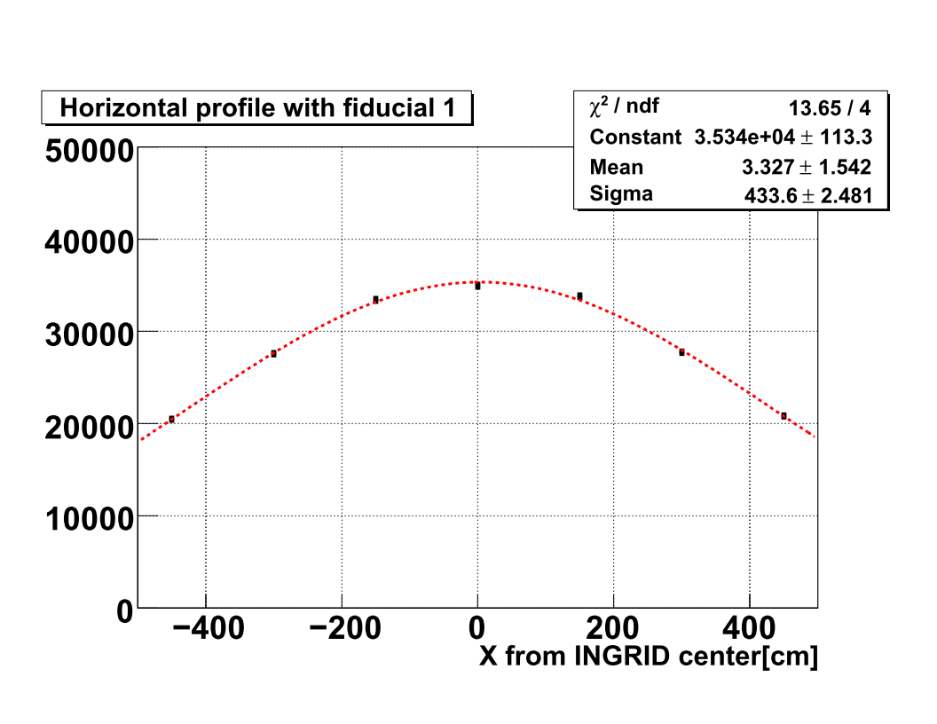
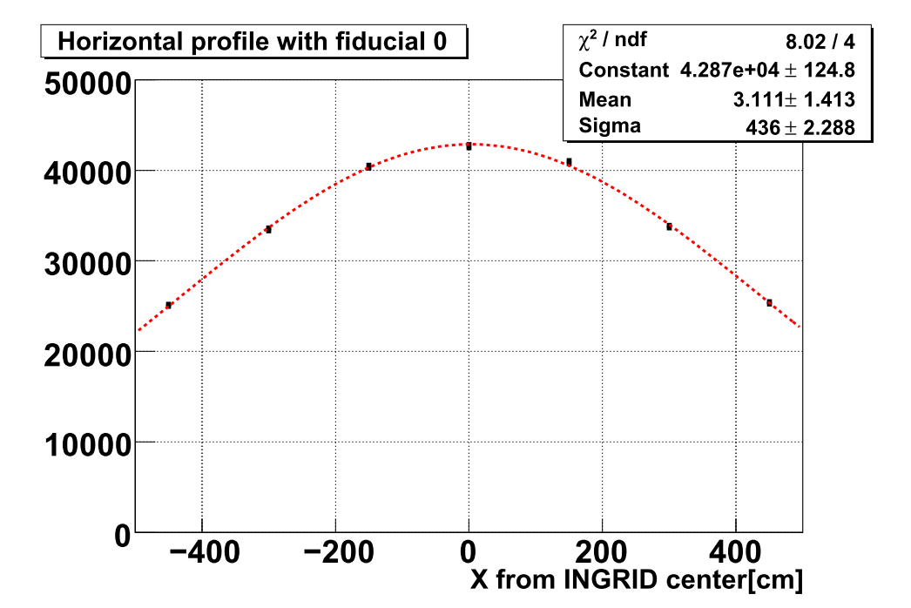
Syst. error of beam center
Compare beam profile(center) with 6 fiducial volumes.
nominal
internal
Center = 3.1 +- 1.4 cm
Width = 436 +- 2.3 cm
Center = 3.3 +- 1.5 cm
Width = 434 +- 2.5 cm
You can see all cases here
27

Slide 28
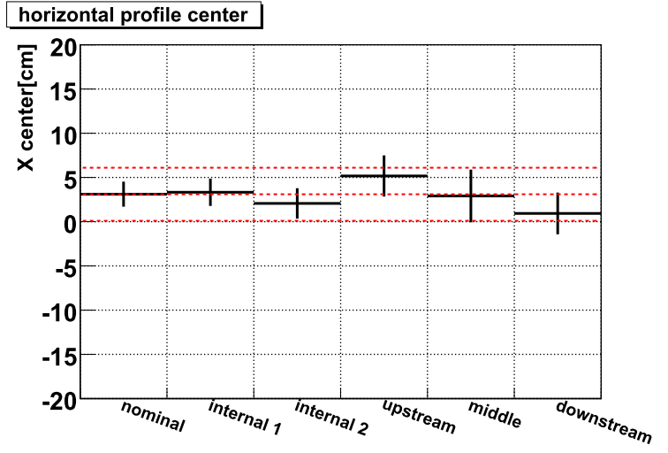
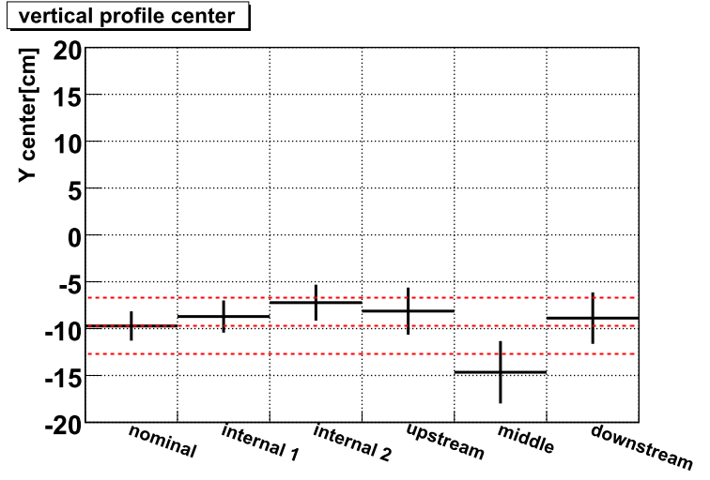
Result
Red hatched line : nominal +- 3cm
Almost consistent within error(~3cm)
28

Slide 29
Systematic error of track matching selection
Method
All the selections except track matching are applied.
And then, track matching selection is applied and # of events is compared btw DATA and MC.
29

Slide 30
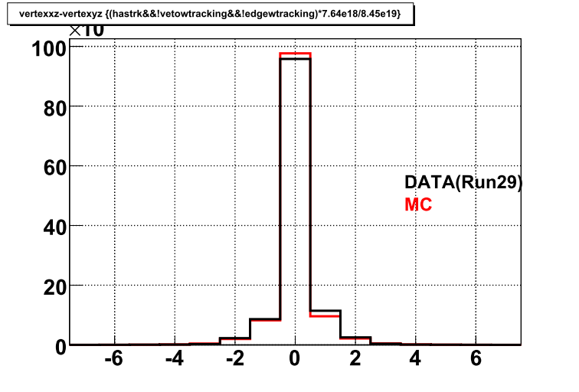
Δ(vertex Z) after event selection
Nominal selection(-1, 0, +1)
Run32
30

Slide 31
Estimation of error
 | DATA |  | MC
Δ(diff. Z) | # of events | ratio | # of events | ratio | diff.
-1, 0, +1 | 493812 | 100 | 1267830 | 100 | 0
-2, -1, 0 | 454491 | 92.0 | 1183797 | 93.4 | -1.3
0, +1, +2 | 468334 | 94.8 | 1200552 | 94.7 | 0.1
+0.1% -1.3%
Sys. error =
31

Slide 32
x-section and flux syst. error study
32

Slide 33
Uncertainty of x-section study
Study of the effect from neutrino interaction uncertainties.
Check the difference of # of neutrino observations of INGRID when change # of interactions in module of each interaction.
ex) # of CCQE interactions × 1.1 → # of observations ?
For check the effect from neutrino interaction uncertainties, not consider the uncertainties of the efficiency of neutrino event selection of INGRID.
This study is about horizontal modules.About vertical modules, we will study in future.

Slide 34
Result of this study
MC:jnubeam 10ab(250kA), NEUT, INGRID MC (old version at last collabo. meeting)
including numu, numubar, nue, nuebar MC data.
Ex) If CCQE+10% → # of CCQE of numu, numubar, nue, nuebar is increased by 10%.
 | # of observations [/10^14pot] | diff. from original value
CCQE + 10% | 0.813 | +3.7%
CC1Pi + 20% | 0.829 | +5.7%
CC other + 20% | 0.829 | +5.7%
NC + 30% | 0.798 | +1.8%
only about horizontal modules
Original of observations is 0.784 / 10^14 pot

Slide 35
Effect of hadron production model difference
Check the effect of hadron production model difference.
Hadron production :
GCALOR/GFLUKA (Jnubeam10b)
FLUKA
Beam condition : nominal beam
Neutrino cross-section : NEUT model
cross-section of all interaction mode.
Neutrino selection efficiency : INGRID MC
Only numu, only horizontal modules.
Consider only stat. error.

Slide 36
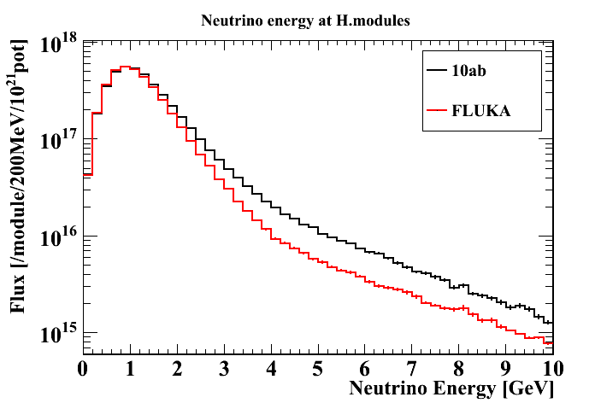
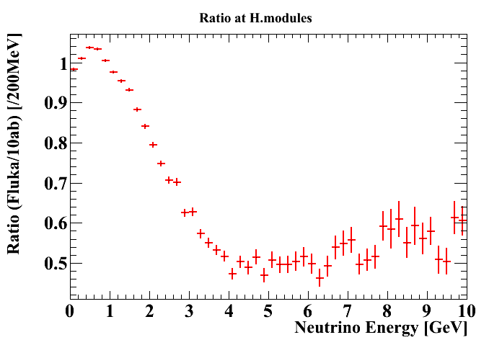
Neutrino energy spectrum (Flux)
mod# | 0 | 1 | 2 | 3 | 4 | 5 | 6 | h.mods
Jnubeam10ab | 5.23E+17 | 6.19E+17 | 6.87E+17 | 7.12E+17 | 6.85E+17 | 6.16E+17 | 5.21E+17 | 4.36E+18
FLUKA | 4.82E+17 | 5.61E+17 | 6.18E+17 | 6.39E+17 | 6.19E+17 | 5.62E+17 | 4.82E+17 | 3.96E+18
Diff. [%] | -7.83 | -9.40 | -10.08 | -10.28 | -9.67 | -8.85 | -7.37 | -9.18
Diff. = (FLUKA-10ab)/10ab×100

Slide 37
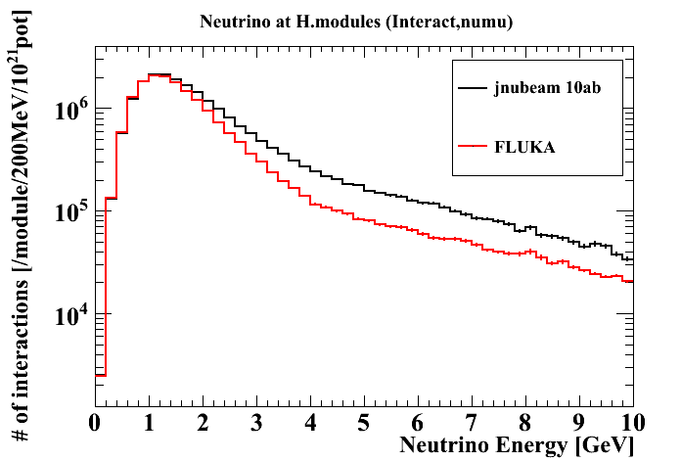
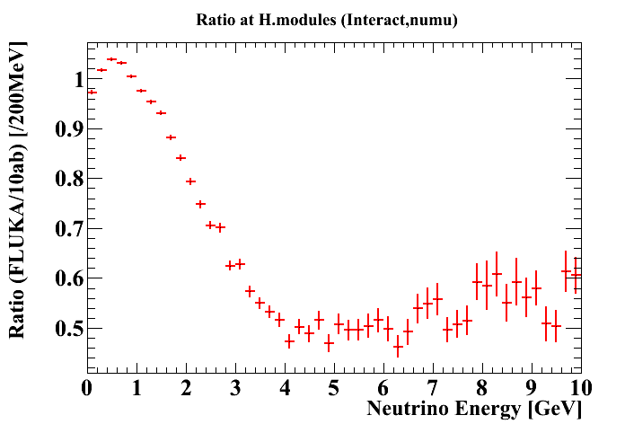
Neutrino energy spectrum (Interaction (×cross-section) )
mod# | 0 | 1 | 2 | 3 | 4 | 5 | 6 | h.mods
Jnubeam10ab | 2.39E+06 | 3.14E+06 | 3.66E+06 | 3.84E+06 | 3.66E+06 | 3.13E+06 | 2.38E+06 | 2.22E+07
FLUKA | 1.98E+06 | 2.55E+06 | 2.95E+06 | 3.11E+06 | 2.96E+06 | 2.55E+06 | 1.99E+06 | 1.81E+07
Diff. [%] | -16.92 | -18.80 | -19.28 | -18.90 | -19.07 | -18.60 | -16.47 | -18.46

Slide 38
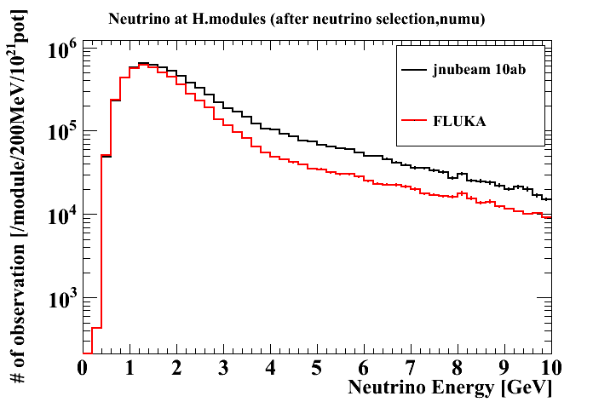
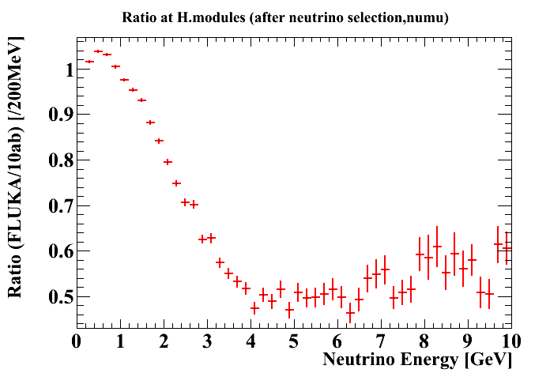
Neutrino energy spectrum (observation (× INGRID efficiency) )
mod# | 0 | 1 | 2 | 3 | 4 | 5 | 6 | h.mods
Jnubeam10ab | 7.57E+05 | 1.04E+06 | 1.24E+06 | 1.31E+06 | 1.24E+06 | 1.04E+06 | 7.56E+05 | 7.38E+06
FLUKA | 5.96E+05 | 8.05E+05 | 9.56E+05 | 1.02E+06 | 9.58E+05 | 8.05E+05 | 5.99E+05 | 5.73E+06
Diff. [%] | -21.26 | -22.74 | -22.93 | -22.26 | -22.76 | -22.67 | -20.80 | -22.33

Slide 39
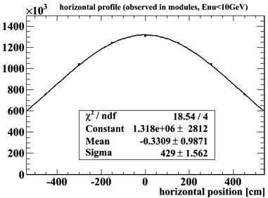
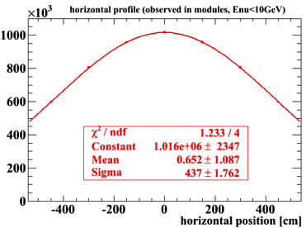
Beam Profile (observation)
Jnubeam 10ab
FLUKA
 | Beam size (sigma) | Ratio
Jnubeam 10ab | 429±2 cm | 1
FLUKA | 437±2 cm | 1.05
Data | 433±4 cm | 1.01

