Slide 1
Observation Gamma rays from neutral current quasi-elastic in the T2K experiment
Huang Kunxian for half of T2K collaboration
Mar. 24, 2014@Okayama Univ.

Slide 2
Contents
Physics
Motivation
Data set and MC production
event reduction
event candidates
NCQE cross-section calculation
systematic uncertainties
results

Slide 3
Gamma Ray after NCQE interaction
ν
ν
Primary Gamma
γ
(~ 6MeV)
Z⁰
Observe Cherenkov light
p or n
γ
Secondary Gamma
Notes:
The nucleon that are knocked out from NCQE interaction may excite other oxygen nuclei.
We can observe Cherenkov light from these gammas.

Slide 4
Measurements of the NCQE cross-section
There have been no measurement of NCQE (neutral current quasi-elastic) scattering at hundreds of MeV with de-excitation photons.
Previous work extrapolated NC coherent up to higher E.
Photons produced by atmospheric neutrinos are a background in supernova relic neutrino searches.
NCQE is the largest NC samples in T2K-SK data.
It can be used to search for sterile neutrino oscillations.
Can use a similar low-energy sample to look for low-mass dark matter.

Slide 5
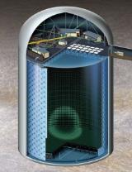
T2K long-baseline experiment
Gifu, Kamioka
Ibaraki, Tokai village
target and horn
MUMON
l
ν_{l}
~40m
J-PARC
Super-K
T2K main physics goals
Discovery of ν_{μ →} ν_{e} appearance: measurement θ₁₃ and CP phase angle δ in the future
ν_{μ →} ν_{μ} disappearance: precise measurement of θ₂₃ and Δm₂₃
Notes:
加速器から

Slide 6
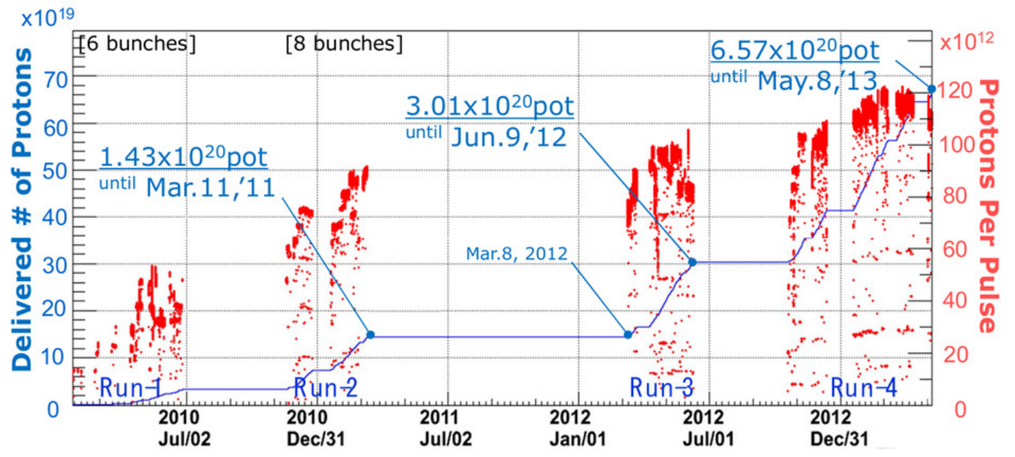
Data Collected and analyzed
Run1~3 data result are analyzed and reported here.
We collected 6.57x10²⁰ proton on target (p.o.t.) of data so far.
Data for this analysis is 3.01x10²⁰ p.o.t.

Slide 7
T2K ν Flux at SuperK
w/o oscillation
Flux peak is at 630MeV, and the tail extend to several GeV.
NCQE cross-sections are large at T2K ν energy region.

Slide 8
NCGamma Event Simulation
NEUT:
neutrino interaction
Geant3:
Detector construction, etc.
Flux data
reweight, reduction cut
Neutrino flux-- simulated with FLUKA & Geant3, constrained by monitoring and external experiments.
NEUT--Use Ankowski model for NCQE scattering and photon production.
Detector simulation—Geant3, GCALOR to simulate cherenkov photons and neutrons which produce secondary gamma.

Slide 9
Signal/Background
Signal: Observe the cherenkov photons after NCQE interaction, in the reconstructed energy range is 4~30MeV.
Main Background:
beam-unrelated: Radioactive impurities from SuperK wall and PMTs
beam-related: NCnon-QE, CC
We will discuss data reduction in following pages.

Slide 10
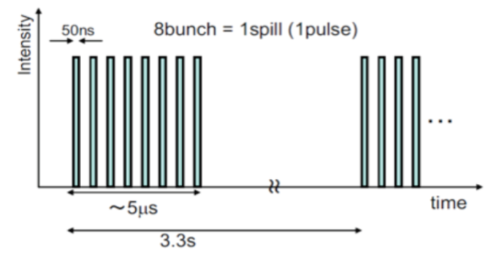
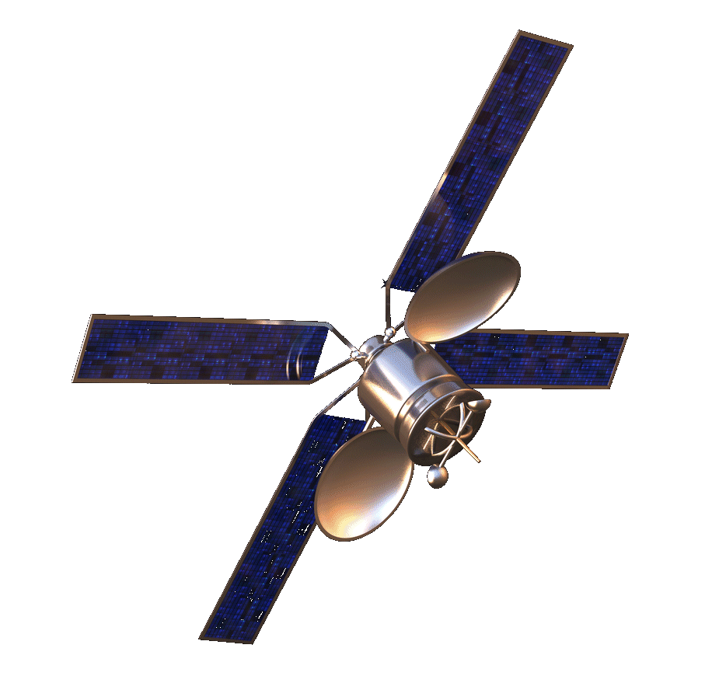
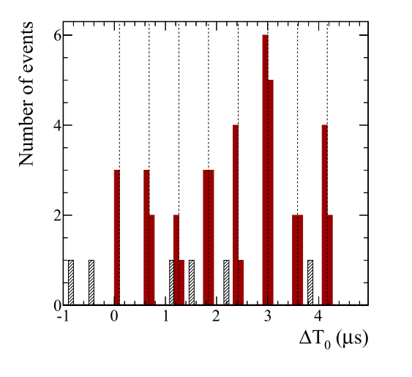
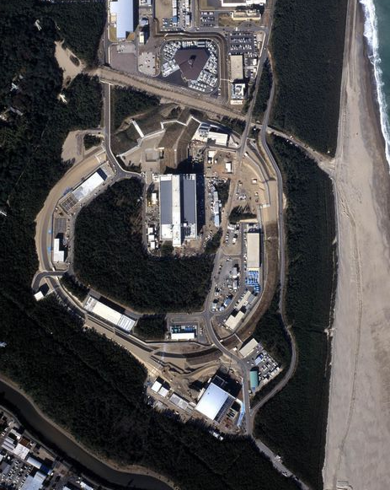
GPS signal and ν beam spill structure
GPS signal synchronize timing record of JPARC and SuperK.
To reduce beam unrelated events, we choose events near bunches structures within ±100ns.
timing distribution of events
proton bunch structure
on timing
GPS receiver
GPS receiver
off timing
297km
SuperK
JPARC
Notes:
The timing of T2K bunch structures at SuperK are decided by fully contained events (CCQE, etc).

Slide 11
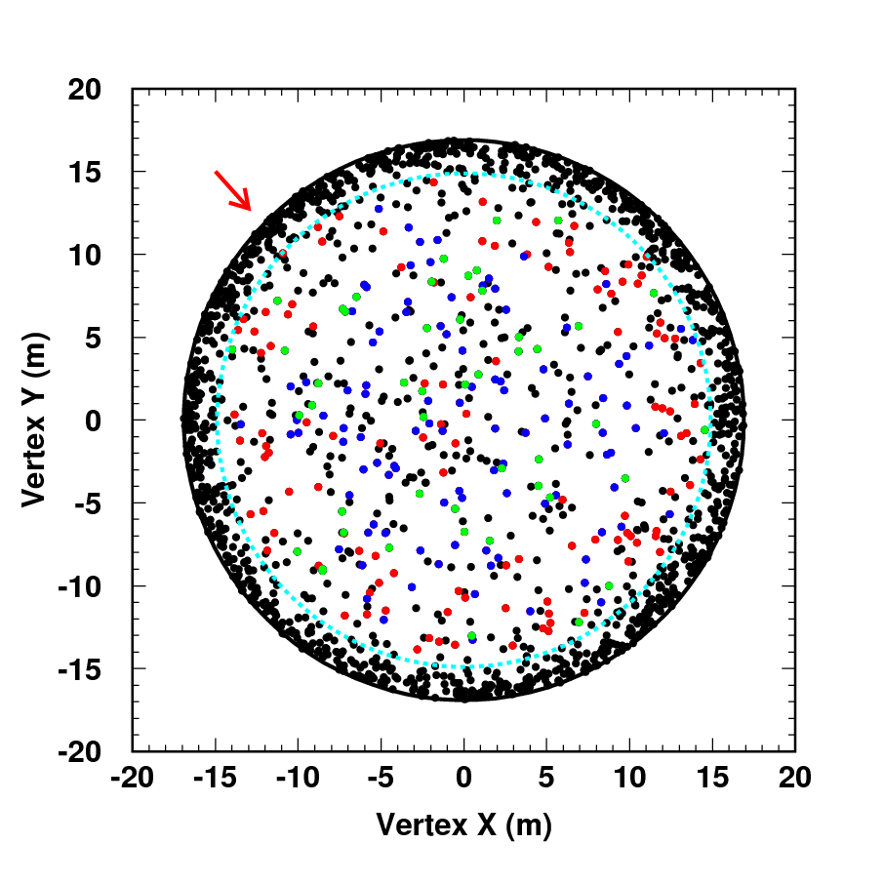
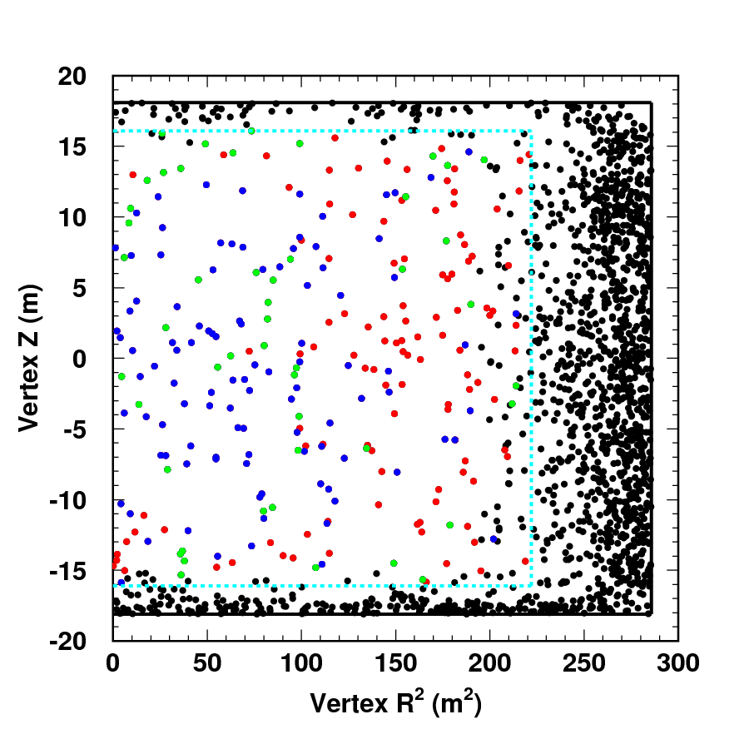
vertex distribution
Y vs. X
Z vs. R²
ν beam
Fidual Volume
Vertex distribution before (after) the following cuts Black : Before FV cut Red : After dwall cut
Blue : After effwall cut Green : After Q_{rec} cut

Slide 12
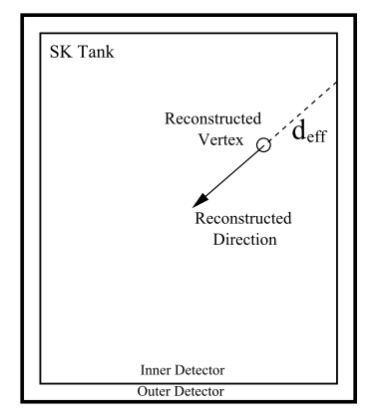
Cut for Gamma ray from Radioactive impurities
SuperK ID wall and PMT contain radioactive impurities
Vertex distance from inner detector wall
fiducial volume (FV): 2m inside
dwall: for lower energy events (Erec<4.75MeV), more strict cut than 2m
effwall(d_{eff}): along backward direction, and it is also energy dependent.
FV
2m
Reconstructed
Vertex
dwall

Slide 13
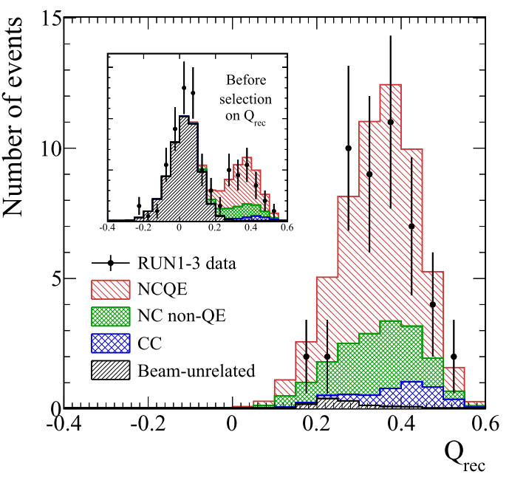
Fit Quality cut
Fit quality cut:
Some beam-unrelated events (radioactive impurities) have reconstruction errors and their reconstructed vertex locate at the center of tank.→ Pass the vertex cut
These error can be identified on hit timing and pattern distribution.
Quality cut criterium $Q_{rec}={g^{2}}_{t}−{g^{2}}_{p}$
$${g^{2}}_{t}:goodness of hit times$$
$${g^{2}}_{p}:goodness of hit pattern$$

Slide 14
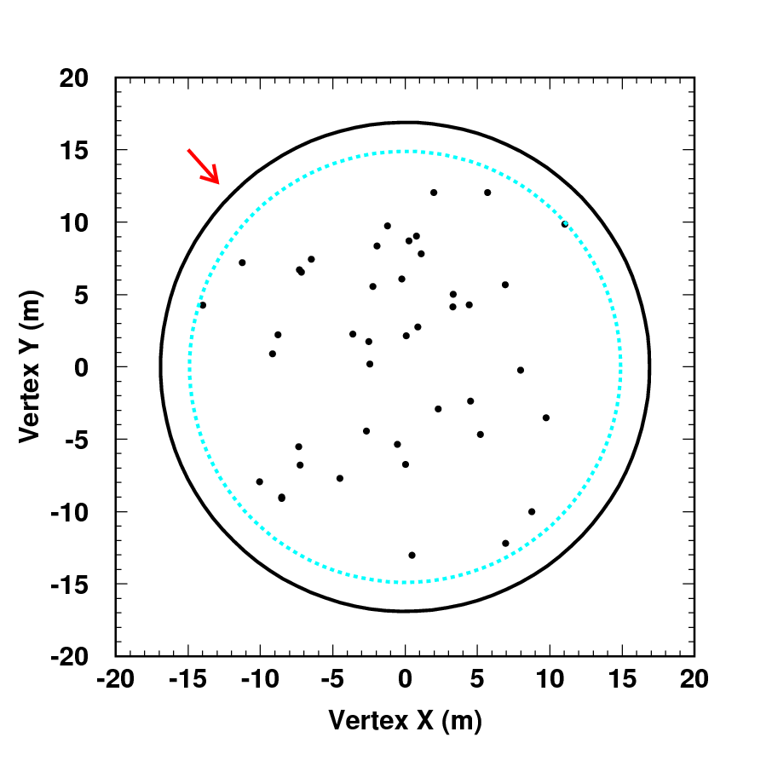
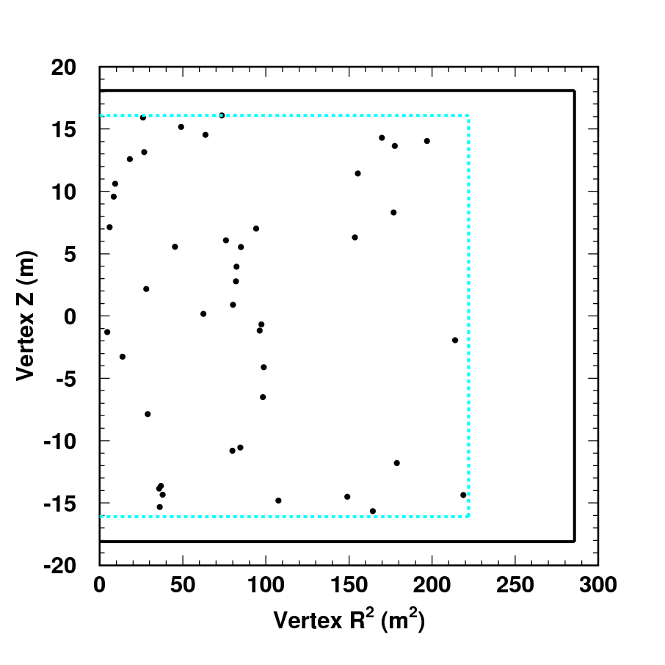
vertex distribution
Y vs. X
Z vs. R²
ν beam
Fidual Volume
Vertex distribution after all data reduction

Slide 15
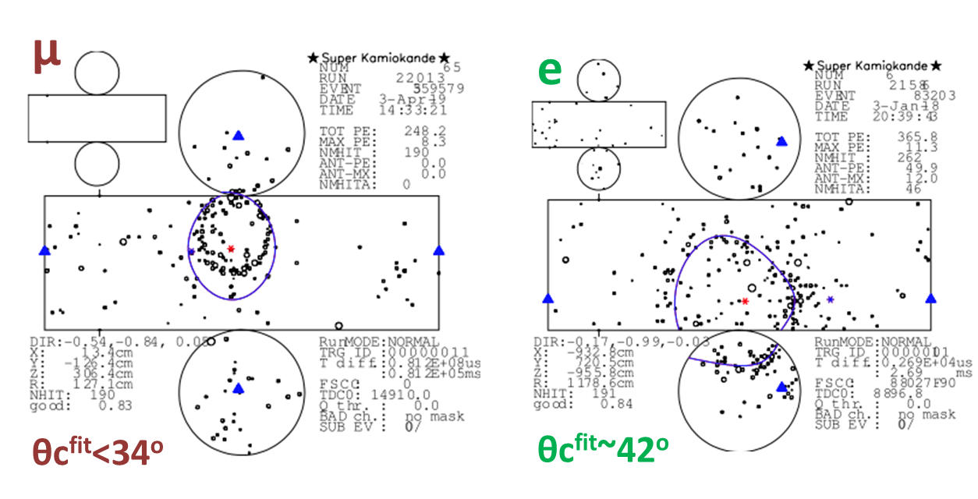
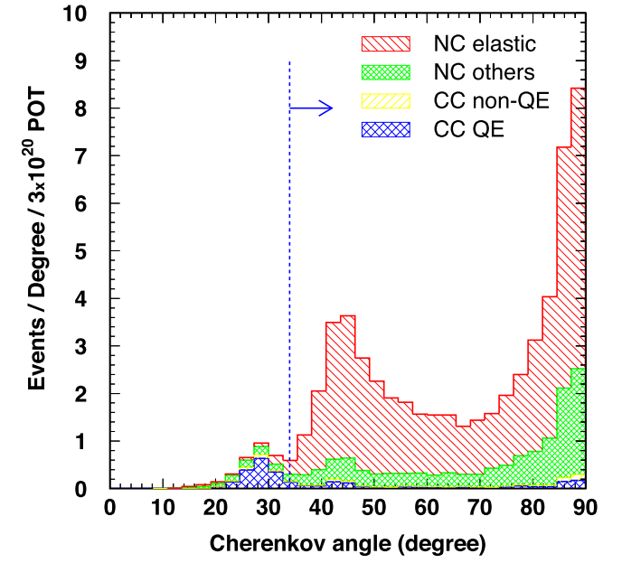
Data Reductions
Cherenkov opening angles:
For our low energy regions, Cherenkov angles of muons are less than 34º. And angles of electrons produced from de-excitation γ are 42º in average. →Select event with angle >34º
Pre-active cut:
decay e signal from CC interaction muons are also one kind background of our observation. Reject events those have 22hits in a 30ns window before trigger time(0~-20us).
MC of T2K Run1~3

Slide 16
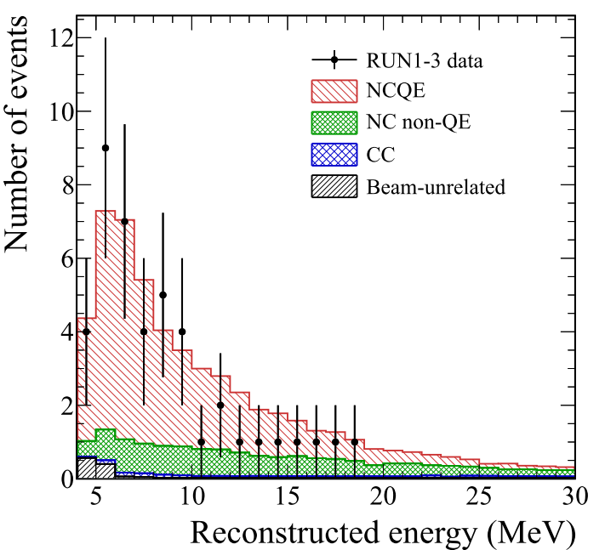
Observed Events
After all the cuts, 43 event candidates are found in reconstruction energy region of 4~30MeV.
And simulation predict 56.61 events
NCQE | 39.1 | 69.1%
NC others | 14.1 | 24.9
CC | 2.2 | 3.9
Beam unrelated | 1.2 | 2.1
Total | 56.61

Slide 17
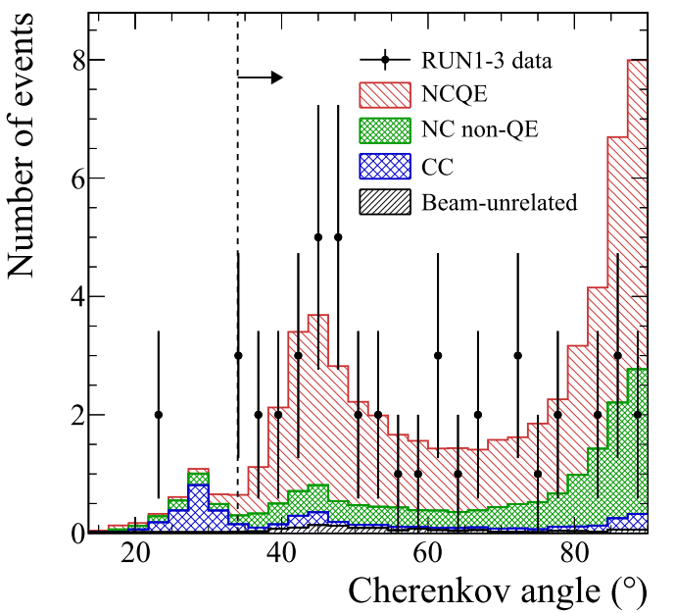
Observed Events
At large Cherenkov angle, there are discrepancy between data and MC simulation.
We are working on the analysis of this discrepancy now.
Notes:
Emphasize that we do not try to separate primary and secondary gammas yet-just take inclusive sample

Slide 18
NCQE Cross-section
observed data event # in Run1~3
NCQE cross-section as below
$$<σ_{ν,NCQE}^{obs}>= \frac{N^{obs}−N_{bkg}^{exp}}{N^{exp}−N_{bkg}^{exp}}<σ_{ν,NCQE}^{theory}>$$
Systematic and statistical uncertainties:
Evaluated the uncertainty using a Monte Carlo method that includes the correlations between signal and background systematic uncertainties.

Slide 19
Systematic Uncertainties
Fraction of sample | Signal NCQE 69% | NC-nonQE 25% | CC 4% | Beam unrel. 2%
Flux | 11% | 10% | 12% | -
Cross-section | -- | 18% | 24% | -
Primary γ Production | 10% | 3% | 6% | -
Secondary γ Production | 13% | 13% | 7.6% | -
Detector response | 2.2% | 2.2% | 2.2% | -
Oscillation Parameters | - | - | 10% | -
Total | 20% | 25% | 30% | 0.8%

Slide 20
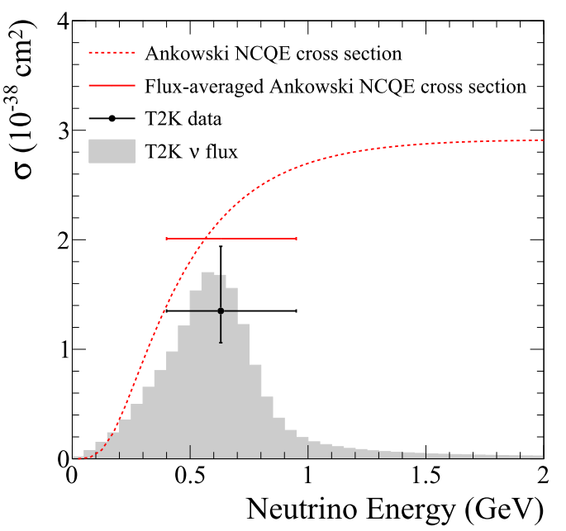
NCQE cross-section
measurement of σ_{NCQE}(T2KRun1~3)
$$<{σ^{obs}}_{ν,NCQE}> =1.35×{10}^{−38}{cm}^{2} \\ 68\%C.L.(1.06, 1.94)×{10}^{−38}{cm}^{2}$$
~1$σ$

Slide 21
Conclusion
T2K have already reached 6.57x10²⁰ proton on target (p.o.t.) now, and we analyzed data about half accumulated p.o.t. for searching gamma rays after NC interaction.
After reduction, 43 events are selected as γ ray candidates, which is lower than MC simulation prediction. (56.61)
There are discrepancy between MC and data in Cherenkov angle distribution
Analysis is now working in progress
Observed NCQE cross-section: $<{σ^{obs}}_{ν,NCQE}> =1.35×{10}^{−38}{cm}^{2}68\%C.L.(1.06, 1.94)×{10}^{−38}{cm}^{2}$

