Slide 1
INGRID status
T. Kikawa

Slide 2
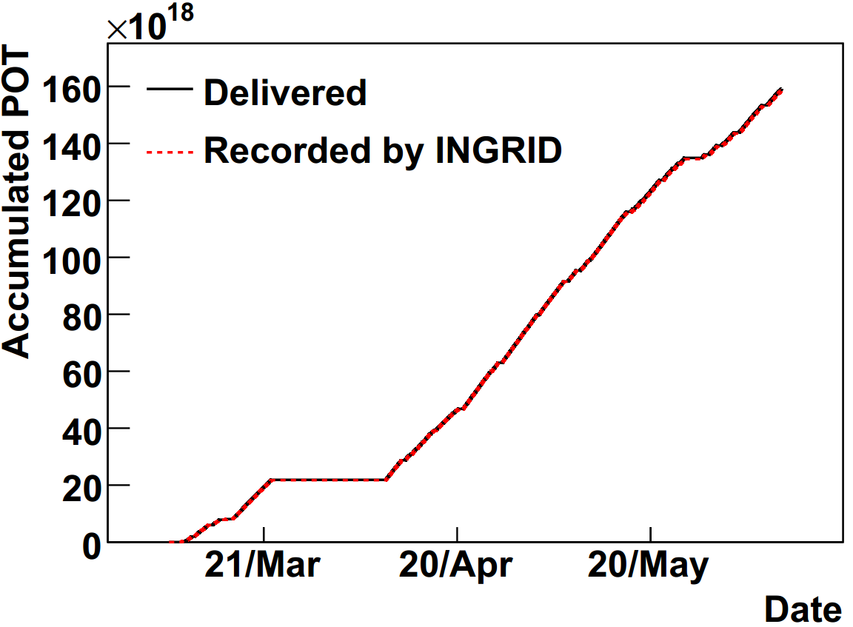
DAQ status
Quick beam summary data without good spill selection is used.
Data taking efficiency is 99.59%.
Period | Feb.27~Jun.9
Delivered spills | 1760253
Recorded spills | 1767466
Delivered POT | 1.5918×10²⁰
Recorded POT | 1.5866×10²⁰
Data taking efficiency | 99.59%

Slide 3
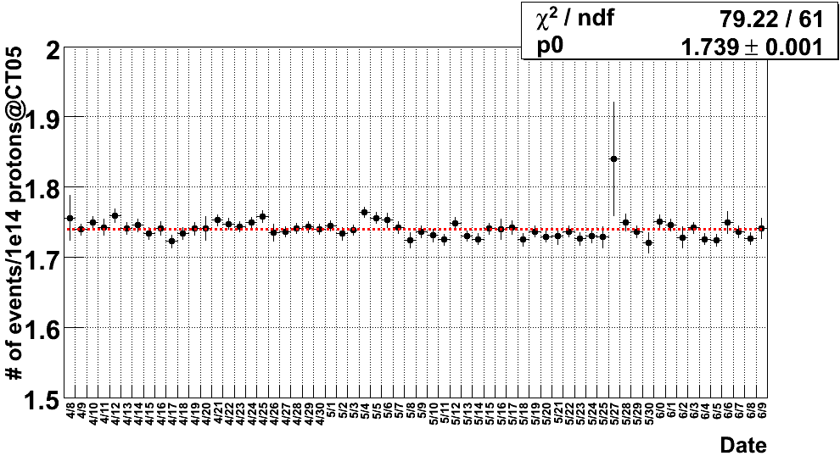
Neutrino event rate
Neutrino event rate is stable.

Slide 4
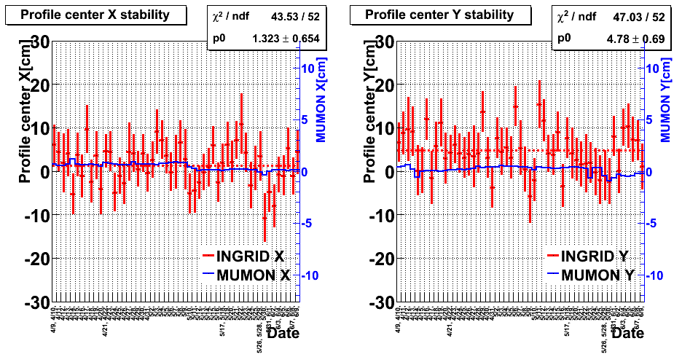
Beam center stability
Beam center is stable within ±1mrad (~28cm).

Slide 5
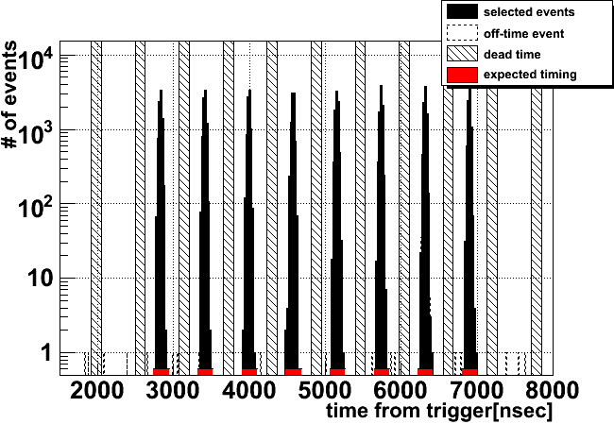
Event timing
Events are observed in the expected timing.

Slide 6
Summary
DAQ is stable.
Neutrino event rate is stable.
Beam center is stable within ±1mrad.
Events are observed in the expected timing.
Expert shift:
  June 7-10 : S. Takahashi
  June 11-13 : A. Murakami

