Slide 1
High pressure xenon gas detector with segmented electroluminescence readout for 0νββ search
Kiseki Nakamura | Kobe university
for the AXEL collaboration

Slide 2
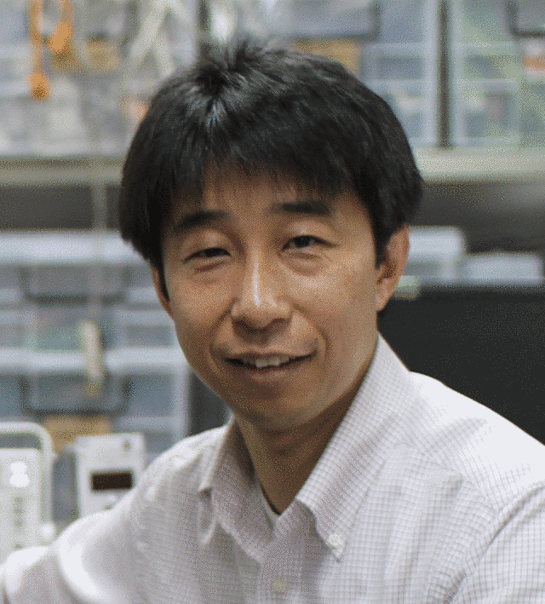
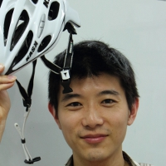
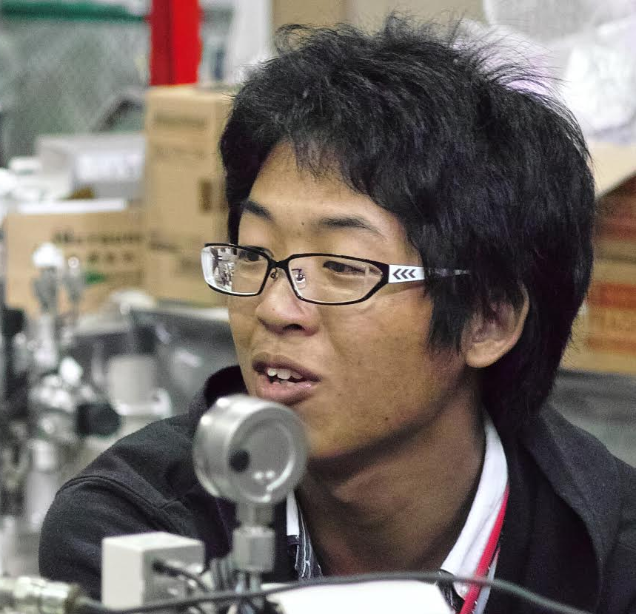
AXEL member in Kyoto
(speaker)
Atsuko K. Ichikawa
Tsuyoshi Nakaya
Kiseki Nakamura
Sei Ban
Shunsuke Tanaka
Kazuhiro Nakamura
Masashi Yoshida

Slide 3
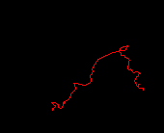
AXEL experiment
High pressure xenon gas TPC for 0νββ search
Energy resolution: gaseous xenon + electroluminescence (EL) readout
target: 0.5%FWHM
Background rejection: tracking by segmented EL readout
Large mass: high pressure
~ ton scale
¹³⁶Xe 10atm
EL
scintillation
photon
e⁻
ELCC
PMT
~4m
SiPM
0V
~-15kV
~-200kV
field cage

Slide 4
AXEL experiment
High pressure xenon gas TPC for 0νββ search
Energy resolution: gaseous xenon + electroluminescence (EL) readout
target: 0.5%FWHM
Background rejection: tracking by segmented EL readout
Large mass: high pressure
~ ton scale
¹³⁶Xe 10atm
EL
scintillation
photon
Similar concept as NEXT experiment
We introduce a new idea "ELCC" for signal readout
Need proof-of-principle by simulation and prototype detectors
e⁻
ELCC
PMT
~4m
SiPM
0V
~-15kV
~-200kV
field cage

Slide 5
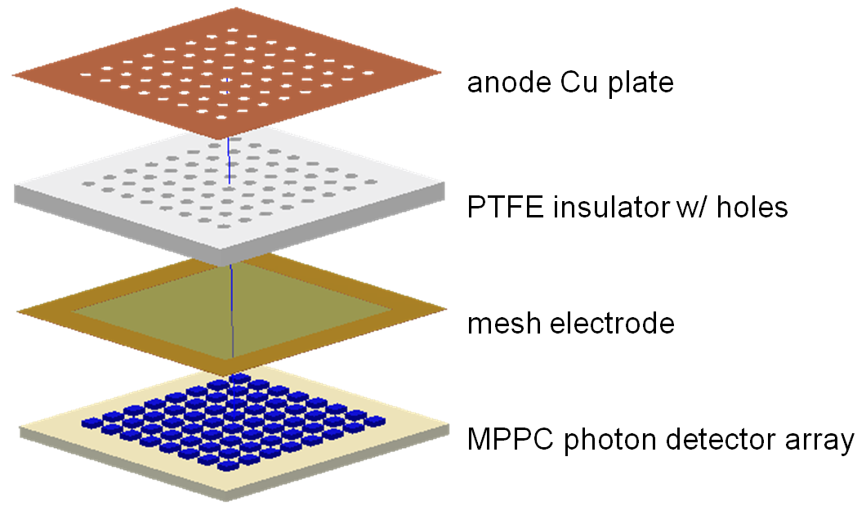
Segmented EL readout: ELCC
Detect EL photons for cell by cell
Energy measurement and tracking
Good uniformity in wide area
Rigid structure --> large size
EL
SiPM

Slide 6
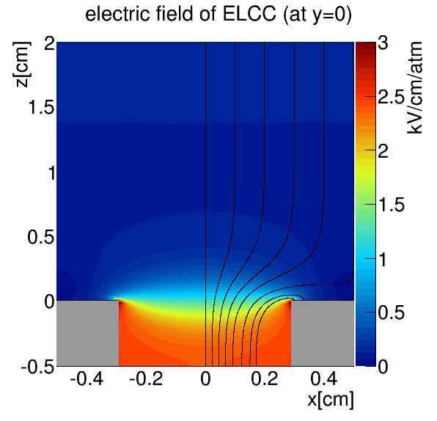
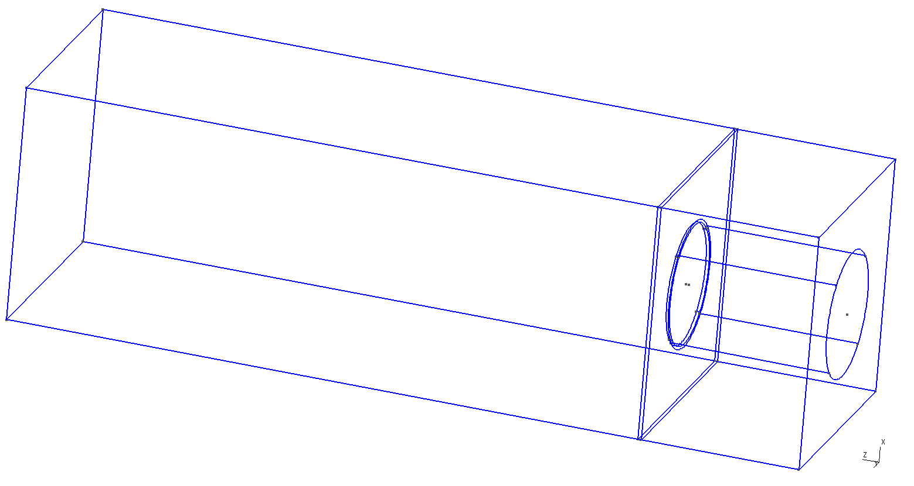
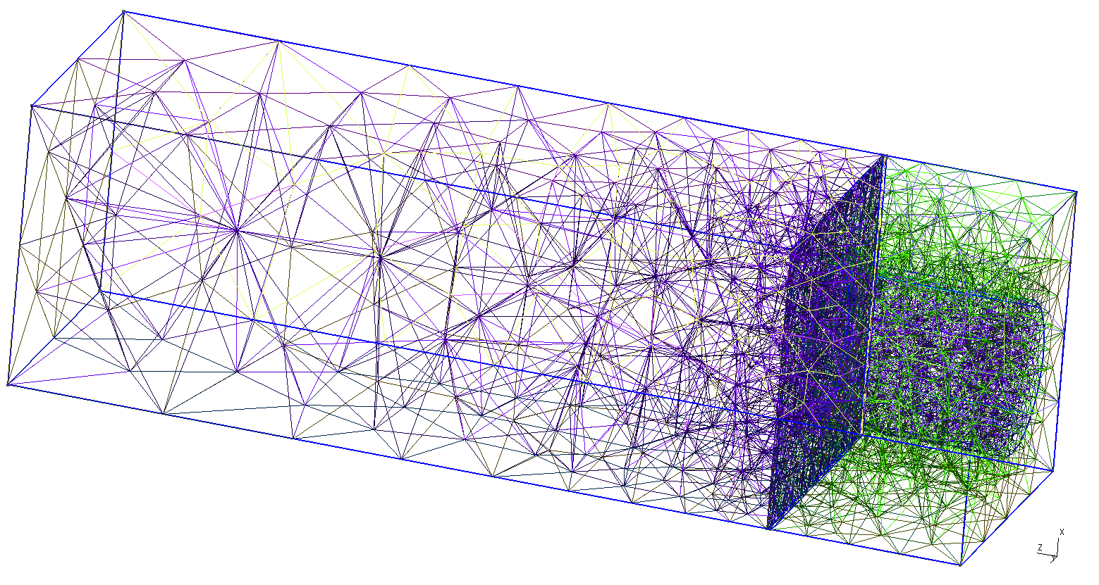
ELCC simulation
Electric field simulation (gmsh + elmer)
By applying high electric field in the EL region, electric field lines are pulled into the cell hole
1.0cm
1.0cm
E_{drift}=100V/cm/atm
gmsh
elmer
2cm
0.6cm
E_{anode}=3kV/cm/atm
0.5cm
0.58cm

Slide 7
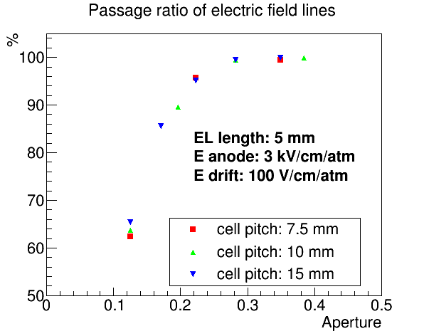
Collection of line of electric field
Larger aperture is better
Taking some E_{drift}, large E_{EL} is better (E_{drift}=100V/cm/atm, E_{EL}>2.5kV/cm/atm)
cell pitch
E_{drift}
hole radius
EL length
E_{EL}
square

Slide 8
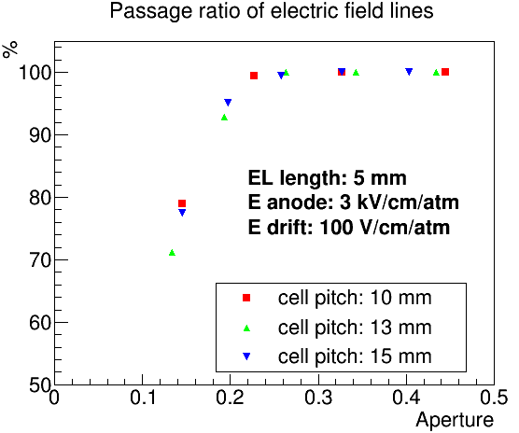
Collection of line of electric field
Hexagonal placement is better
Next prototype will be OK
cell pitch
E_{drift}
hole radius
EL length
E_{EL}
current prototype
next prototype
square
hexagonal

Slide 9
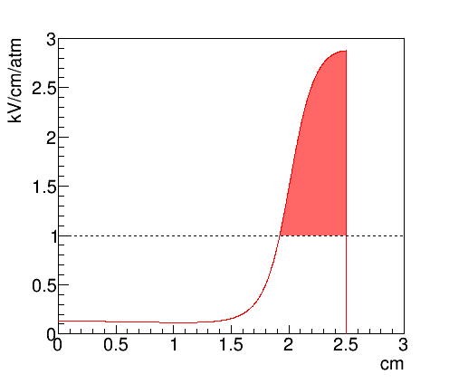
Uniformity of EL generation
EL Yield is proportional to [electric field strength] x [path length]
Uniformity : 1.4%
Since initial electron number is 1e5, effect on energy resolution will be 1.4%/√1e5 = 0.005%
Initial position dependence of EL yield
Electric field along the path

Slide 10
Electron and photon propagation simulation
Electron track by Garfield++
EL photons by Monte Carlo method
6photon/e- @SiPM(3mm square)
hit position at SiPM
detected photon num
hit timing
1000ev
1000ev
1000ev

Slide 11
Estimation of energy resolution
Simulation process
0νββ event by Geant4
statistical fluctuation with fano factor
drift to the ELCC plane with diffusion
EL generation (6photon/e⁻)
Simulated energy resolution: 0.37%(FWHM)
ionizing process: 0.27%
EL process: 0.25%
Detected EL num
Detected EL num

Slide 12
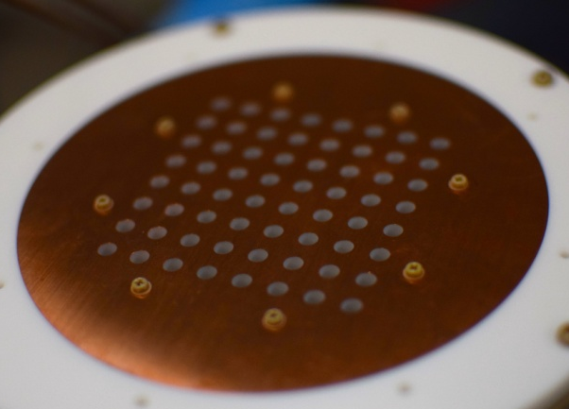
Prototype detector
arxiv: 1701.03931
Prototype detector
Parameters
Sensitive region: 6 x 6 x 9 cm
Cell num: 64
Gas pressure: 4 bar
E_{drift}: 100 V/cm/atm
E_{EL}: 2.7kV/cm/atm
MPPC-VUV3
PDE: 23%
Size: 3 x 3 mm²
9cm
7.5mm
MPPCs
anode electrode

Slide 13
ELCC design
To prevent discharge, PTFE holes is slightly smaller than anode(Cu) holes
cross section view

Slide 14
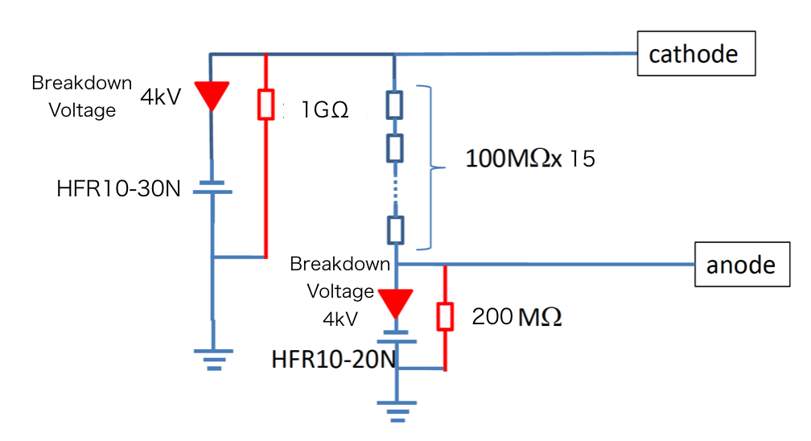
High voltage applying
Two HV modules to control both EL field and drift field
HFR10-30N, HFR10-20N [Matsusada-precision]
Diode and resistance for circuit protection
-24kV
-15kV
EL
SiPM

Slide 15
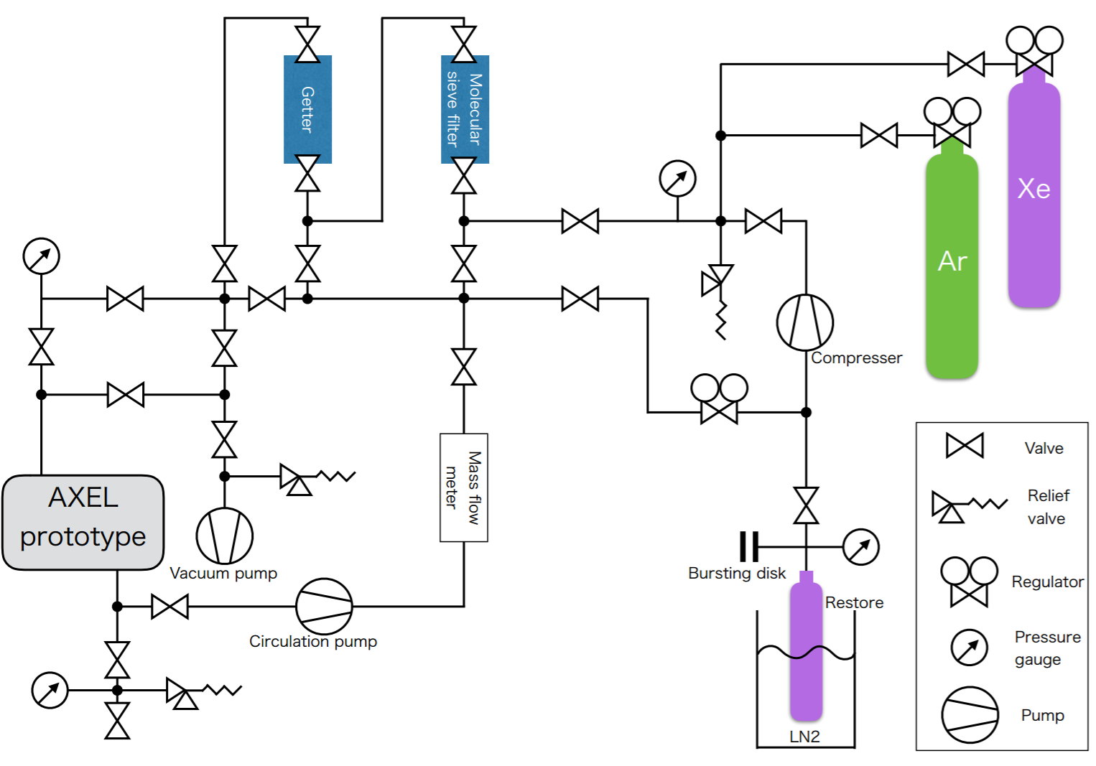
Gas circulation system
Circulate high pressure xenon gas
pump: PumpWorks PW2070
SAES micro torr MC1-902FV
API-GETTER-I -Re
Number of photons slightly increase at first
used for analysis

Slide 16
Event sample
Waveforms of MPPC and PMT
EL light & scintillation light are observed
MPPC: 65MHz 12bit 2Vpp
PMT: 100MHz 14bit 2Vpp

Slide 17
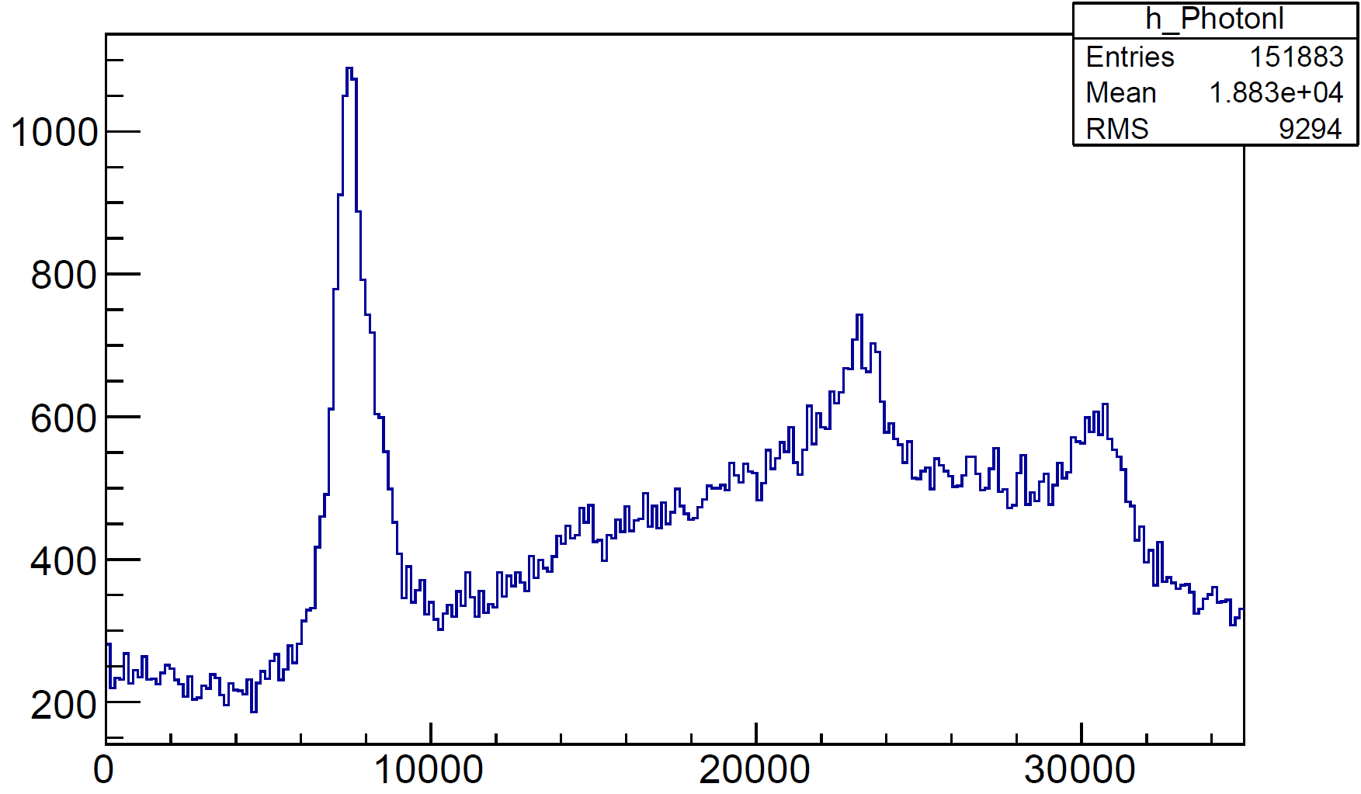
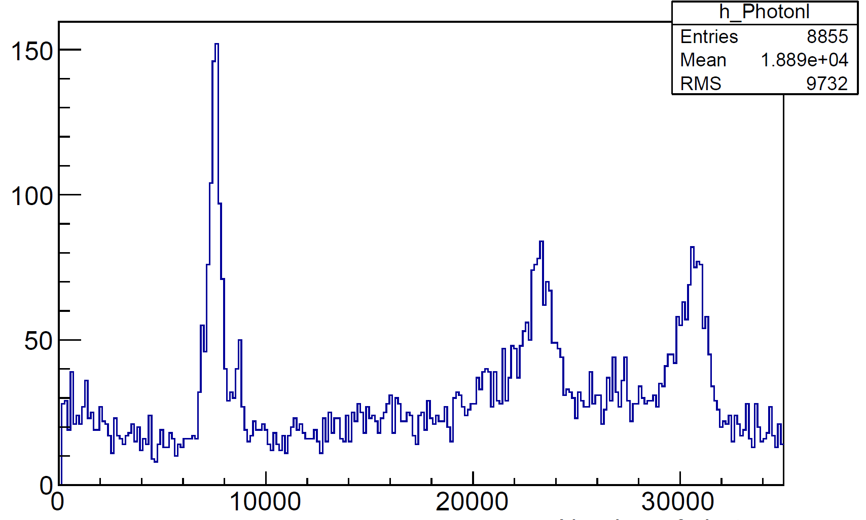
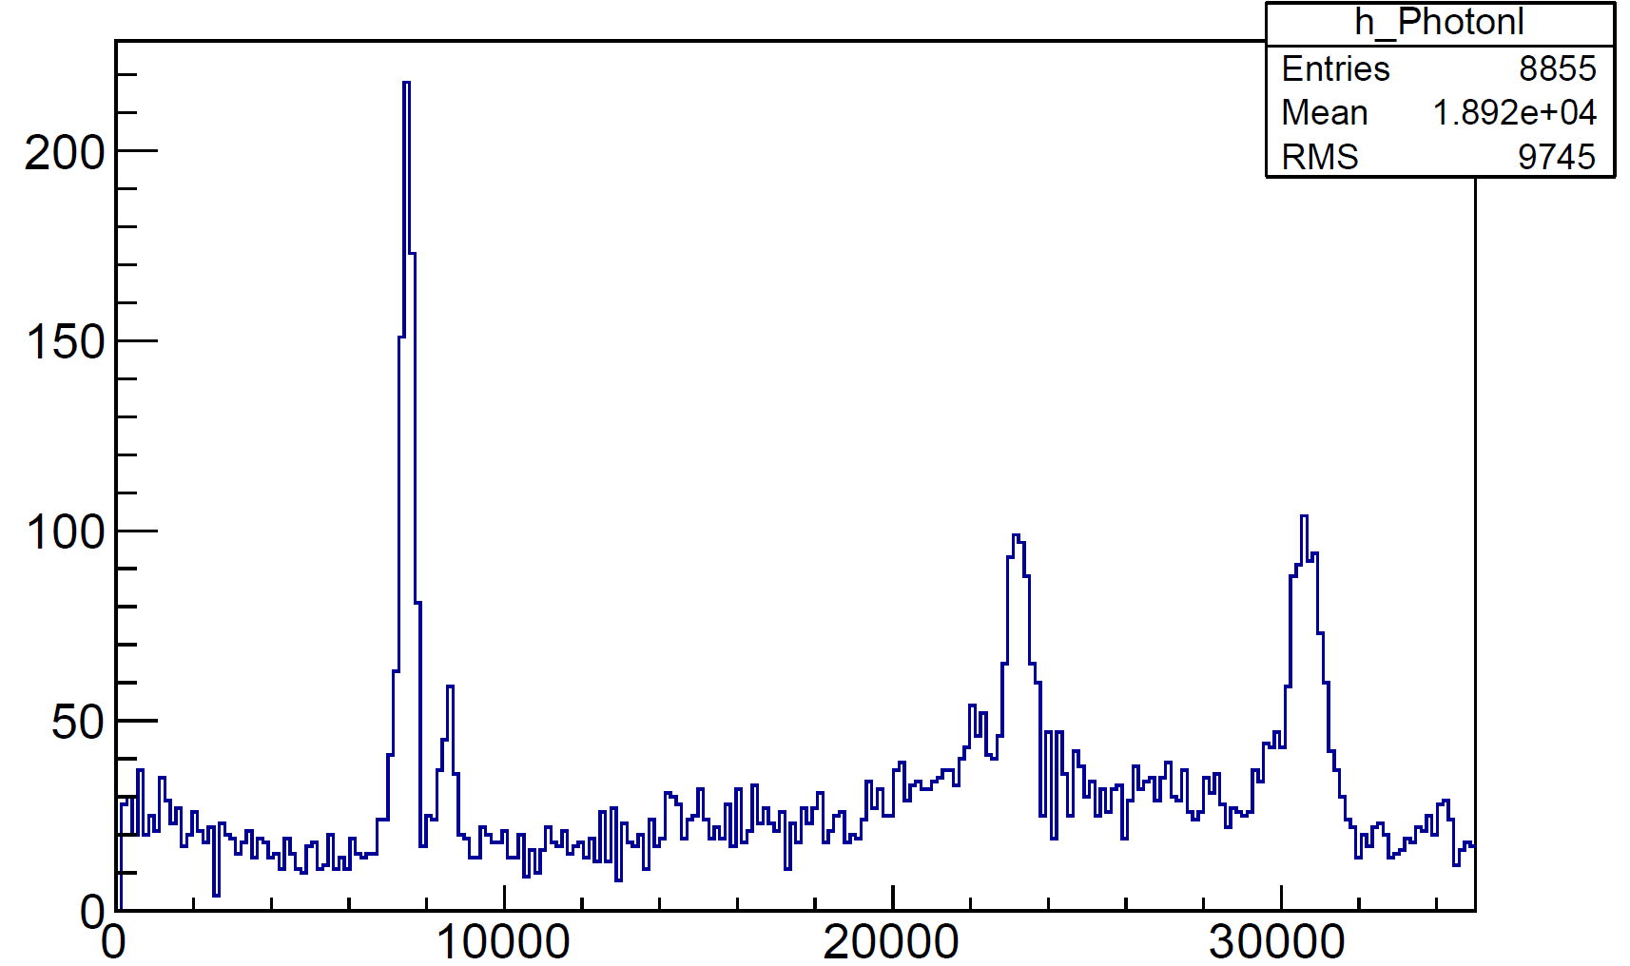
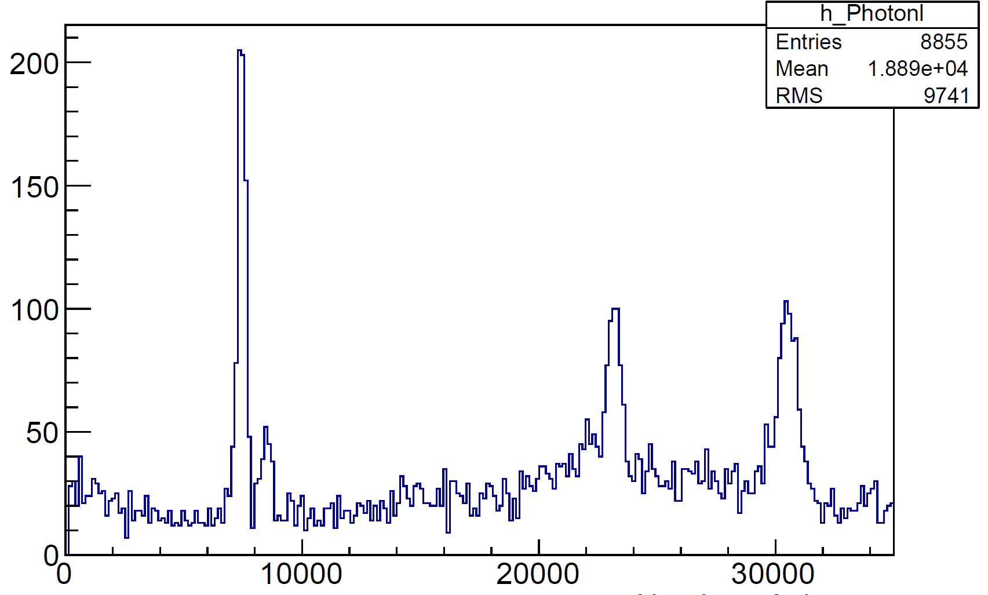
Analysis flow
Fiducial cut
XY by hit channel, Z by PMT timing
EL gain correction
Measure each cell gain by 30keV peak
Dark count correction
Depend on time duration of EL photon
fiducial
EL-gain
dark

Slide 18
Measured energy spectrum
Four (five?) peaks are observed using ⁵⁷Co source
X-ray (Kα)
29.78 keV
Escape peak (Kα)
92.28 keV
Escape peak (Kβ) ?
88.44 keV
Full peak
122.06 keV
X-ray (Kβ)
33.62 keV

Slide 19
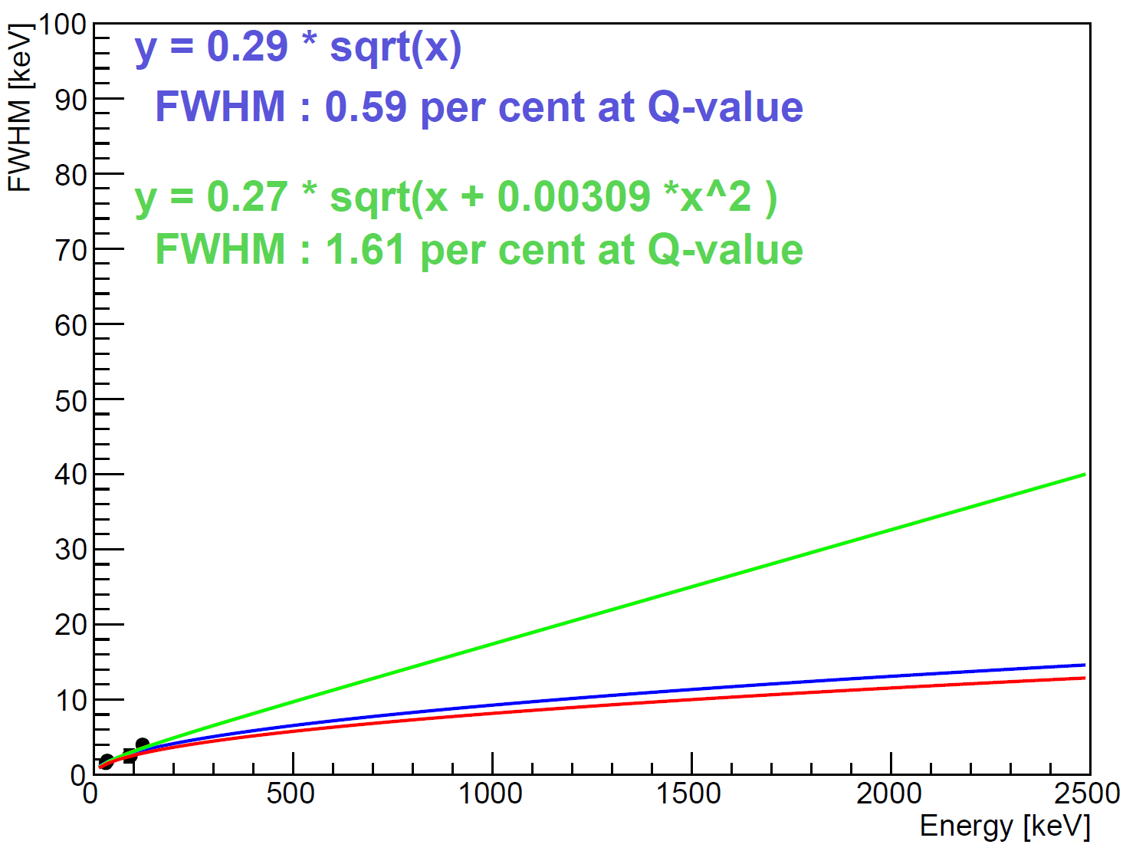
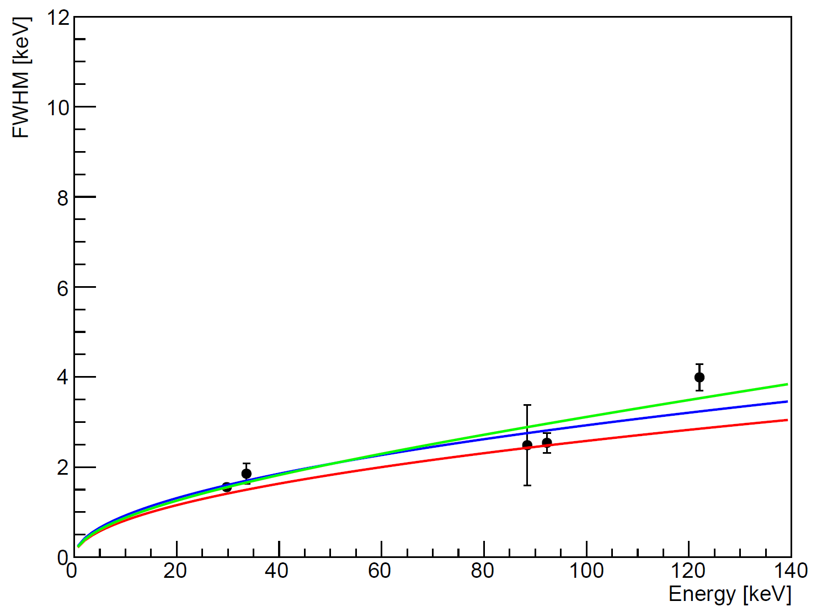
Measured energy resolution
Measured energy: 30,34,88,92,122 keV
Extrapolating 2.5MeV by assuming
: 1.61%FWHM
: 0.59%FWHM
0.5%FWHM@2.5MeV

Slide 20
Upgrade of ELCC structure
New ELCC will come soon for testing...
Higher energy measurement (511keV gamma-ray)
Multi electrode (scale up study)
Hexagonal placement (better than square one)
1/3 of anode hole plate
old
new
GND mesh

Slide 21
Large prototype project
100L scale detector
Purpose
test at 2.5MeV
test tracking
get large size technique
Status
Chamber will come by this summer
Electronics development ongoing
Developing Cockcroft-Walton high voltage generation
Cabling test

Slide 22
Simulation study for BG rejection
Track topology (by Geant4)
2-blobs : 0νββ
small : α-ray BG
multi-site : γ-ray BG with Compton scattering (~98%)
Basically, 2.5MeV γ-ray with photo absorption (~2%) is the serious background
0νββ
α-ray (2.5MeV)
γ-ray (2.5MeV)

Slide 23
BG simulation with Geant4
energy of lower blob
Assumption
1 ton ¹³⁶Xe
2.9ppt ²¹⁴Bi in chamber
Sensitivity
m_{ββ}=60meV (current)
m_{ββ}=20meV (reduce chamber mass: 10ton --> 100kg)
Upper limit of EXO's copper
Heaviest component
current simulation
chamber mass: 10ton --> 100kg
original electron track
reconstructed track

Slide 24
Summary
AXEL project developing high pressure xenon gas TPC for 0nbb search.
Segmented electroluminescence readout (ELCC) is key component.
Simulated performance of ELCC is good.
Energy resolution measured by current prototype detector: 0.6-1.6%FWHM @ 2.5MeV
Large prototype construction started.
1ton detector sensitivity will reach ~20meV

Slide 25
High energy resolution
8
Ionization process
Use gaseous xenon
W-value = 22.1eV
Fano-factor = 0.13
=> 0.25%(FWHM) @2.5MeV
Signal multiplication
Use ElectroLuminescence (EL)
light yield/length is proportional to the electric field
amplification fluctuation is small
E_{γ}=662keV
6
100atm
4
Energy reolution %
2
NIMA396(1997)360
0
0
1
2
3
4
density [g/cm³]
Avalanche
ElectroLuminescence
Noble gas detector

Slide 26
New GND mesh idea
Fine etched electrode
Isolate cell from EL photon
Strong for stretching and deflection
PTFE
MPPC
MPPC

Slide 27
Tracking
rate of γ-ray from
²¹⁴Bi (2448keV)
Avogadro number
6.02x10²³[/mol]
branching ratio
0.0157
180000
[cts/year]
chamber mass
10⁷[g](=10ton)
half life of ²³⁸U
4.468x10⁹[year]
contamination
2.9x10⁻¹²(=2.9ppt)
atomic weight of ²³⁸U
238 [g/mol]
process | 0νββ efficiency | γ (2448keV) rate
initial condition | 100% | 180000 cts/year
fiducial-cut | 79% | 12000 cts/year
multi-cluster-cut | 49% | 75 cts/year
2-blob-selection | 19% | 5.5 cts/year
solid angle
(chamber --> gas)
98% is Compton
Simulated signal-efficiency and BG-rate
for each analysis steps

