Slide 1
Development of a high energy resolution xenon gas TPC for 0νββ decay search :
Sei Ban
Kyoto University
For the AXEL collaboration

Slide 2
Introduction : Neutrinoless Double Beta Decay (0νββ decay)
It occurs only if the neutrino has Majorana mass term
2νββ decay
0νββ decay
If the neutrino is Majorana ……
- naturally explains the smallness of the neutrino mass
- One of the conditions of Leptogenesis story
XeSAT2018 at Waseda University, 19 Sep 2018

Slide 3
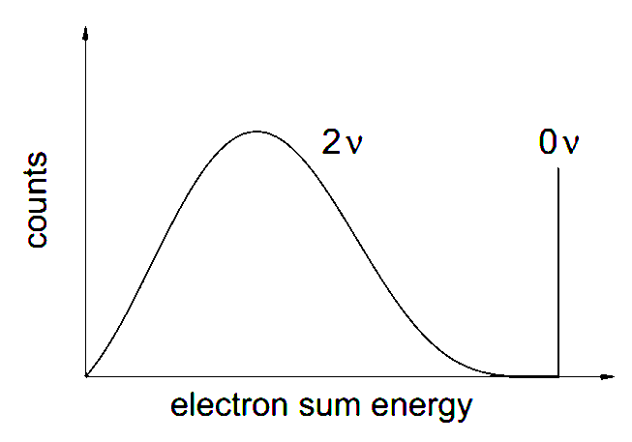
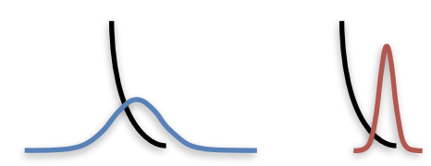
Introduction : Neutrinoless Double Beta Decay (0νββ decay)
To discovery 0νββ decay ……
Large target mass
Energy
resolution
Low BG
(BG rejection)
Pioneering work by the NEXT experiment group demonstrated usability of high pressure xenon gas time projection chamber (TPC) for 0νββ decay search
XeSAT2018 at Waseda University, 19 Sep 2018

Slide 4
Contents
AXEL experiments
Prototype detector (1) : 10 L prototype
Prototype detector (2) : 180 L prototype
Future prospect
Summary
XeSAT2018 at Waseda University, 19 Sep 2018

Slide 5
Contents
AXEL experiments
Prototype detector (1) : 10 L prototype
Prototype detector (2) : 180 L prototype
Future prospect
Summary
XeSAT2018 at Waseda University, 19 Sep 2018

Slide 6
A Xe ElectroLuminescence : AXEL experiment
High pressure Xe gas TPC with unique cell readout structure
for 0νββ decay search
Tracking
(BG rejection)
Readout Ionization signals
a few meters
● Electroluminescence (EL) process
photon
Scintillation
e
Ionization
electrons
PMT
Φa few meters
Atom
ELCC plane
Linear response to applied electric field
Without avalanche process
→ less fluctuation of multiplication
Details are in the next page
¹³⁶Xe 10 bar
Good energy resolution
150~200kV
Large mass
→ goal : 0.5%FWHM @ Q-value
→ ton scale ¹³⁶Xe gas
XeSAT2018 at Waseda University, 19 Sep 2018

Slide 7
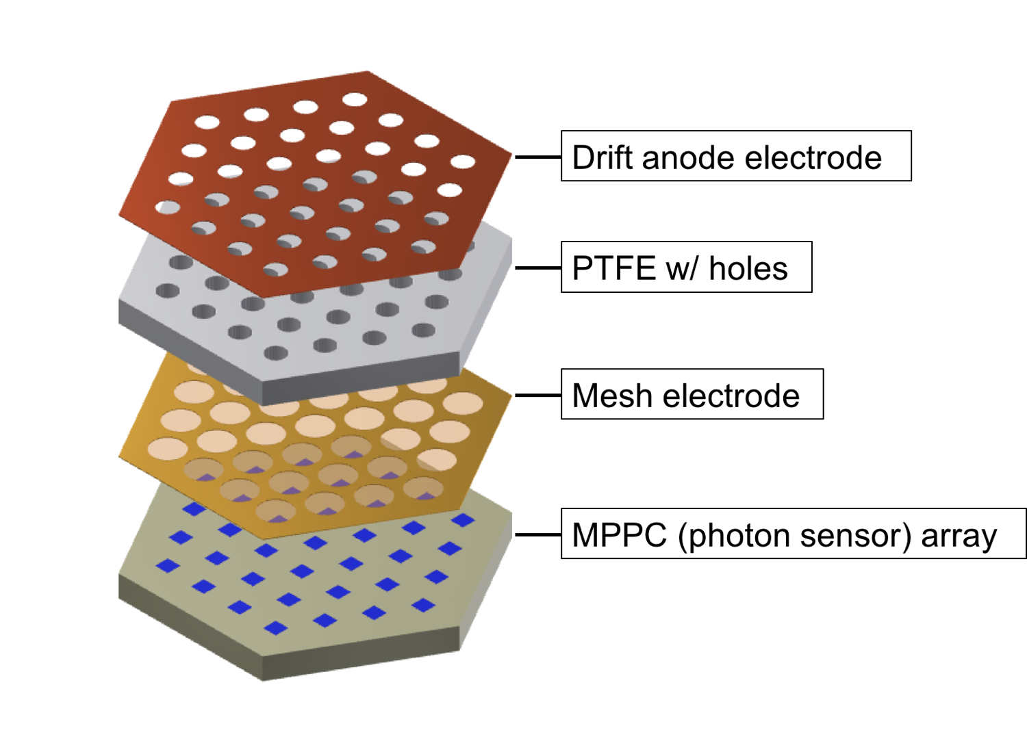
A Xe ElectroLuminescence : AXEL experiment
Electroluminescence Light Collection Cell : ELCC
- Energy measurement and Tracking in each cells
- Uniform response to event position
- Extendable to large size because of its rigid structures
MPPC
e⁻
e⁻
e⁻
MPPC
e⁻
MPPC
EEL
EDrift
Simulation study of ELCC was done and presented
in XeSAT2017
( https://indico.cern.ch/event/573069/sessions/230066/attachments/1440275/2217034/kisekinakamura_20170405_XeSAT.pdf )
Ionization electrons are collected into cells
if EEL > EDrift , And converted into EL light
XeSAT2018 at Waseda University, 19 Sep 2018

Slide 8
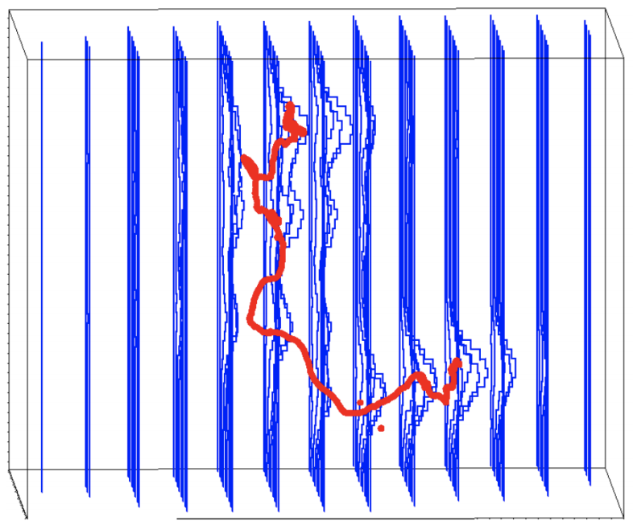
A Xe ElectroLuminescence : AXEL experiment
Reconstruct the event topologies from
hit pattern and wave form
- α and multi-site events are easily removed
simulation
expected event displays
(simulation : 10 atm Xe, 15mm-pitch, 1MHz sampling)
Compton g-ray (2.5MeV)
0νββ
a-ray (2.5MeV)
XeSAT2018 at Waseda University, 19 Sep 2018

Slide 9
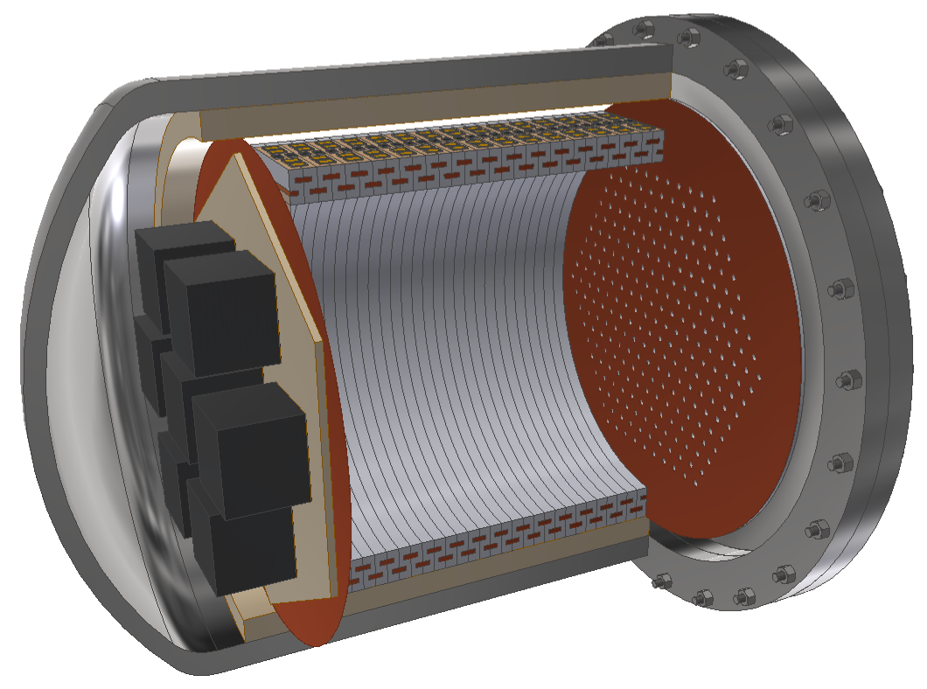
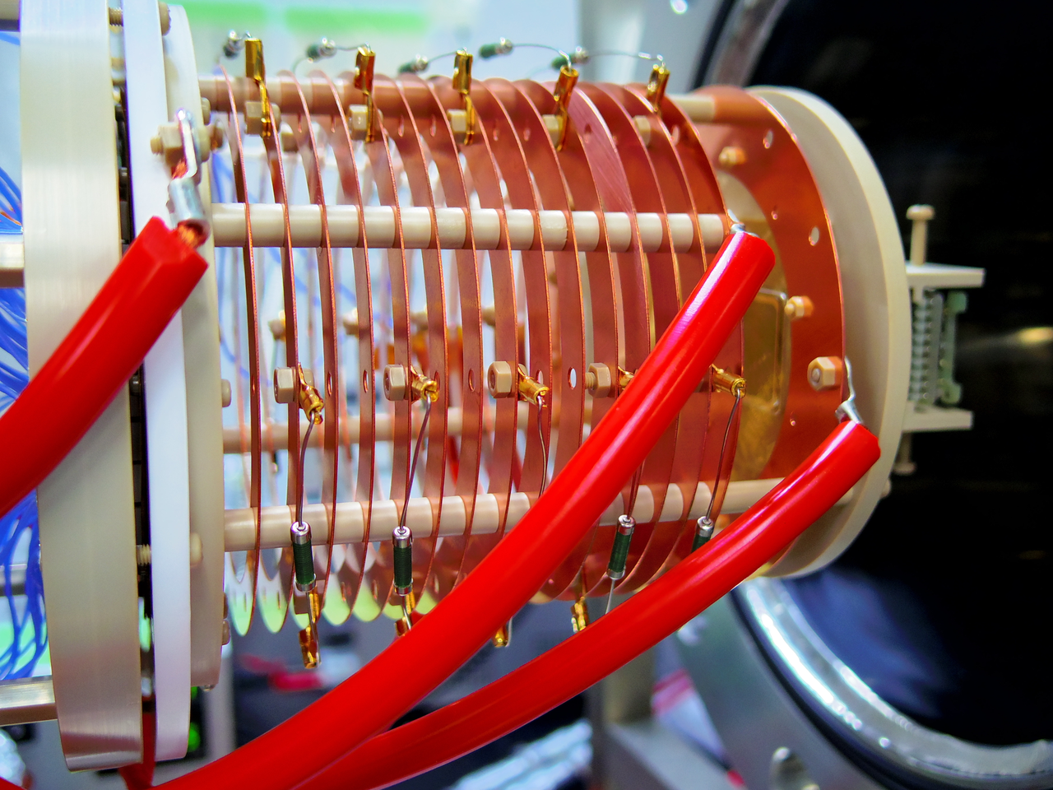
A Xe ElectroLuminescence : AXEL experiment
202X ~
Road map of the AXEL experiment
- Finish evaluation of the prototype detectors until 2020
- aiming to start physics run from 2021
ton scale
- Discovery(?)
- sweep out IH
2018 ~
2021 ~
~ 100kg scale
~φ50cm
2014~2018
- Physics run
- World record
9cm
~50cm
φ10cm
- ~5.6kg Xe
- Know-how of enlargement
- Energy resolution study
(near the Q-value)
- Background study
- now, constructing
- ~0.08kg Xe
- Demonstrate the ELCC concept
- Energy resolution study
( 122keV, 356keV, 511keV )
XeSAT2018 at Waseda University, 19 Sep 2018

Slide 10
Contents
AXEL experiments
Prototype detector (1) : 10 L prototype
Prototype detector (2) : 180 L prototype
Future prospect
Summary
XeSAT2018 at Waseda University, 19 Sep 2018

Slide 11
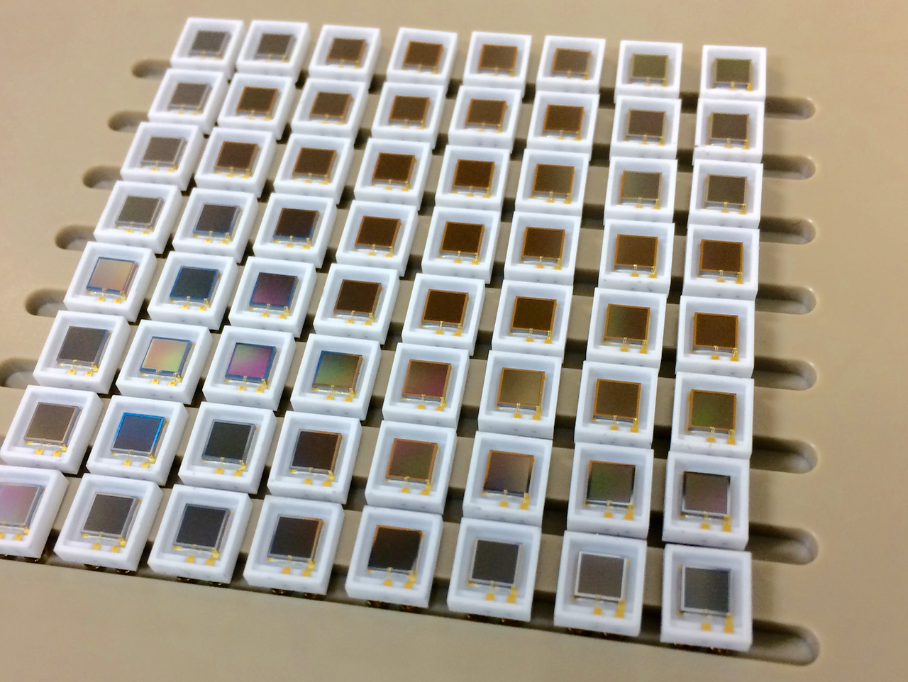
Prototype detector (1) : 10L prototype
Sensitive region : φ10cm × 9cm
# of channel : 64
Purpose : Demonstrate the performance of ELCC
Prototype detector
MPPCs
Sensitive to VUV light
9cm
5mm
7.5mm
φ10cm
PMTs
2.5cm
XeSAT2018 at Waseda University, 19 Sep 2018

Slide 12
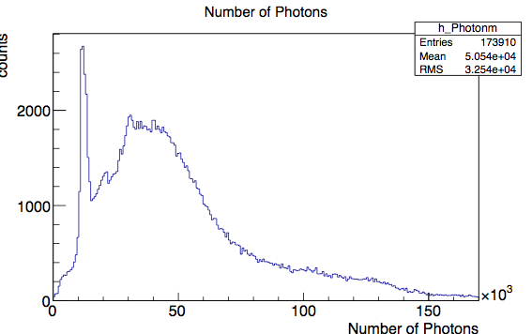
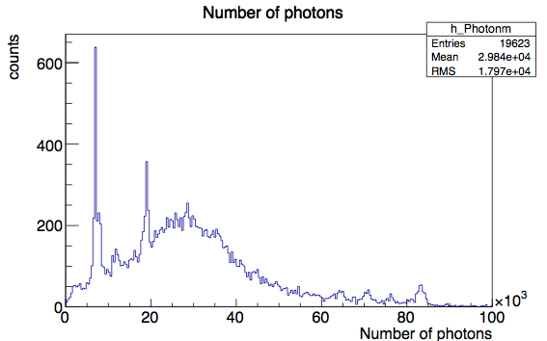
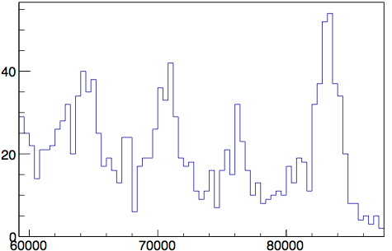
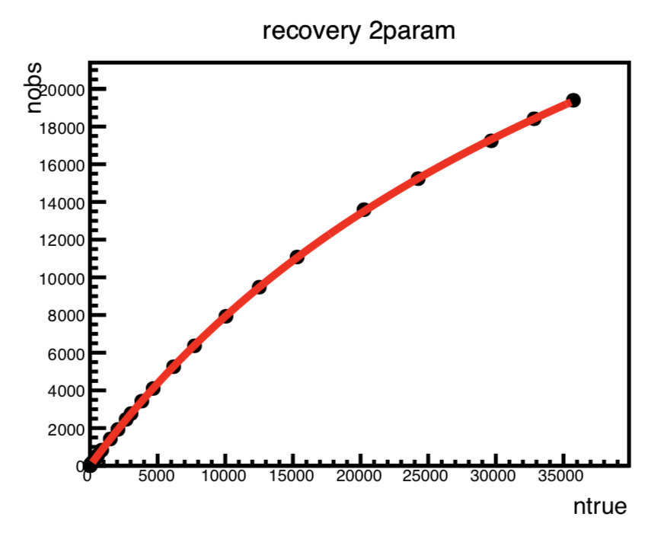
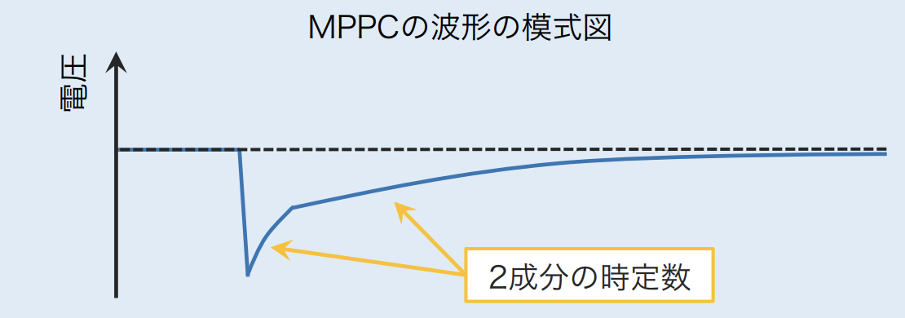
Prototype detector (1) : 10L prototype
Data and Analysis
- Gas ： Xe 8 bar
- Edrift ：83 V/cm/bar
- EEL ：2.375 kV/cm/bar
- source : ¹³³Ba
- Fiducial cut
- Saturated events → cut
- Cell gain calibration
- MPPC saturation correction
etc……
30keV
30keV
Correction using 30 keV X-ray peak position
MPPC signal saturate as # of incident photons increases
- saturation curve is characterized by
MPPC recovery time
- measured recovery time one by one
→ apply to
correction
30keV
302keV
356keV
272keV?
326keV
81keV
51keV
Schematic of MPPC signal
Voltage
two time constants
XeSAT2018 at Waseda University, 19 Sep 2018

Slide 13
Prototype detector (1) : 10L prototype
Fitting of the histogram
-
- Fitting by “ Σgaussian + ax+b” in low E region
- Fitting by “ Σgaussian + exp” in high E region
→ ⊿E : 2.54% FWHM at 356 keV
→ 0.97% FWHM at Q-value, extrapolated by √E
X-ray of Xenon
276keV
302keV
356keV
326keV
81keV
50keV
XeSAT2018 at Waseda University, 19 Sep 2018

Slide 14
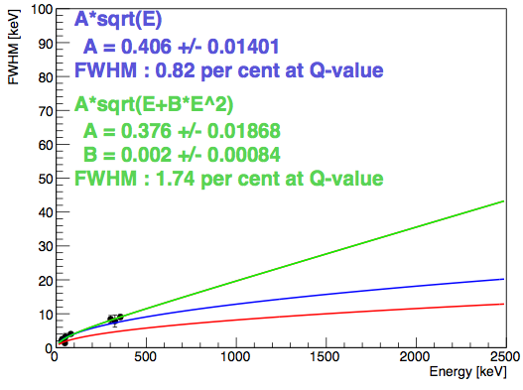
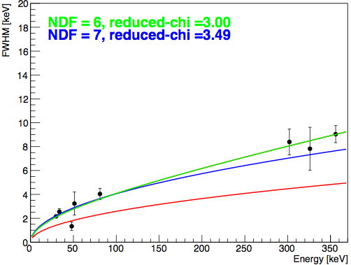
Prototype detector (1) : 10L prototype
Energy resolution at Q-value
- Estimated to 0.82 ~ 1.74 % FWHM at Q-value (2458keV)
- Simulation (Geant4) is also on-going to understand this result
Q-value
A = 0.376 +/- 0.0186
B = 0.002 +/- 0.0008
-> Extrapolate to Q-value
FWHM 1.74% (@2458keV)
A = 0.406 +/- 0.0140
-> Extrapolate to Q-value
FWHM 0.82% (@2458keV)
Target : 0.5% FWHM
XeSAT2018 at Waseda University, 19 Sep 2018

Slide 15
Contents
AXEL experiments
Prototype detector (1) : 10 L prototype
Prototype detector (2) : 180 L prototype
Future prospect
Summary
XeSAT2018 at Waseda University, 19 Sep 2018

Slide 16
Prototype detector (2) : 180L prototype
- Evaluation of energy resolution near the Q-value
- Now, constructing……
Cockcroft-Walton for HV
ELCC
Readout electronics
Pressure vessel
Field cage
XeSAT2018 at Waseda University, 19 Sep 2018

Slide 17
Prototype detector (2) : 180L prototype
- Evaluation of energy resolution near the Q-value
- Now, constructing……
Cockcroft-Walton for HV
ELCC
Readout electronics
Pressure vessel
Field cage
XeSAT2018 at Waseda University, 19 Sep 2018

Slide 18
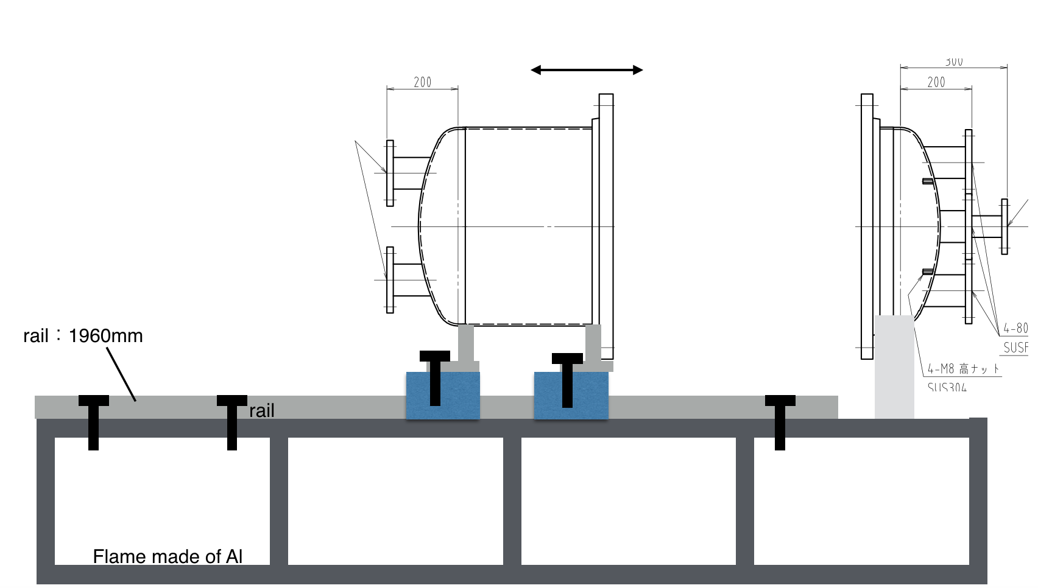
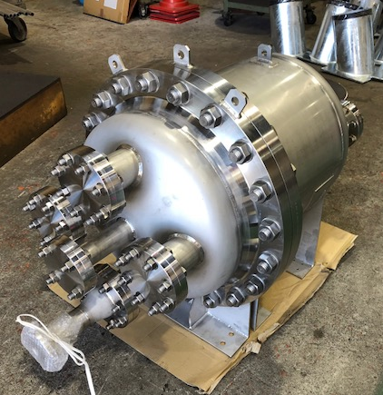
Prototype detector (2) : 180L prototype
Pressure vessel
- SUS304L
- Volume : ~180L (Sensitive Volume : ~100L)
- Now, ready !
XeSAT2018 at Waseda University, 19 Sep 2018

Slide 19
Prototype detector (2) : 180L prototype
- Evaluation of energy resolution near the Q-value
- Now, constructing……
Cockcroft-Walton for HV
ELCC
Readout electronics
Pressure vessel
Field cage
XeSAT2018 at Waseda University, 19 Sep 2018

Slide 20
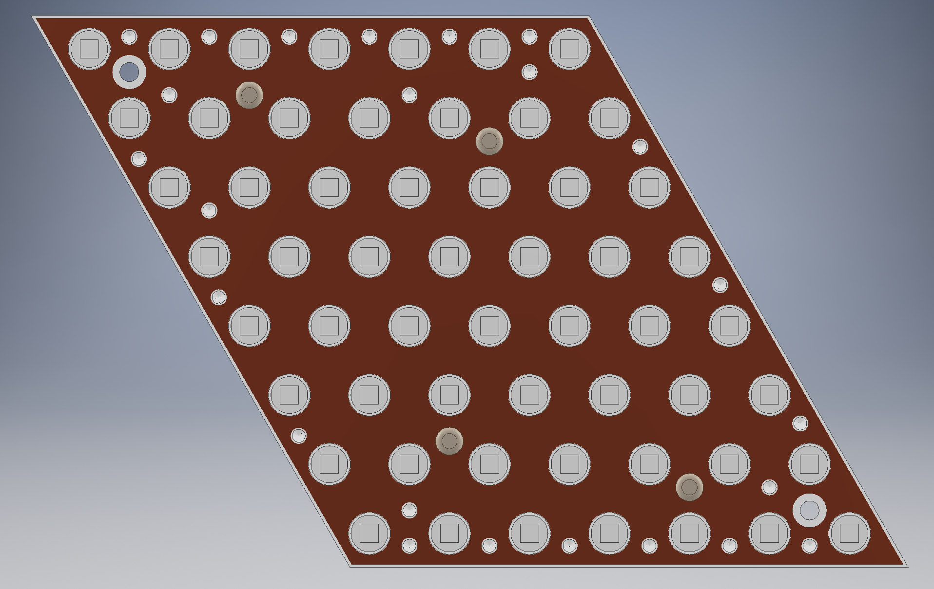
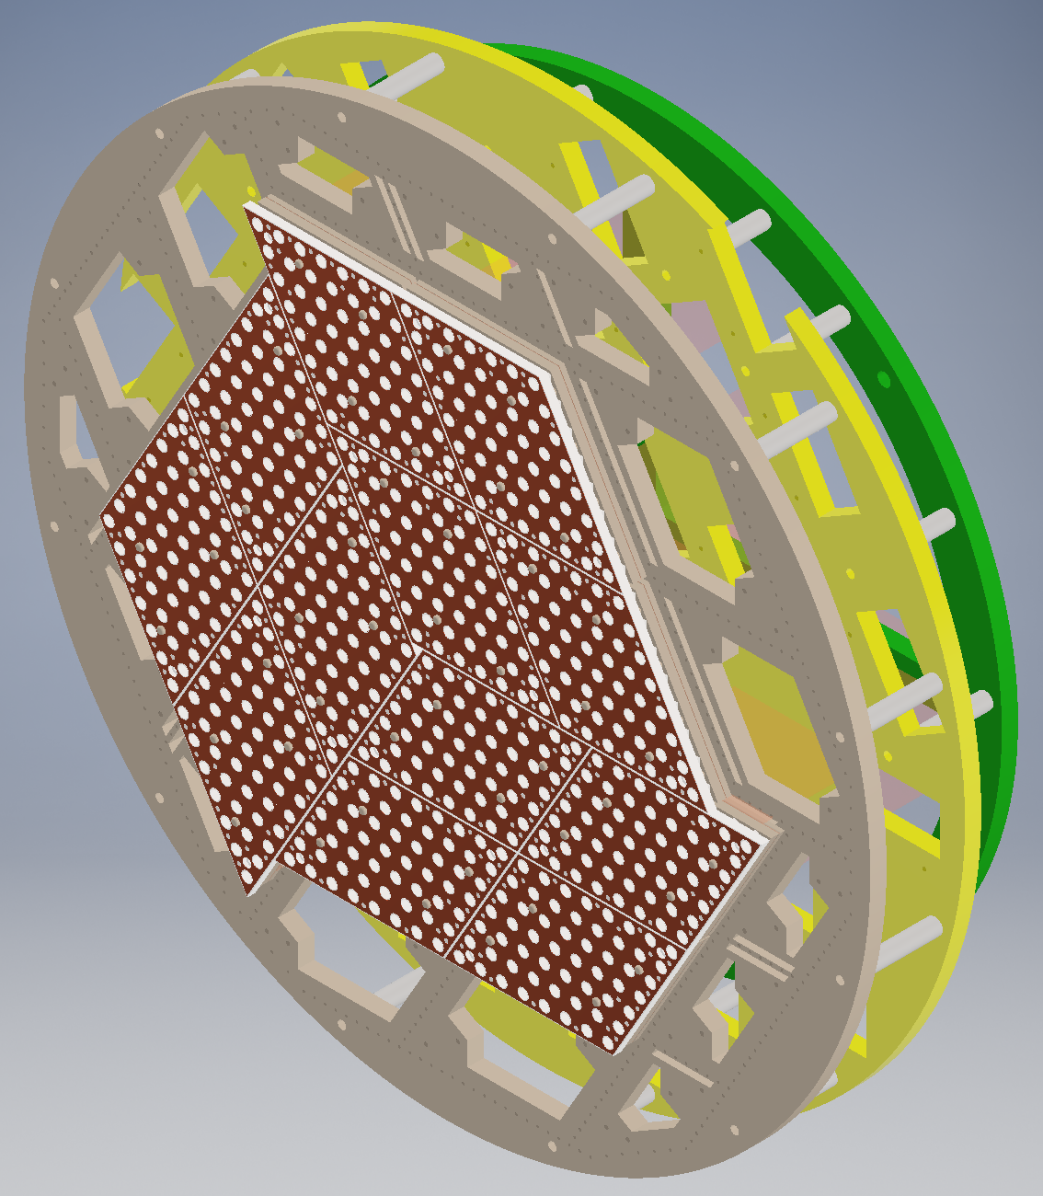
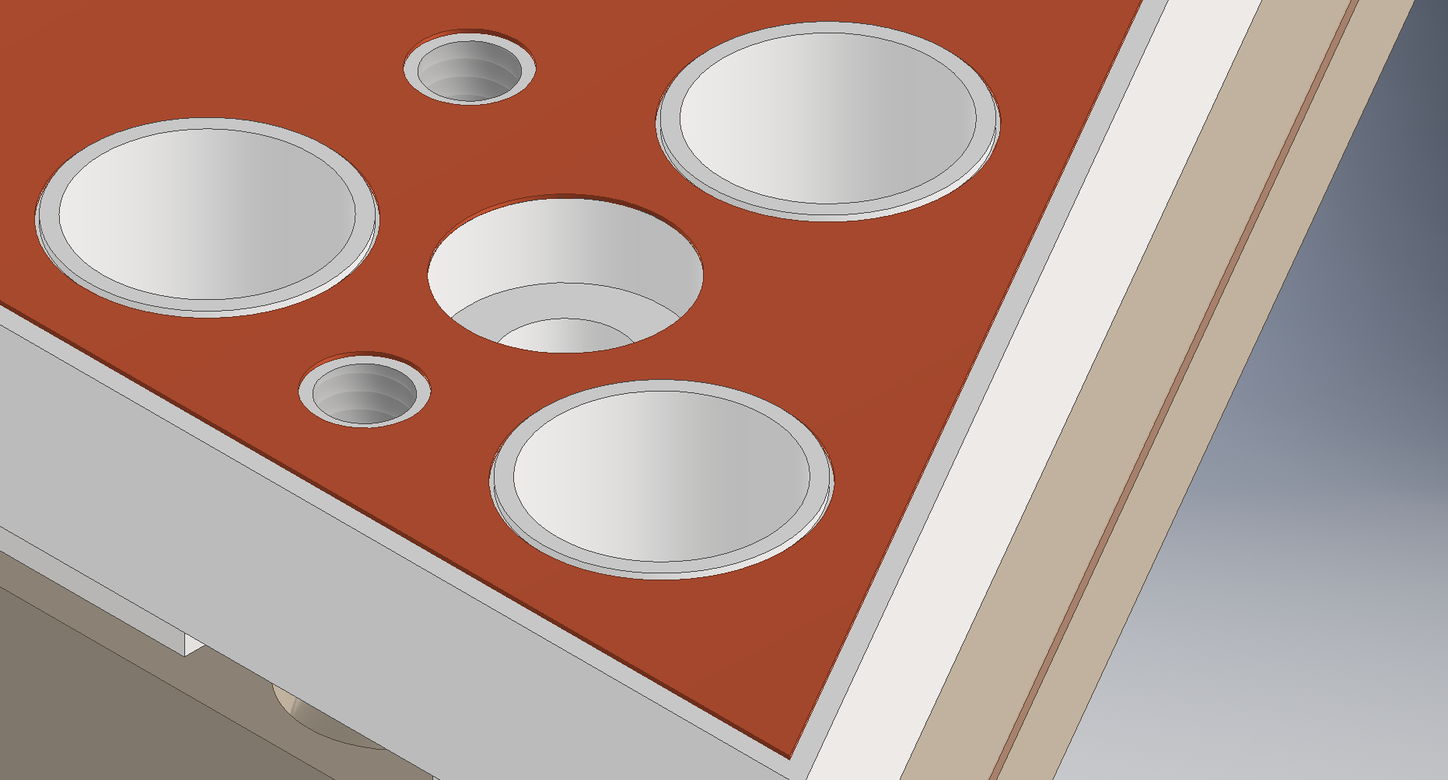
Prototype detector (2) : 180L prototype
ELCC
- Prefabricated style → easily to extend
- Number of channels : ~1000 ch
- Design is almost fixed
unit
XeSAT2018 at Waseda University, 19 Sep 2018

Slide 21
Prototype detector (2) : 180L prototype
- Evaluation of energy resolution near the Q-value
- Now, constructing……
Cockcroft-Walton for HV
ELCC
Readout electronics
Pressure vessel
Field cage
XeSAT2018 at Waseda University, 19 Sep 2018

Slide 22
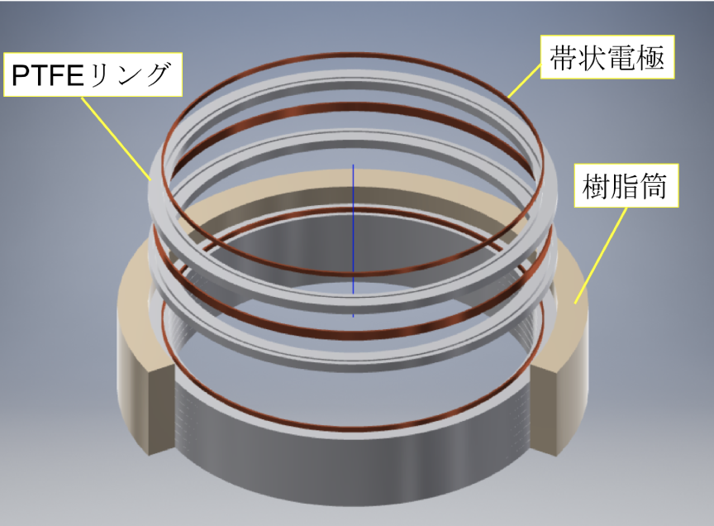
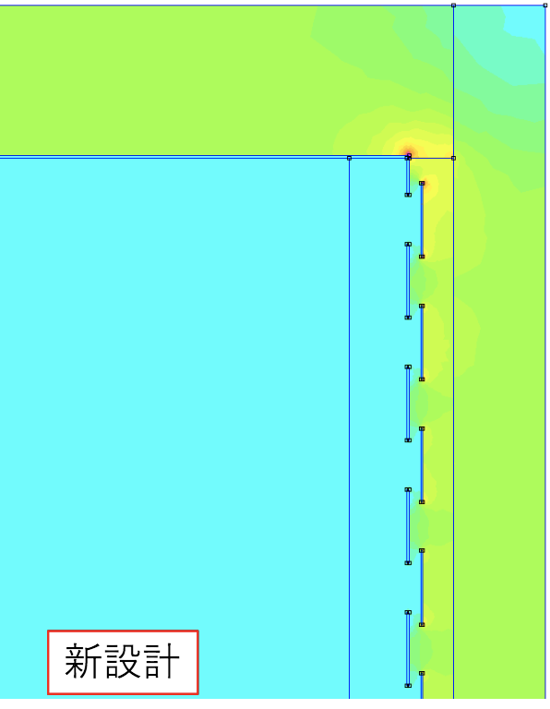
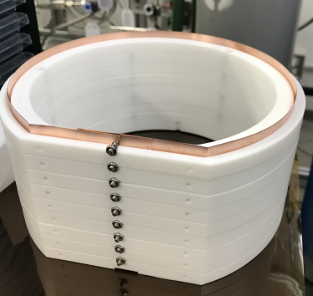
Prototype detector (2) : 180L prototype
Field cage
- Alignment drift field by strip electrodes
- Reflecting scintillation photons by PTFE
- Withstand discharge structure
- Uniformity of Field strength is checked by FEM simulation
- Now, testing with 10L prototype detector
PTFE
Electrode
Insulator
Electric field
Electric field simulation by FEM
XeSAT2018 at Waseda University, 19 Sep 2018

Slide 23
Prototype detector (2) : 180L prototype
- Evaluation of energy resolution near the Q-value
- Now, constructing……
Cockcroft-Walton for HV
ELCC
Readout electronics
Pressure vessel
Field cage
XeSAT2018 at Waseda University, 19 Sep 2018

Slide 24
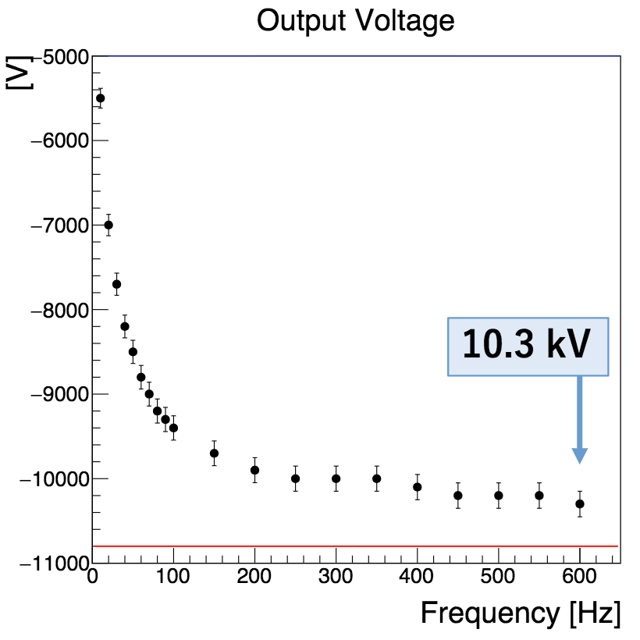
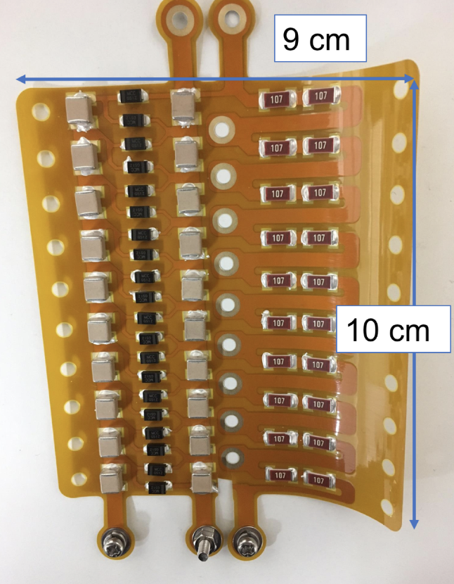
Prototype detector (2) : 180L prototype
Introduce low voltage into chamber and boost by Cockcroft-Wakton
inside the chamber to avoid discharge at feedthrough
- Low outgas due to Polyimide
- succeed to generate 10kV with a prototype
Input amplitude : 540 V
XeSAT2018 at Waseda University, 19 Sep 2018

Slide 25
Prototype detector (2) : 180L prototype
- Evaluation of energy resolution near the Q-value
- Now, constructing……
Cockcroft-Walton for HV
ELCC
Readout electronics
Pressure vessel
Field cage
XeSAT2018 at Waseda University, 19 Sep 2018

Slide 26
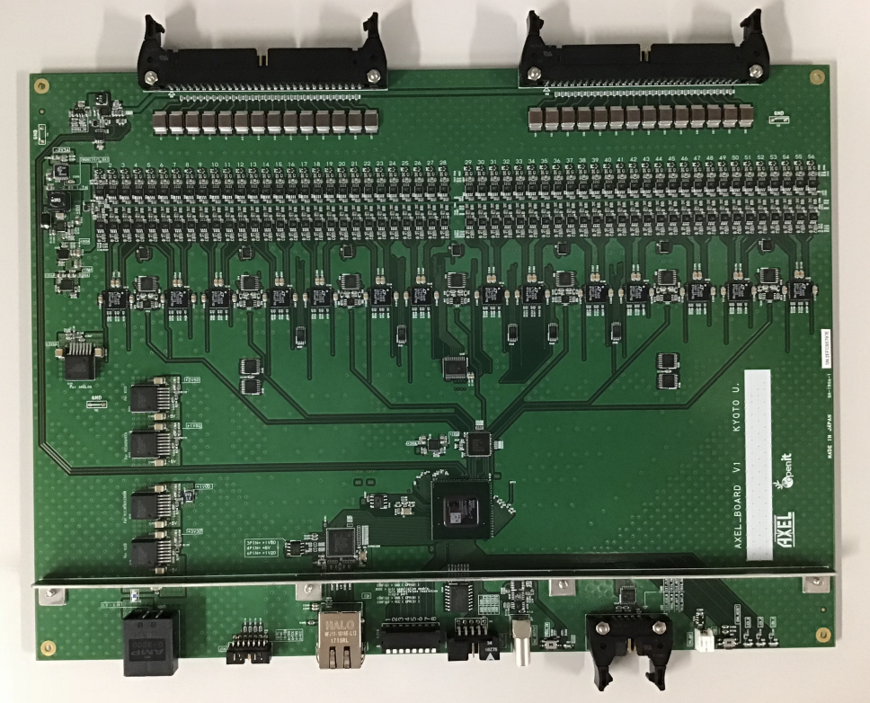
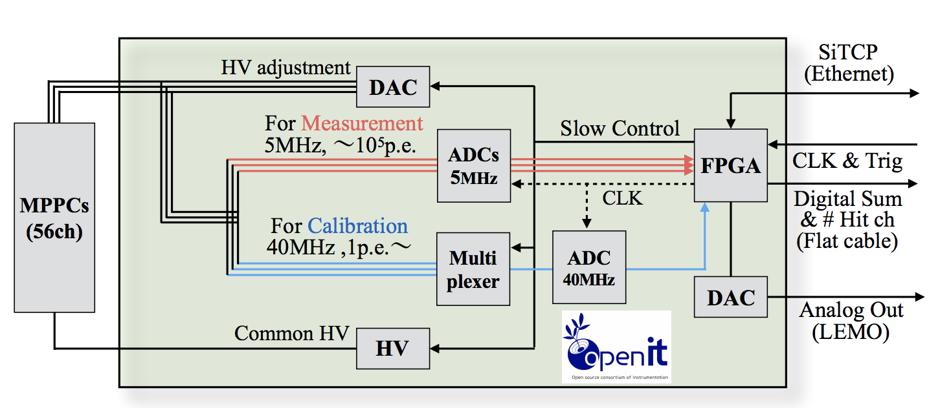
Prototype detector (2) : 180L prototype
Readout Electronics
- Readout waveforms of MPPC : 56 ch/board
- Two Flash ADCs to achieve wide dynamic range : 1 p.e ~ 10⁴p.e
- High Voltage supply to MPPCs (in the 0.2mV)
- Monitor MPPC gain constantly
→ adjust (feedback) gain in 0.25% accuracy
- Low cost
XeSAT2018 at Waseda University, 19 Sep 2018

Slide 27
Contents
AXEL experiments
Prototype detector (1) : 10 L prototype
Prototype detector (2) : 180 L prototype
Future prospect
Summary
XeSAT2018 at Waseda University, 19 Sep 2018

Slide 28
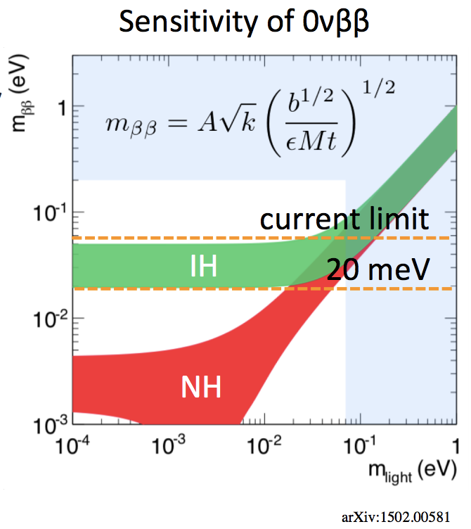
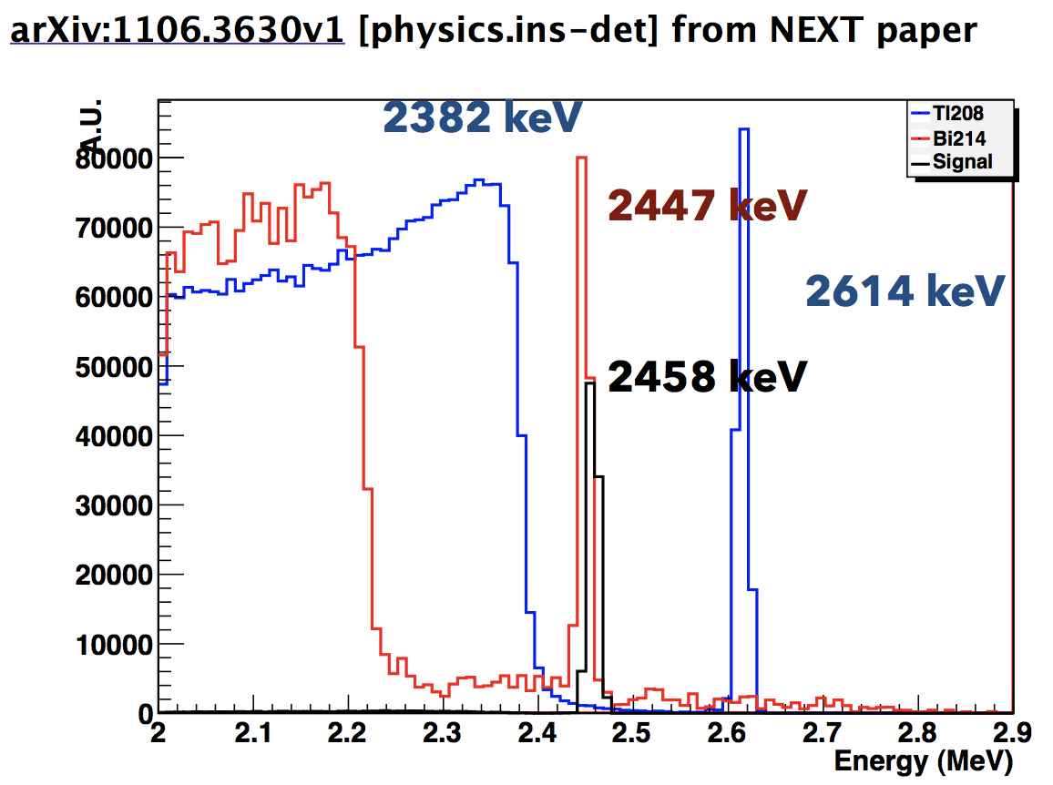
Future prospect
Sensitivity estimation for 1 ton detector
- Need to reach mββ = 20 meV
- Background free is required
- ²¹⁴Bi (2447 keV) is serious BG source
- Main source : Pressure vessel (~10 ton)
- Even if we use oxygen-free copper
2.9 ppt ²¹⁴Bi (cf. EXO-200)
→ 75 event/year for 1 ton detector
arXiv.1502.00581
XeSAT2018 at Waseda University, 19 Sep 2018

Slide 29
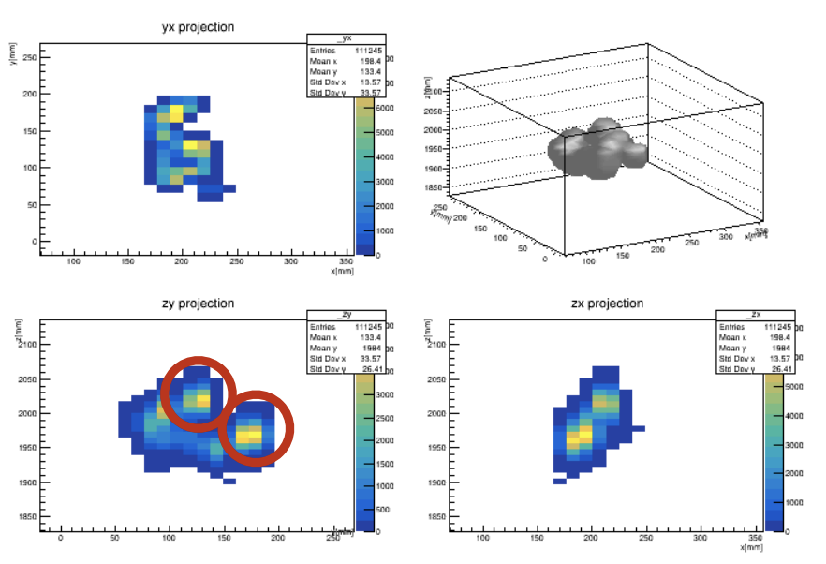
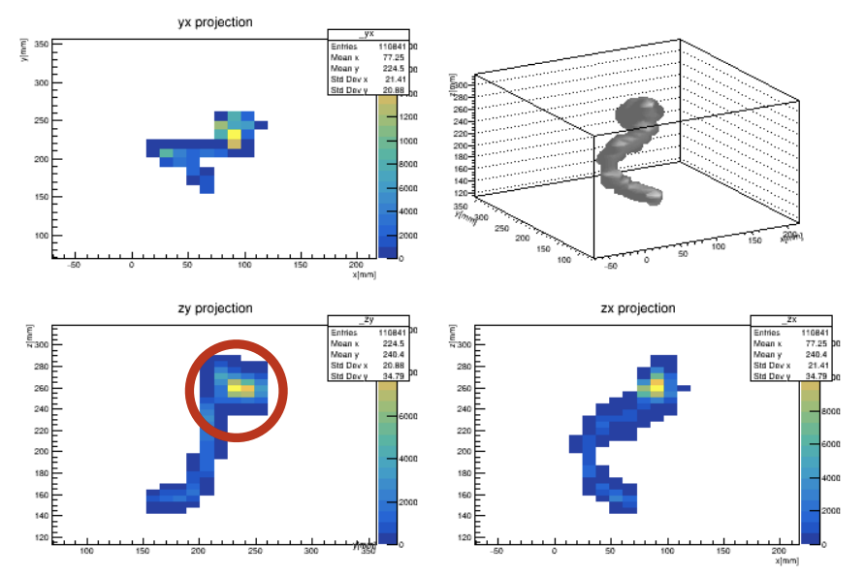
Future prospect
Topological information
- 0νββ decay has two blobs
- Photoelectric absorption of gamma event only has one blob
→ To Identify two blobs is very powerful strategy
0νββ
Gamma-ray
XeSAT2018 at Waseda University, 19 Sep 2018

Slide 30
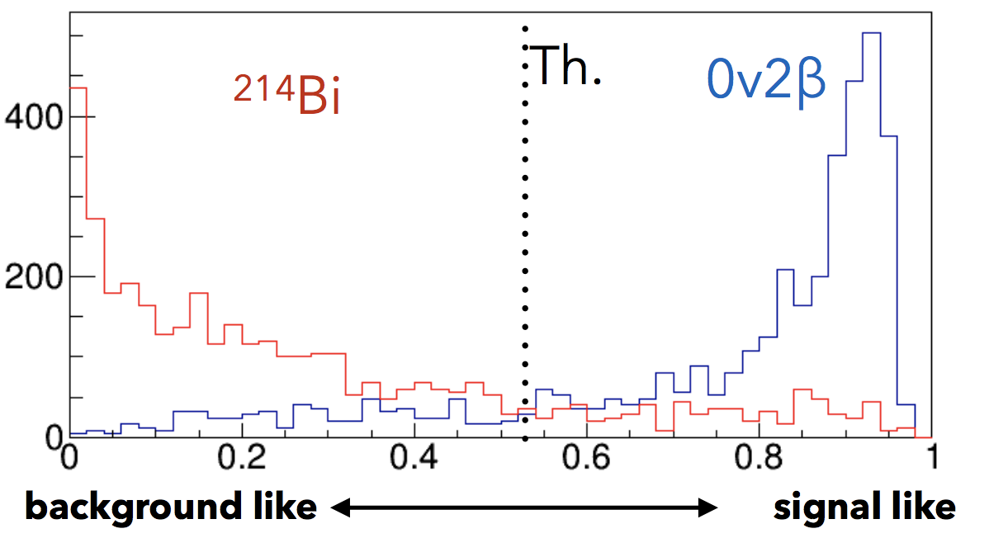
Future prospect
Topological information
- Deep Learning is one of the options
- Learning with simulation of 0νββ and gamma-ray
- Signal efficiency : 48.8% : BG : 75 evt/ye → 7.9 evt/yr (1 ton Xe)
(assuming 10 tons of pressure vessel made of Oxygen-free Cu)
- Estimated sensitivity : mββ = 37 meV (1 ton yr Xe)
XeSAT2018 at Waseda University, 19 Sep 2018

Slide 31
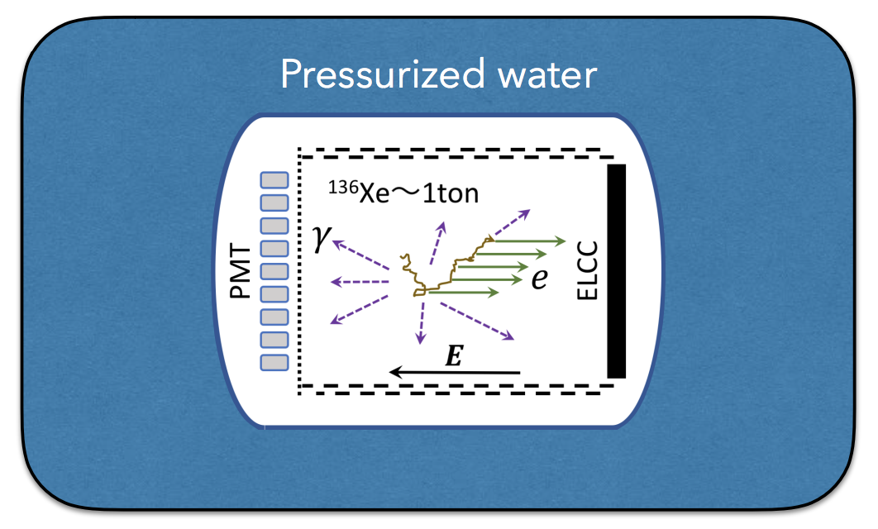
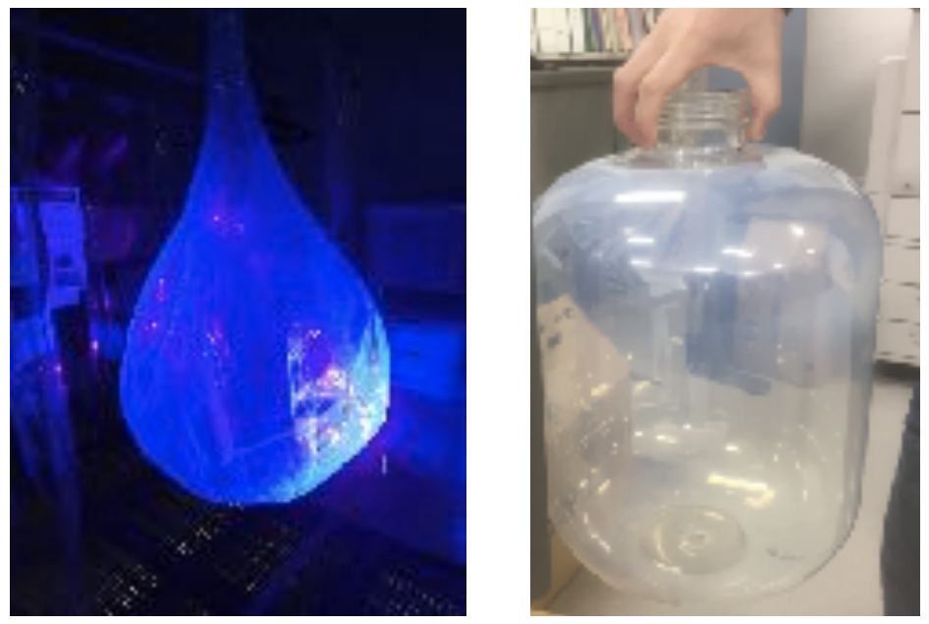
Future prospect
Further more…
- Pressurized water shield
- water Cherenkov can be used for muon veto
- thin pressure vessel to reduce mass → reduce ²¹⁴Bi BG
- Active shield vessel
- detects alpha and beta ray event of ²¹⁴Bi in the materials of vessel
Polyethylene Naphthalate
XeSAT2018 at Waseda University, 19 Sep 2018

Slide 32
Contents
AXEL experiments
Prototype detector (1) : 10 L prototype
Prototype detector (2) : 180 L prototype
Future prospect
Summary
XeSAT2018 at Waseda University, 19 Sep 2018

Slide 33
Summary
AXEL is high pressure gas Xe TPC for 0νββ decay search
- Cellular readout structure (ELCC) is characteristic of AXEL
Small (10L) prototype detector has constructed
- Demonstrate the performance of ELCC
- ⊿ E : 0.82 ~ 1.74 %(FWHM, extrapolated to Q-value) is estimated
Large (180L) prototype detector is now constructing
- Pressure vessel : Done
- ELCC : Design is done
- Field cage : Now, testing…
- Cockcroft-Wakton : Now, testing…
- Readout electronics : Prototype is done
Aiming to mββ = 20 meV with some ideas (e.g. Deep leaning)
XeSAT2018 at Waseda University, 19 Sep 2018

Slide 34
Backup
XeSAT2018 at Waseda University, 19 Sep 2018

Slide 35
Contents
AXEL experiments
Simulation study
Prototype detector (1) : 10 L prototype
Prototype detector (2) : 180 L prototype
Summary
XeSAT2018 at Waseda University, 19 Sep 2018

Slide 36
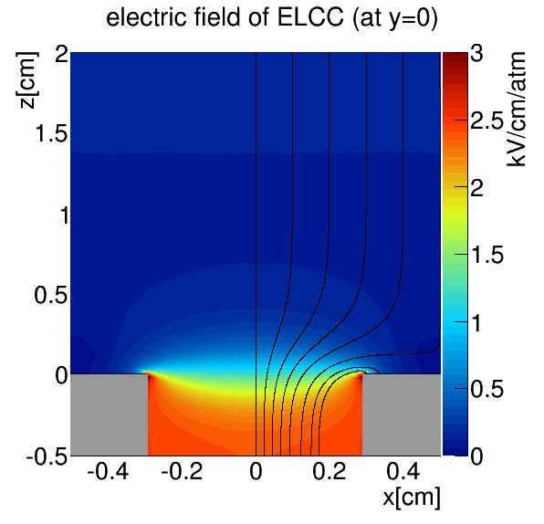
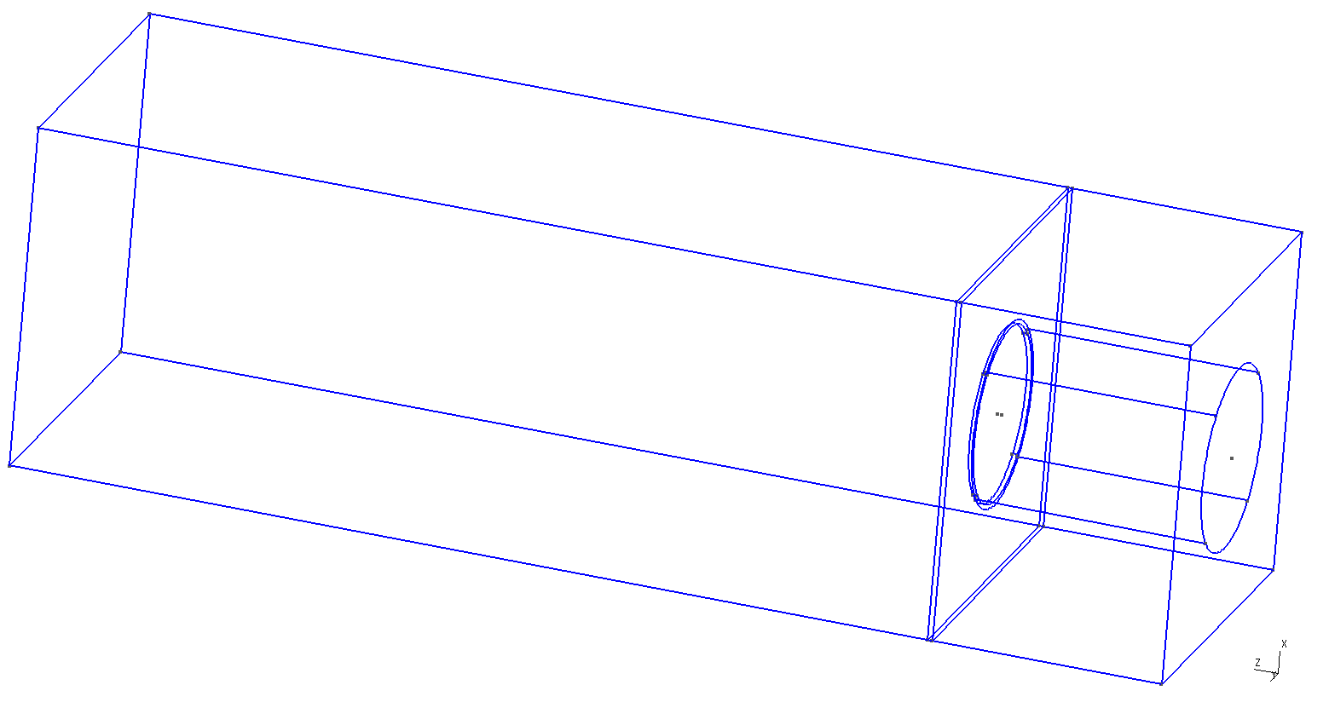
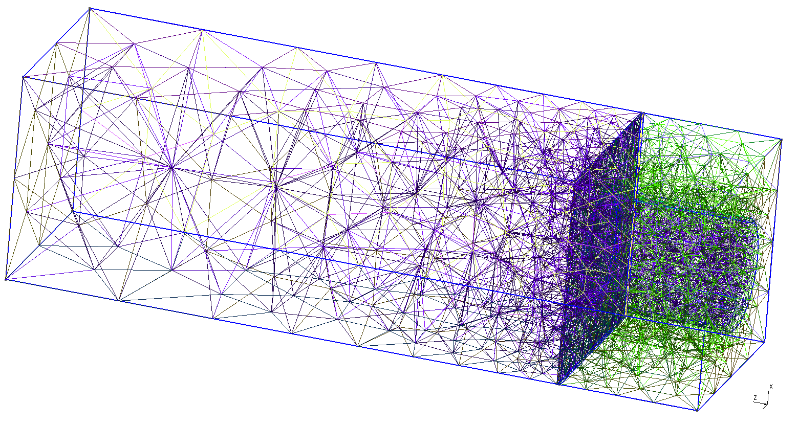
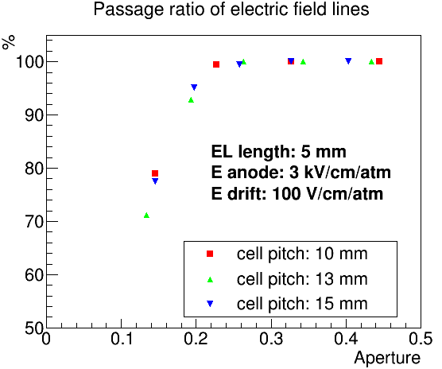
Simulation study
1.0cm
1.0cm
Collection efficiency
of electric field line
is checked by simulation
(gmsh + Elmer)
E_{drift}=100V/cm/atm
2cm
gmsh
elmer
0.6cm
E_{anode}=3kV/cm/atm
0.5cm
0.58cm
square
hexagonal
our design
XeSAT2018 at Waseda University, 19 Sep 2018

Slide 37
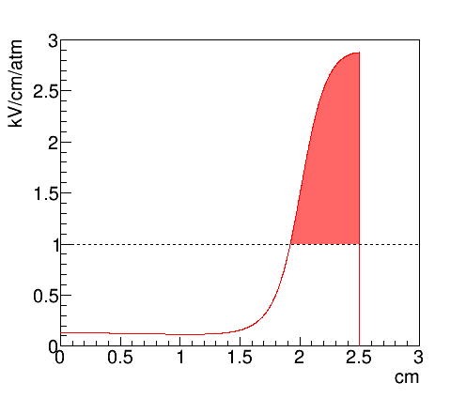
Simulation study
Electron track by Garfield++
Line of electric field
Electric field strength along the line
(red : EL region)
Generate EL lights by MC method
(reflect coefficient of PTFE : 60%)
XeSAT2018 at Waseda University, 19 Sep 2018

Slide 38
Uniformity of EL generation
Simulation study
EL Yield is proportional to [electric field strength] x [path length]
Uniformity : 1.4%
Since initial electron number is 1e5, effect on energy resolution will be 1.4%/√1e5 = 0.005%
Initial position dependence of EL yield
Electric field along the path
XeSAT2018 at Waseda University, 19 Sep 2018

Slide 39
Simulation study
Estimated energy resolution
Simulation process
0νββ event by Geant4
statistical fluctuation with fano factor
drift to the ELCC plane with diffusion
EL generation (6photon/e⁻)
Simulated energy resolution: 0.37%(FWHM)
ionizing process: 0.27%
EL process: 0.25%
Number of detected photons
Number of detected photons
XeSAT2018 at Waseda University, 19 Sep 2018

Slide 40
Contents
AXEL experiments
Simulation study
Prototype detector (1) : 10 L prototype
Prototype detector (2) : 180 L prototype
Summary
XeSAT2018 at Waseda University, 19 Sep 2018

Slide 41
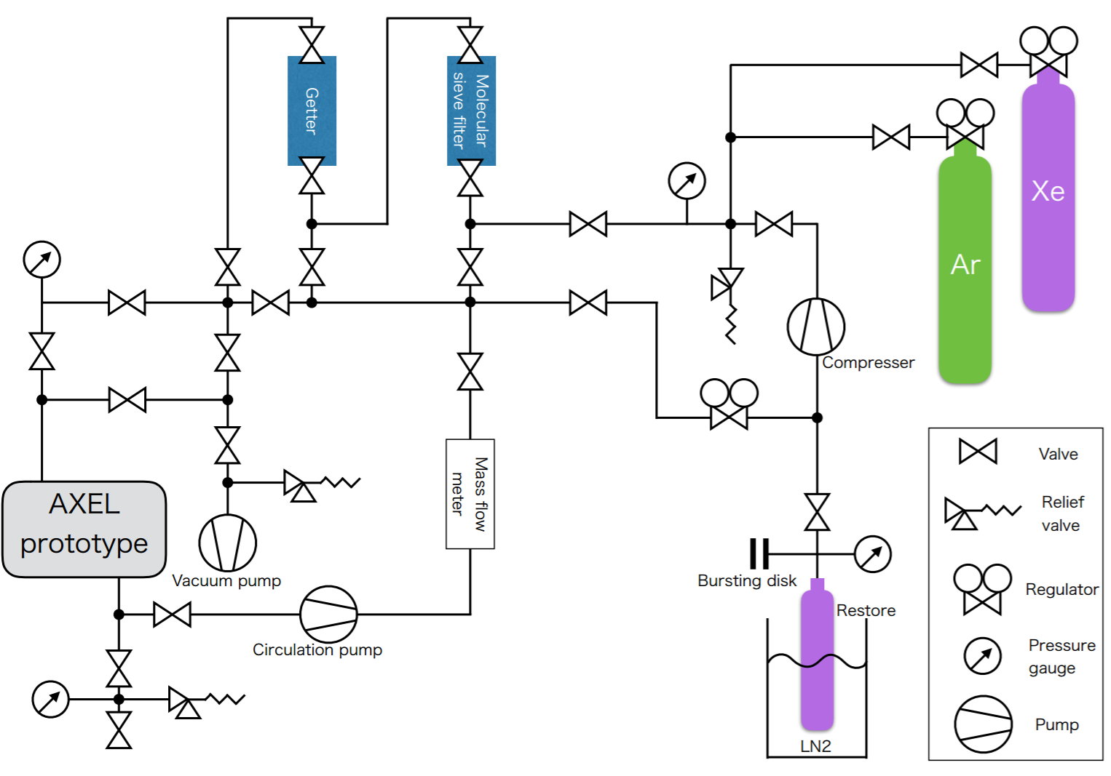
Prototype detector (1) : 10L prototype
Gas system
- circulation pump : PumpWorks PW2070
- SEAS micro torr MC1-902FV
- API GETTER-I Re
XeSAT2018 at Waseda University, 19 Sep 2018

Slide 42
Prototype detector (1) : 10L prototype
Data and Analysis
- Gas ： Xe 8 bar
- Edrift ：83 V/cm/bar
- EEL ：2.375 kV/cm/bar
- source : ¹³³Ba
- Fiducial cut
- Saturated event → cut
- Cell gain calibration
- MPPC saturation correction
etc……
30keV
30keV
Correction using 30 keV X-ray peak position
Details in the next page
30keV
276keV?
272keV?
302keV
356keV
81keV
326keV
51keV
XeSAT2018 at Waseda University, 19 Sep 2018

Slide 43
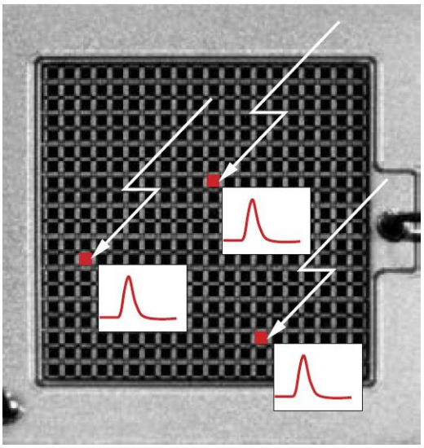
Prototype detector (1) : 10L prototype
MPPC saturation correction
- Signal is saturated as # of incident photons approaches the total number of pixel of MPPC
Schematic of MPPC signal
Voltage
two time constants
- saturation curve is determined by recovery
time of MPPC
- Measured recovery time of MPPC one by
one, and apply to analysis
XeSAT2018 at Waseda University, 19 Sep 2018

Slide 44
Contents
AXEL experiments
Prototype detector (1) : 10 L prototype
Prototype detector (2) : 180 L prototype
Future prospect
Summary
XeSAT2018 at Waseda University, 19 Sep 2018

Slide 45
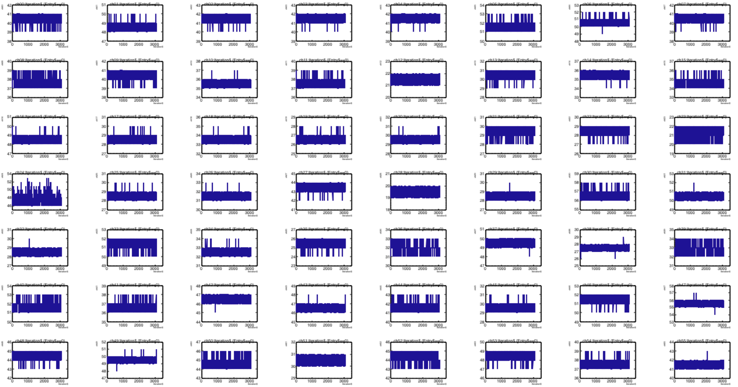
Prototype detector (2) : 180L prototype
Readout Electronics
- Succeed to readout waveform signals with both of ADCs
XeSAT2018 at Waseda University, 19 Sep 2018

Slide 46
Contents
AXEL experiments
Prototype detector (1) : 10 L prototype
Prototype detector (2) : 180 L prototype
Future prospect
Summary
XeSAT2018 at Waseda University, 19 Sep 2018

Slide 47
Future prospect
XeSAT2018 at Waseda University, 19 Sep 2018

