Slide 1
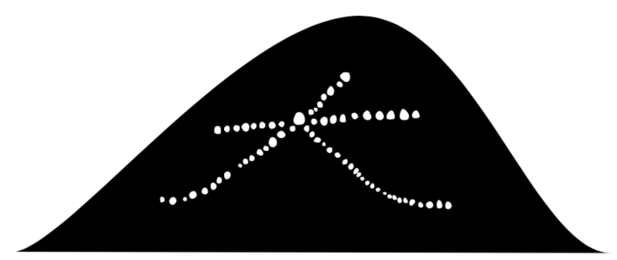
High pressure Xe gas TPC for 0νββ decay search :
Sei Ban
Kyoto University
For the AXEL collaboration

Slide 2
Contents
DBD18
21 Oct 2018
AXEL experiments
Prototype detector (1) : 10 L prototype
Prototype detector (2) : 180 L prototype
Future prospect
Summary

Slide 3
Contents
DBD18
21 Oct 2018
AXEL experiments
Prototype detector (1) : 10 L prototype
Prototype detector (2) : 180 L prototype
Future prospect
Summary

Slide 4
A Xe ElectroLuminescence : AXEL
DBD18
21 Oct 2018
High pressure Xe gas TPC with unique cell readout structure
for 0νββ decay search
Tracking
(BG rejection)
Readout Ionization signals
a few meters
● Electroluminescence (EL) process
photon
e
Atom
Scintillation
Ionization
electrons
PMT
Linear response to applied electric field
Without avalanche process
→ less fluctuation of multiplication
Details are in the next page
Φa few meters
ELCC plane
¹³⁶Xe 10 bar
Good energy resolution
Large mass
→ ton scale ¹³⁶Xe gas
150~200kV
→ goal : 0.5%FWHM @ Q-value

Slide 5
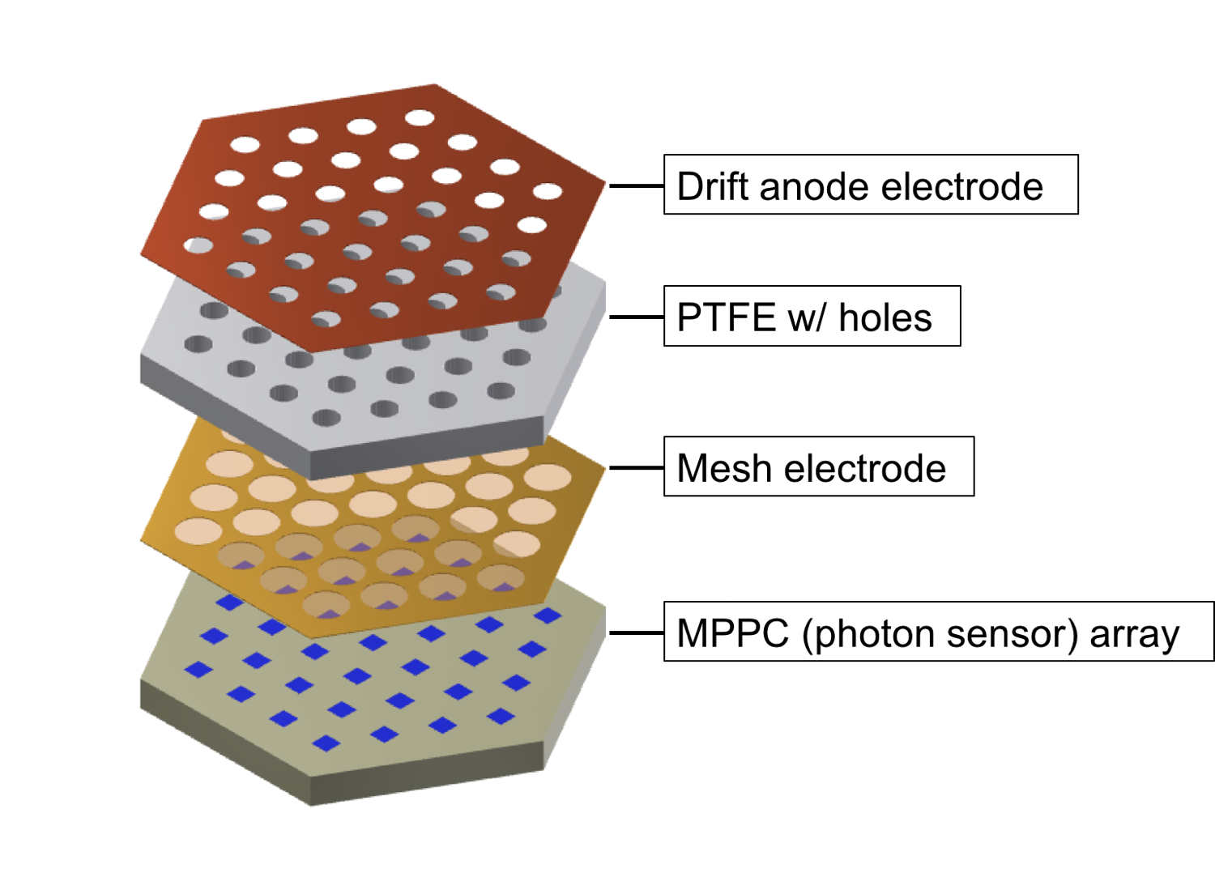
A Xe ElectroLuminescence : AXEL
DBD18
21 Oct 2018
Electroluminescence Light Collection Cell : ELCC
- Energy measurement and Tracking in each cells
- Uniform response to event position
- Extendable to large size because of its rigid structures
Ionization electrons are collected into cells
if EEL > EDrift , And converted into EL light
MPPC
e⁻
e⁻
e⁻
MPPC
e⁻
MPPC
EEL
EDrift
Simulation study of ELCC was done and presented
in XeSAT2017
( https://indico.cern.ch/event/573069/sessions/230066/attachments/1440275/2217034/kisekinakamura_20170405_XeSAT.pdf )

Slide 6
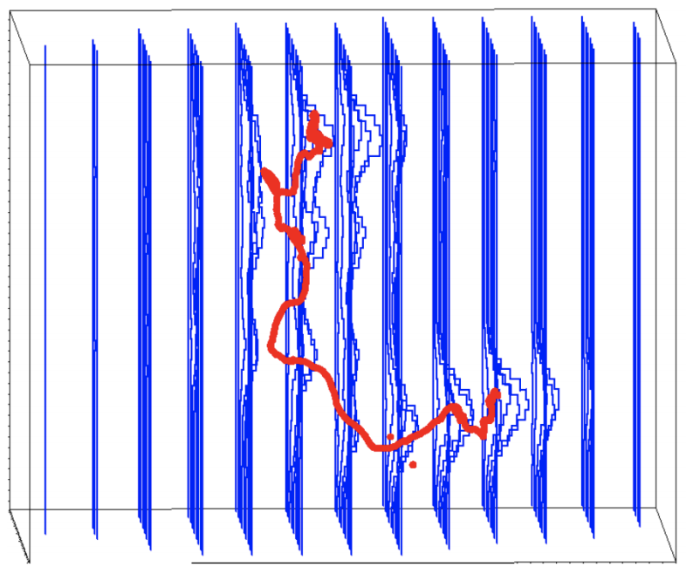
A Xe ElectroLuminescence : AXEL
DBD18
21 Oct 2018
Reconstruct the event topologies from
hit pattern and wave form
- α and multi-site events are easily removed
- Photo absorption of gamma events are
distinguished with Deep Learning (Later)
simulation
expected event displays
(simulation : 10 atm Xe, 15mm-pitch, 1MHz sampling)
Compton g-ray (2.5MeV)
0νββ
a-ray (2.5MeV)

Slide 7
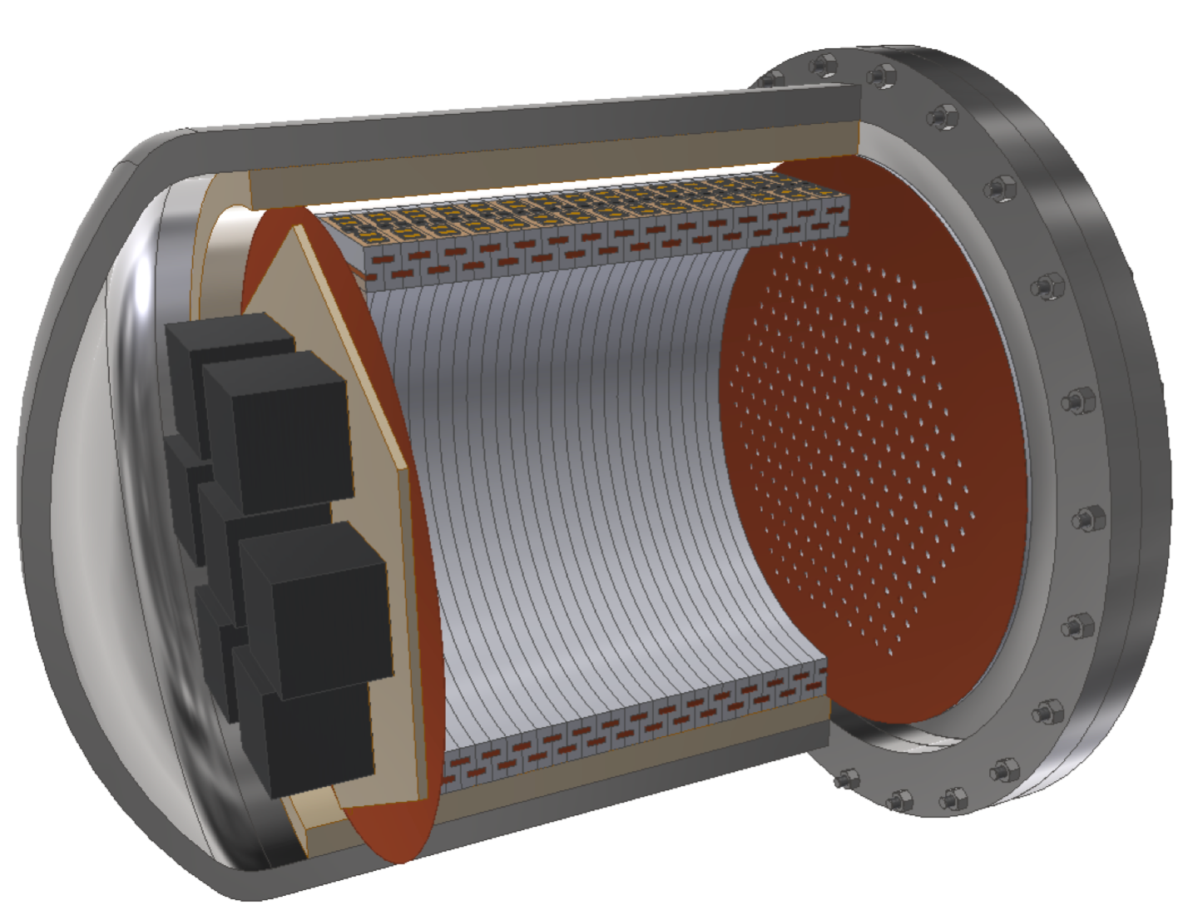
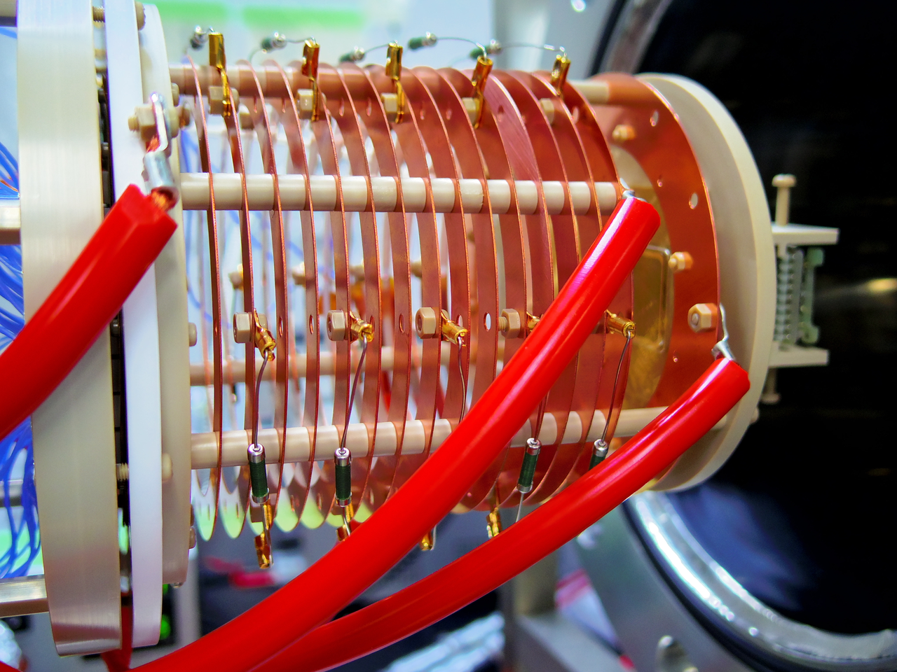
A Xe ElectroLuminescence : AXEL
DBD18
21 Oct 2018
Road map of the AXEL experiment
- Finish evaluation of the prototype detectors until 2020
- aiming to start physics run from 2021
202X ~
ton scale
- Discovery(?)
- sweep out IH
2018 ~
2021 ~
~ 100kg scale
2014~2018
~φ50cm
9cm
- Physics run
- World record
~50cm
φ10cm
- ~5.6kg Xe
- Know-how of enlargement
- Energy resolution study
(near the Q-value)
- Background study
- now, constructing
- ~0.08kg Xe
- Demonstrate the ELCC concept
- Energy resolution study
( 122keV, 356keV, 511keV )

Slide 8
Contents
DBD18
21 Oct 2018
AXEL experiments
Prototype detector (1) : 10 L prototype
Prototype detector (2) : 180 L prototype
Future prospect
Summary

Slide 9
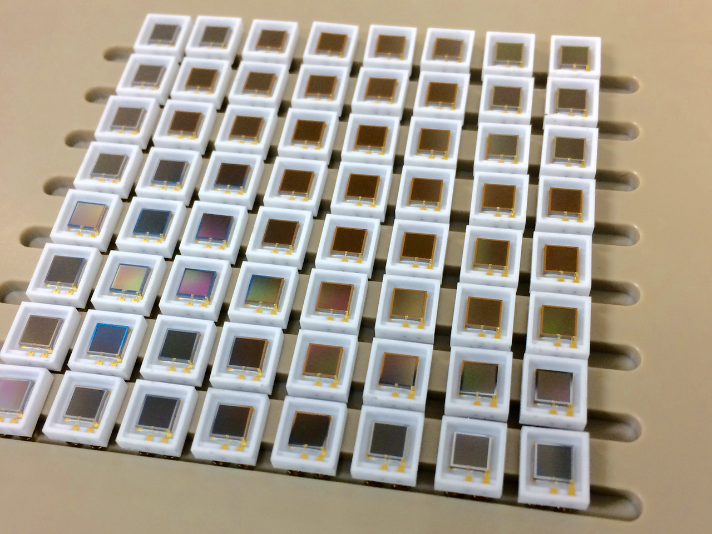
Prototype detector (1) : 10L prototype
DBD18
21 Oct 2018
Sensitive region : φ10cm × 9cm
# of channel : 64
Purpose : Demonstrate the performance of ELCC
Prototype detector
MPPCs
Sensitive to VUV light
9cm
5mm
7.5mm
φ10cm
PMTs
2.5cm

Slide 10
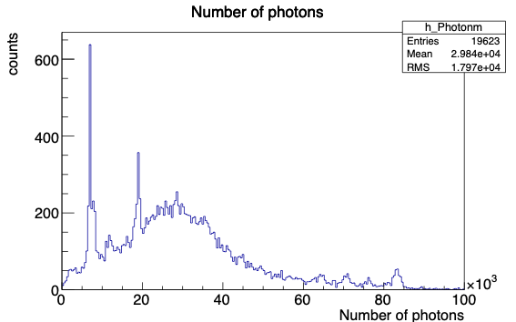
Prototype detector (1) : 10L prototype
DBD18
21 Oct 2018
Evaluated a performance of the prototype detector
using ¹³³Ba gamma-ray source (356keV)
- Gas ： Xe 8 bar
- Edrift ：83 V/cm/bar
- EEL ：2.375 kV/cm/bar
- source : ¹³³Ba
- Fitting by “ Σgaussian + ax+b” in low E region
- Fitting by “ Σgaussian + exp” in high E region
→ ⊿E : 2.54% FWHM at 356 keV
→ 0.97% FWHM at Q-value, extrapolated by √E
276keV
302keV
356keV
X-ray of Xenon
326keV
81keV
50keV

Slide 11
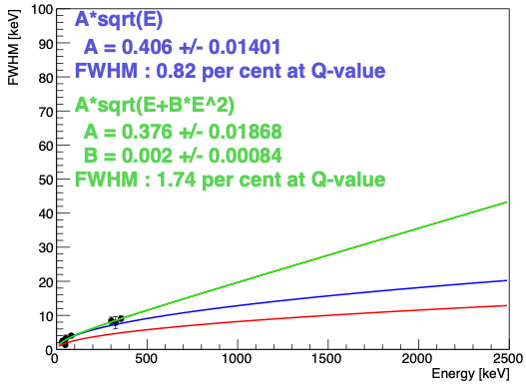
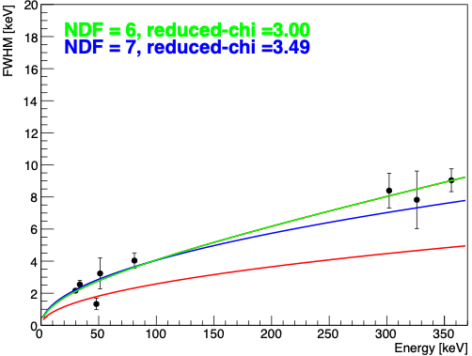
Prototype detector (1) : 10L prototype
DBD18
21 Oct 2018
Energy resolution at Q-value
- Estimated to 0.82 ~ 1.74 % FWHM at Q-value (2458keV)
- Simulation (Geant4) is also on-going to understand this result
Q-value
A = 0.376 +/- 0.0186
B = 0.002 +/- 0.0008
-> Extrapolate to Q-value
FWHM 1.74% (@2458keV)
A = 0.406 +/- 0.0140
-> Extrapolate to Q-value
FWHM 0.82% (@2458keV)
Target : 0.5% FWHM

Slide 12
Contents
DBD18
21 Oct 2018
AXEL experiments
Prototype detector (1) : 10 L prototype
Prototype detector (2) : 180 L prototype
Future prospect
Summary

Slide 13
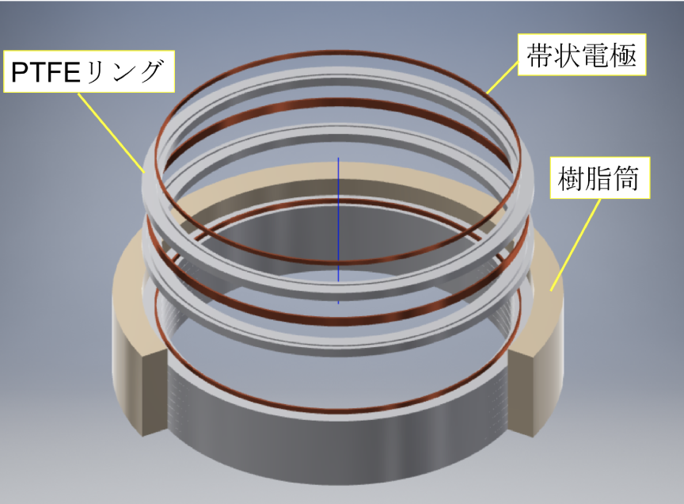
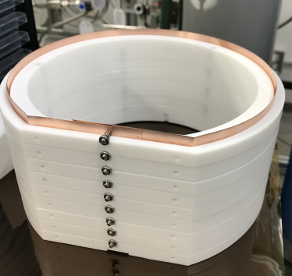
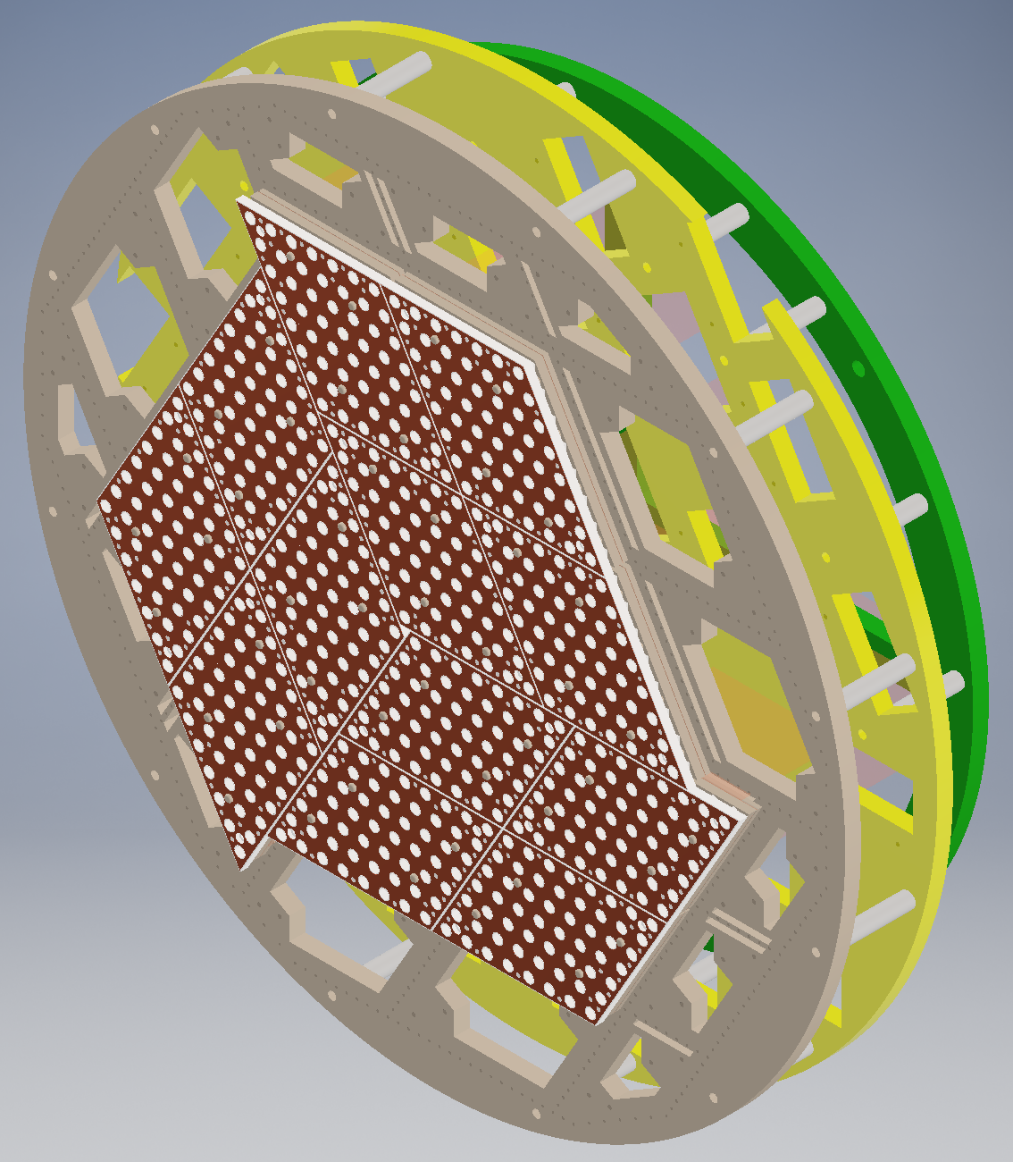
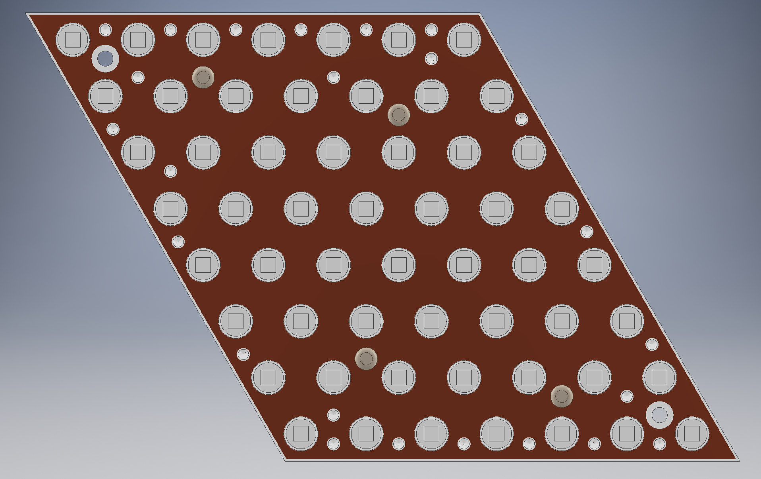
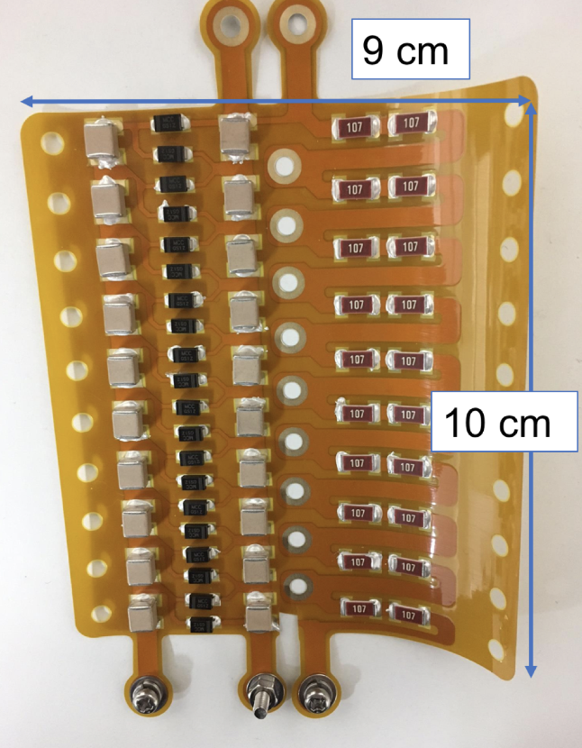
DBD18
21 Oct 2018
- Evaluation of energy resolution near the Q-value
- Now, constructing……
- Field Shaper
- Discharge resistant : embedded electrode, insulator
- increase scintillation light yield due to PTFE reflection
PTFE
Electrode
Insulator
- ELCC (readout structure of ionization signal)
- Prefabricated style → easily to extend
- Number of channels : ~1000 ch
- Design is almost fixed
- Cockcroft-walton
- Generate ~65kV
inside the vessel
- Low outgas (Polyimide)
unit
~φ50cm
~50cm
Polyimide
FPC

Slide 14
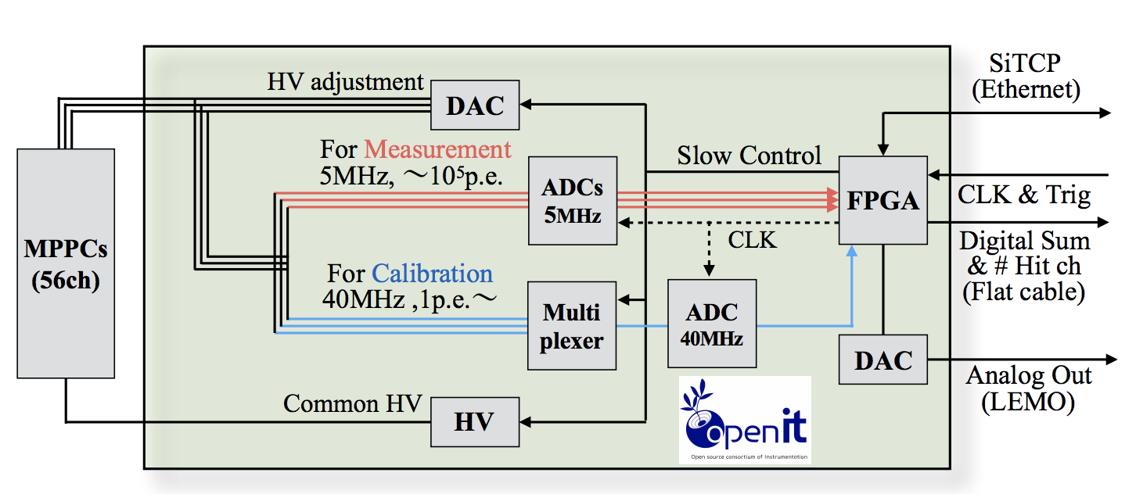
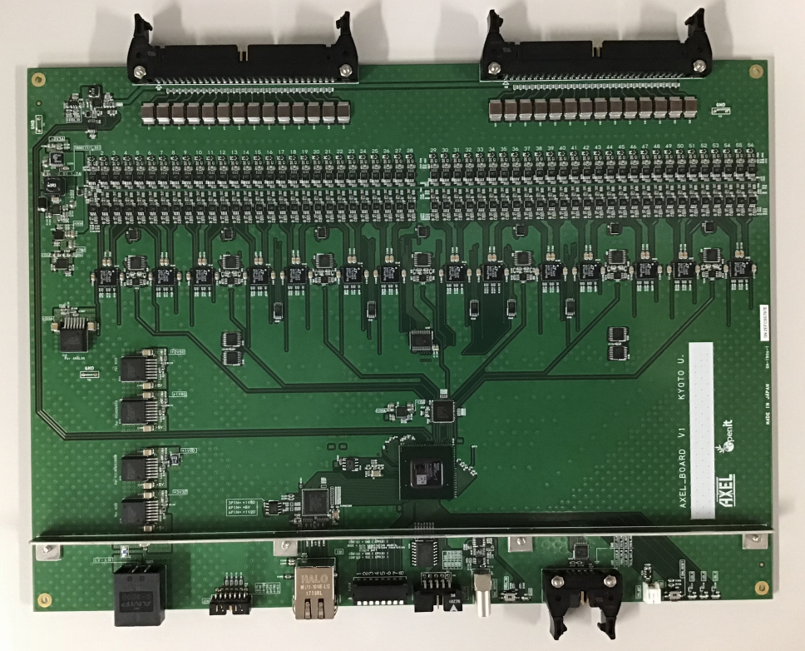
DBD18
21 Oct 2018
- Evaluation of energy resolution near the Q-value
- Now, constructing……
- Readout electronics
- Readout waveforms of MPPC : 56 ch/board
- Two Flash ADCs to achieve wide dynamic range : 1 p.e ~ 10⁴p.e
- High Voltage supply to MPPCs (in the 0.2mV)
- Monitor MPPC gain constantly
→ adjust (feedback) gain in 0.25% accuracy
- Low cost

Slide 15
Contents
DBD18
21 Oct 2018
AXEL experiments
Prototype detector (1) : 10 L prototype
Prototype detector (2) : 180 L prototype
Future prospect
Summary

Slide 16
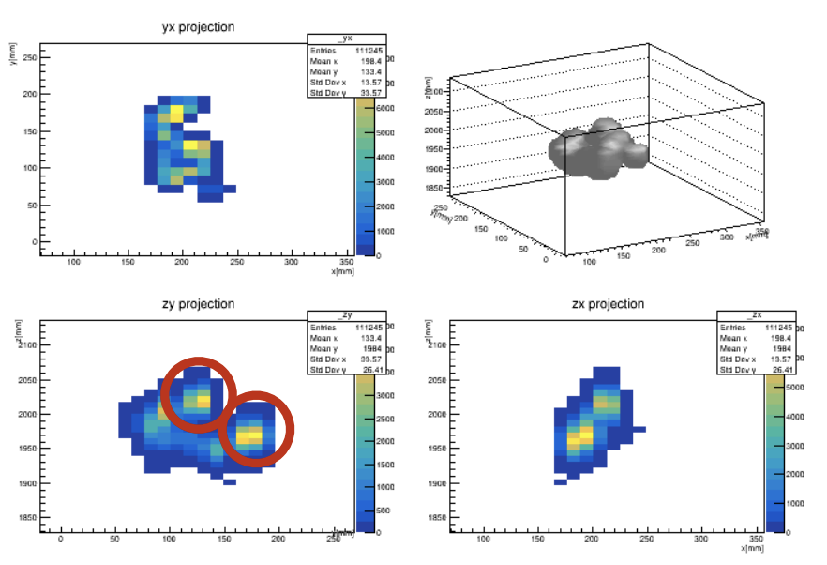
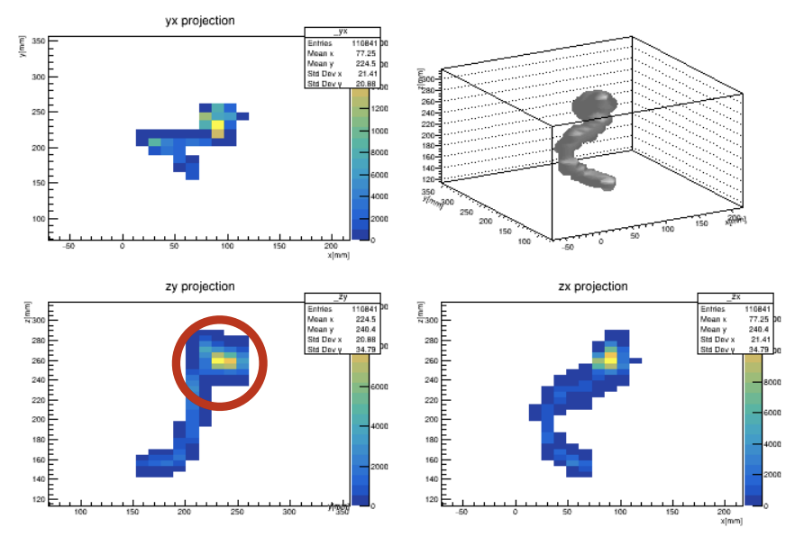
Future prospect
DBD18
21 Oct 2018
- Gamma-ray with photoelectric absorption event will be a serious BG
- Topological information
- 0νββ decay has two blobs
- Photoelectric absorption of gamma event only has one blob
→ To Identify two blobs is very powerful strategy
0νββ
Gamma-ray
(simulation)
(simulation)

Slide 17
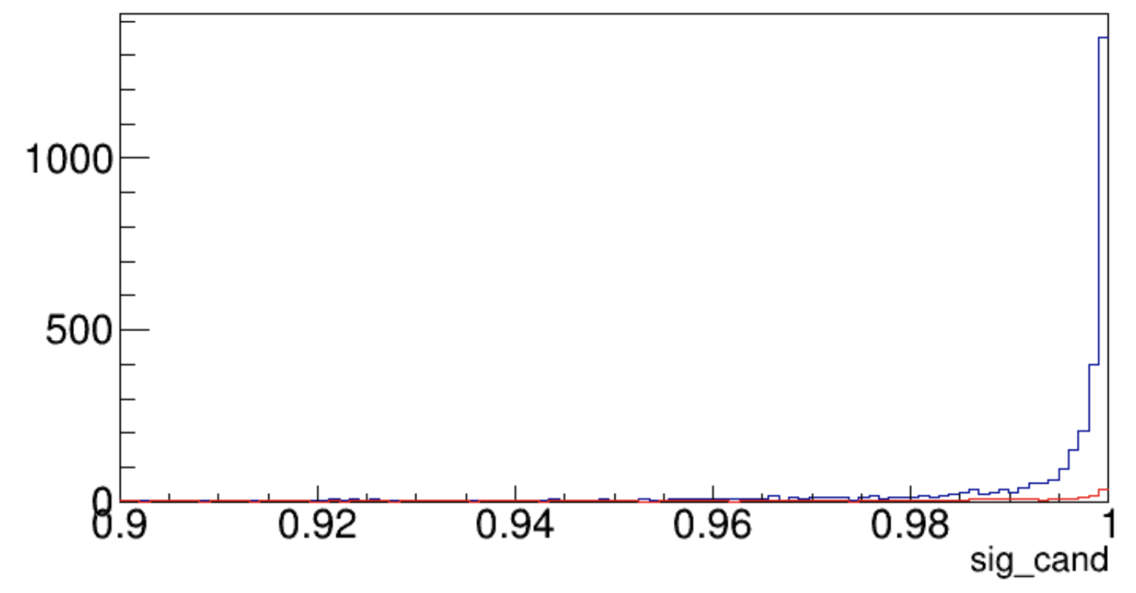
Future prospect
DBD18
21 Oct 2018
Topological information
- Deep Learning(DL) is one of the options
- Learning with simulation of 0νββ and gamma-ray
- Pitch of readout cell is variable to optimization (performance vs costs…)
- Signal efficiency : 41% : BG : 121 evt/yr → 3.2 evt/yr w/ DL (1 ton Xe)
(assuming 10 tons of pressure vessel made of Oxygen-free Cu, 10mm-pitch readout)
- Estimated sensitivity : mββ = 32 meV (1 ton yr Xe, 10 mm-pitch)
signal
Gamma(BG)

Slide 18
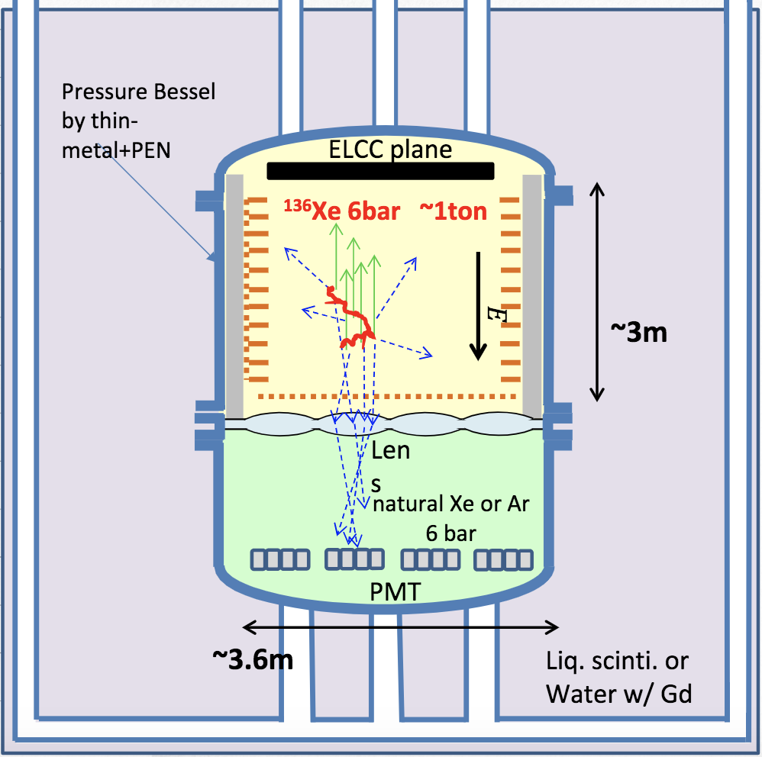
Future prospect
DBD18
21 Oct 2018
More ideas…
- Timing information of scintillation
- color represents the timing (ideal case)
0νββ Gamma
- in real case, it will be more complicated
due to
- depth of field
- time constant of scintillation etc…
- Thin, active vessel
- reduce ²¹⁴Bi : thin
- detect α from ²¹⁴Po : active
→ coincidence of Bi-Po

Slide 19
Contents
DBD18
21 Oct 2018
AXEL experiments
Prototype detector (1) : 10 L prototype
Prototype detector (2) : 180 L prototype
Future prospect
Summary

Slide 20
Summary
DBD18
21 Oct 2018
AXEL is high pressure gas Xe TPC for 0νββ decay search
- Cellular readout structure (ELCC) is characteristic of AXEL
Small (10L) prototype detector has constructed
- Demonstrate the performance of ELCC
- ⊿ E : 0.82 ~ 1.74 %(FWHM, extrapolated to Q-value) is estimated
Large (180L) prototype detector is now constructing
- To demonstrate the performance of AXEL detector at near the Q-value
- To get the know-how to enlargement our detector
Aiming to mββ = 20 meV with some ideas
- e.g. Deep leaning, timing information, thin (active) vessel

Slide 21
Thank you

Slide 22
Backup
DBD18 at Hilton Waikoloa village, Hawaii, 21 Oct 2018

Slide 23
Members
Shuhei Obara
T.Nakadaira
DBD18 at Hilton Waikoloa village, Hawaii, 21 Oct 2018

Slide 24
Introduction : Neutrinoless Double Beta Decay (0νββ decay)
It occurs only if the neutrino has Majorana mass term
2νββ decay
0νββ decay
If the neutrino is Majorana ……
- naturally explains the smallness of the neutrino mass
- One of the conditions of Leptogenesis story
DBD18 at Hilton Waikoloa village, Hawaii, 21 Oct 2018

Slide 25
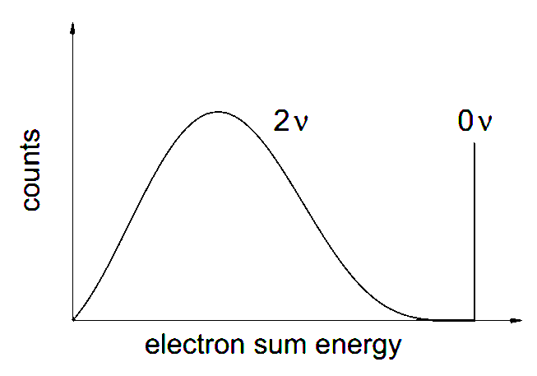
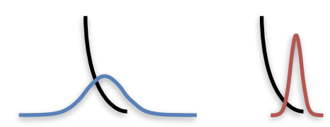
Introduction : Neutrinoless Double Beta Decay (0νββ decay)
To discovery 0νββ decay ……
Large target mass
Energy
resolution
Low BG
(BG rejection)
Pioneering work by the NEXT experiment group demonstrated usability of high pressure xenon gas time projection chamber (TPC) for 0νββ decay search
DBD18 at Hilton Waikoloa village, Hawaii, 21 Oct 2018

Slide 26
Contents
AXEL experiments
Simulation study
Prototype detector (1) : 10 L prototype
Prototype detector (2) : 180 L prototype
Summary
DBD18 at Hilton Waikoloa village, Hawaii, 21 Oct 2018

Slide 27
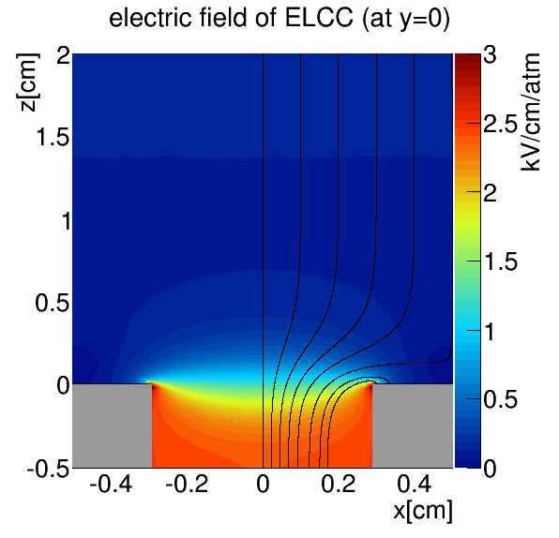
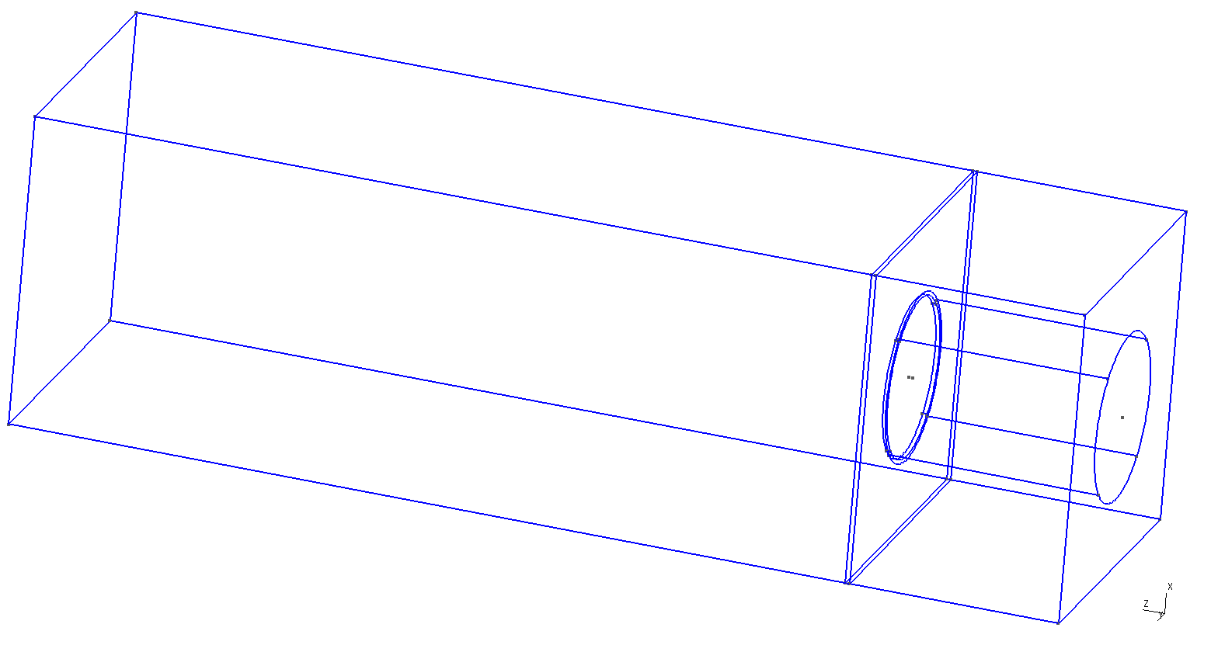
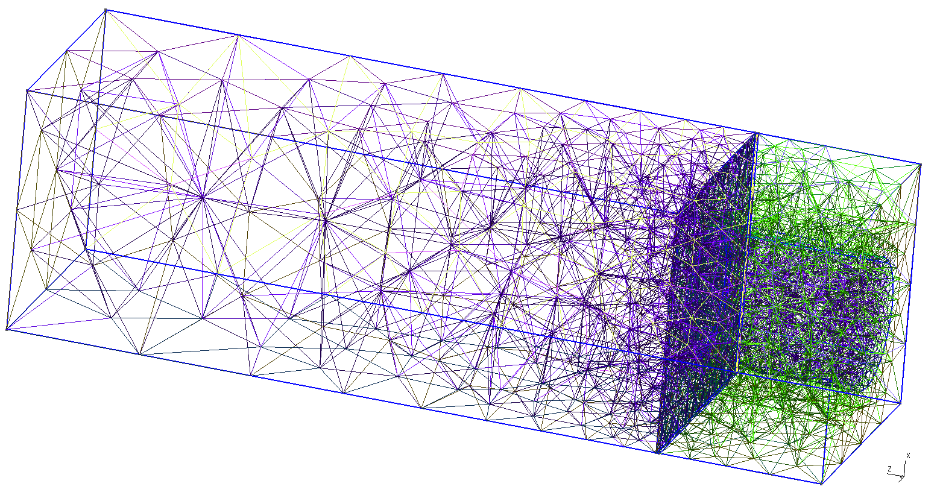
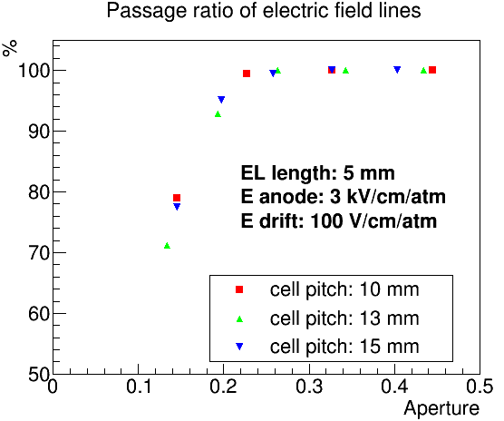
Simulation study
1.0cm
1.0cm
Collection efficiency
of electric field line
is checked by simulation
(gmsh + Elmer)
E_{drift}=100V/cm/atm
2cm
gmsh
elmer
0.6cm
E_{anode}=3kV/cm/atm
0.5cm
0.58cm
square
hexagonal
our design
DBD18 at Hilton Waikoloa village, Hawaii, 21 Oct 2018

Slide 28
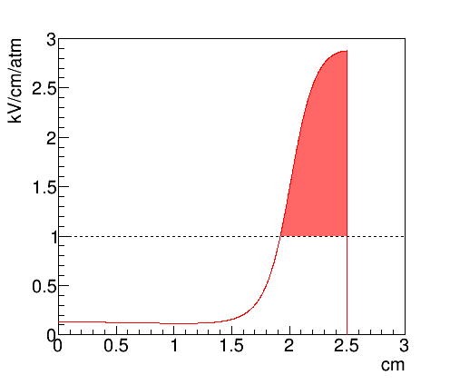
Simulation study
Electron track by Garfield++
Line of electric field
Electric field strength along the line
(red : EL region)
Generate EL lights by MC method
(reflect coefficient of PTFE : 60%)
DBD18 at Hilton Waikoloa village, Hawaii, 21 Oct 2018

Slide 29
Uniformity of EL generation
Simulation study
EL Yield is proportional to [electric field strength] x [path length]
Uniformity : 1.4%
Since initial electron number is 1e5, effect on energy resolution will be 1.4%/√1e5 = 0.005%
Initial position dependence of EL yield
Electric field along the path
DBD18 at Hilton Waikoloa village, Hawaii, 21 Oct 2018

Slide 30
Simulation study
Estimated energy resolution
Simulation process
0νββ event by Geant4
statistical fluctuation with fano factor
drift to the ELCC plane with diffusion
EL generation (6photon/e⁻)
Simulated energy resolution: 0.37%(FWHM)
ionizing process: 0.27%
EL process: 0.25%
Number of detected photons
Number of detected photons
DBD18 at Hilton Waikoloa village, Hawaii, 21 Oct 2018

Slide 31
Contents
AXEL experiments
Simulation study
Prototype detector (1) : 10 L prototype
Prototype detector (2) : 180 L prototype
Summary
DBD18 at Hilton Waikoloa village, Hawaii, 21 Oct 2018

Slide 32
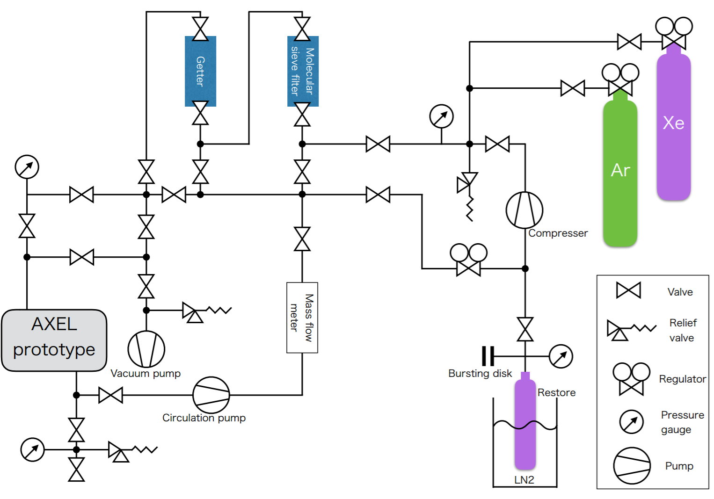
Prototype detector (1) : 10L prototype
Gas system
- circulation pump : PumpWorks PW2070
- SEAS micro torr MC1-902FV
- API GETTER-I Re
DBD18 at Hilton Waikoloa village, Hawaii, 21 Oct 2018

Slide 33
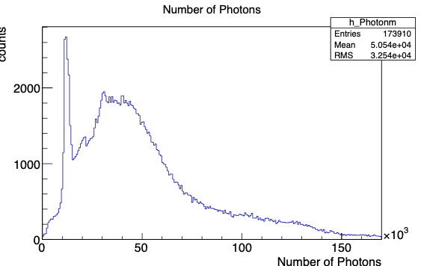
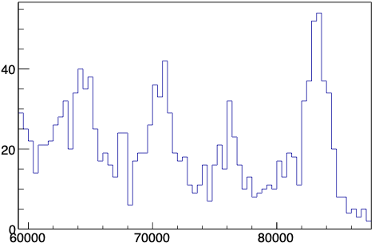
Prototype detector (1) : 10L prototype
Data and Analysis
- Gas ： Xe 8 bar
- Edrift ：83 V/cm/bar
- EEL ：2.375 kV/cm/bar
- source : ¹³³Ba
- Fiducial cut
- Saturated event → cut
- Cell gain calibration
- MPPC saturation correction
etc……
30keV
30keV
Correction using 30 keV X-ray peak position
Details in the next page
30keV
276keV?
272keV?
302keV
356keV
81keV
326keV
51keV
XeSAT2018 at Waseda University, 19 Sep 2018

Slide 34
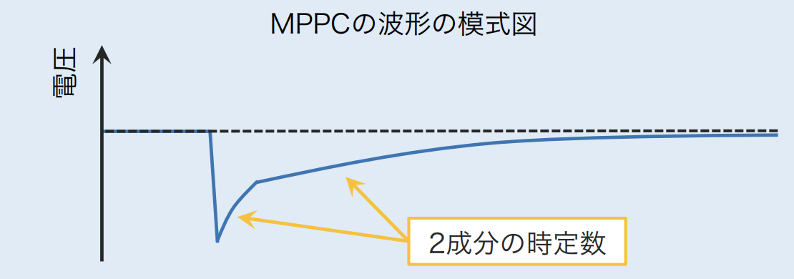
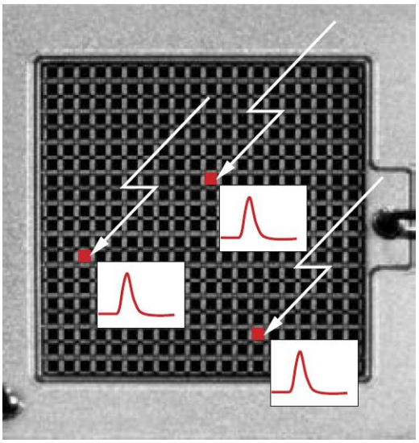
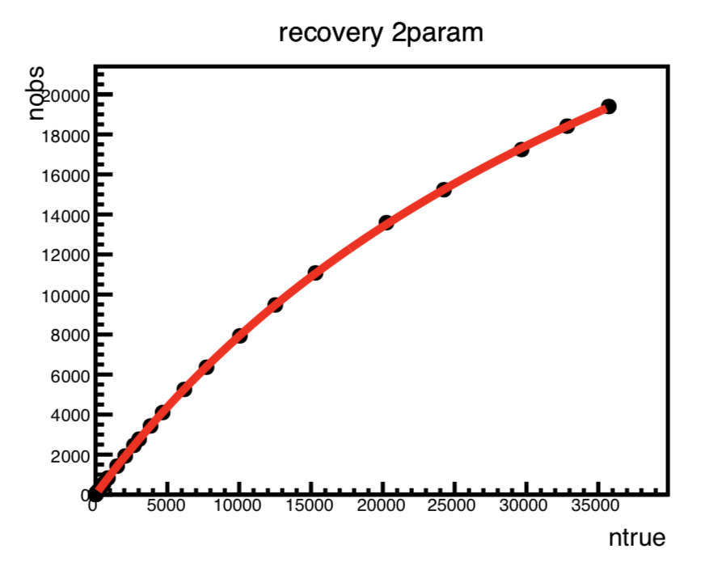
Prototype detector (1) : 10L prototype
MPPC saturation correction
- Signal is saturated as # of incident photons approaches the total number of pixel of MPPC
Schematic of MPPC signal
Voltage
two time constants
- saturation curve is determined by recovery
time of MPPC
- Measured recovery time of MPPC one by
one, and apply to analysis
DBD18 at Hilton Waikoloa village, Hawaii, 21 Oct 2018

Slide 35
Prototype detector (1) : 10L prototype
Data and Analysis
- Gas ： Xe 8 bar
- Edrift ：83 V/cm/bar
- EEL ：2.375 kV/cm/bar
- source : ¹³³Ba
- Fiducial cut
- Saturated events → cut
- Cell gain calibration
- MPPC saturation correction
etc……
30keV
30keV
Correction using 30 keV X-ray peak position
MPPC signal saturate as # of incident photons increases
- saturation curve is characterized by
MPPC recovery time
- measured recovery time one by one
→ apply to
correction
30keV
302keV
356keV
272keV?
326keV
81keV
51keV
Schematic of MPPC signal
Voltage
two time constants

Slide 36
Prototype detector (1) : 10L prototype
Fitting of the histogram
-
- Fitting by “ Σgaussian + ax+b” in low E region
- Fitting by “ Σgaussian + exp” in high E region
→ ⊿E : 2.54% FWHM at 356 keV
→ 0.97% FWHM at Q-value, extrapolated by √E
X-ray of Xenon
276keV
302keV
356keV
326keV
81keV
50keV
DBD18 at Hilton Waikoloa village, Hawaii, 21 Oct 2018

Slide 37
Contents
AXEL experiments
Prototype detector (1) : 10 L prototype
Prototype detector (2) : 180 L prototype
Future prospect
Summary
DBD18 at Hilton Waikoloa village, Hawaii, 21 Oct 2018

Slide 38
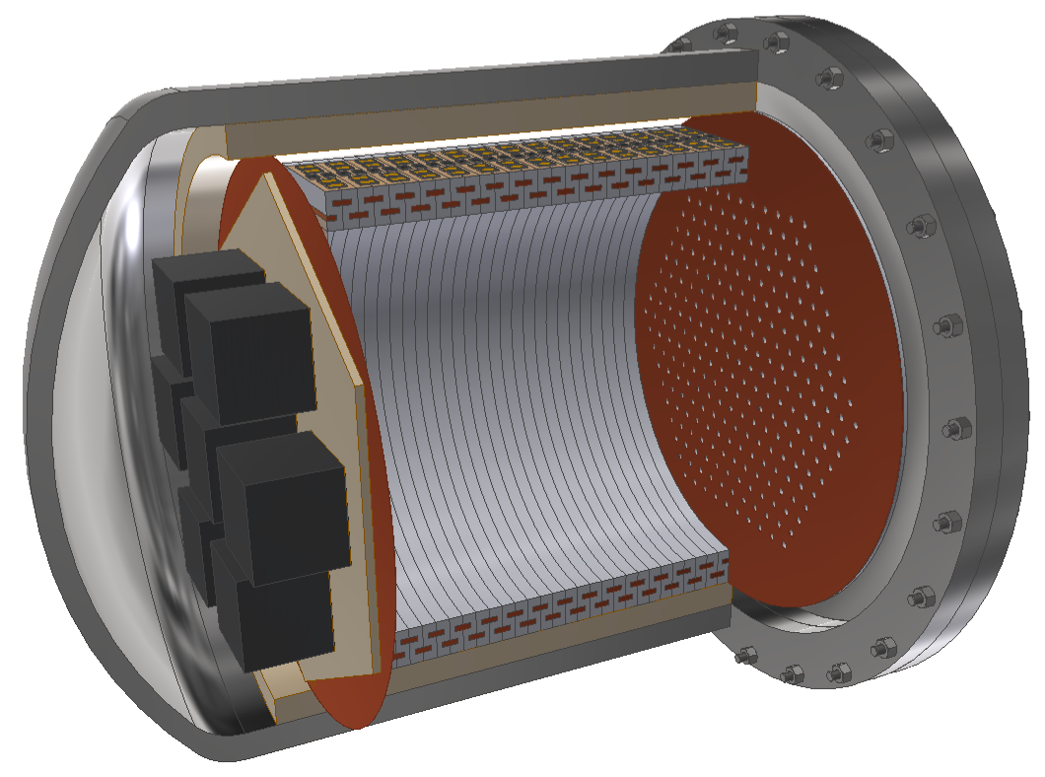
Prototype detector (2) : 180L prototype
- Evaluation of energy resolution near the Q-value
- Now, constructing……
Cockcroft-Walton for HV
ELCC
Readout electronics
Pressure vessel
Field cage
DBD18 at Hilton Waikoloa village, Hawaii, 21 Oct 2018

Slide 39
Prototype detector (2) : 180L prototype
- Evaluation of energy resolution near the Q-value
- Now, constructing……
Cockcroft-Walton for HV
ELCC
Readout electronics
Pressure vessel
Field cage
DBD18 at Hilton Waikoloa village, Hawaii, 21 Oct 2018

Slide 40
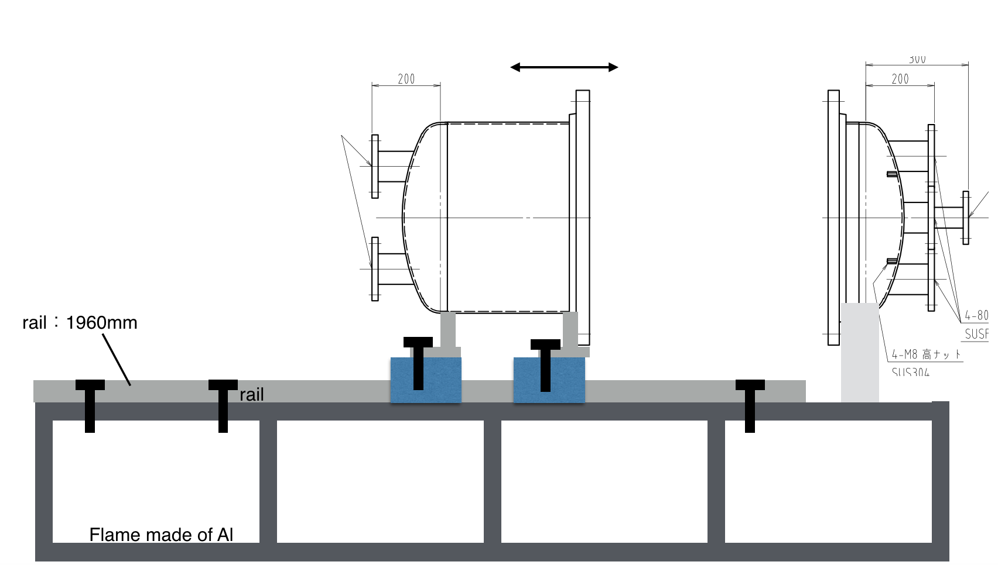
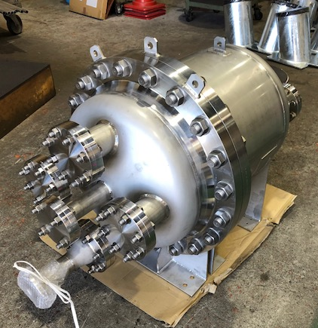
Prototype detector (2) : 180L prototype
Pressure vessel
- SUS304L
- Volume : ~180L (Sensitive Volume : ~100L)
- Now, ready !
DBD18 at Hilton Waikoloa village, Hawaii, 21 Oct 2018

Slide 41
Prototype detector (2) : 180L prototype
- Evaluation of energy resolution near the Q-value
- Now, constructing……
Cockcroft-Walton for HV
ELCC
Readout electronics
Pressure vessel
Field cage
DBD18 at Hilton Waikoloa village, Hawaii, 21 Oct 2018

Slide 42
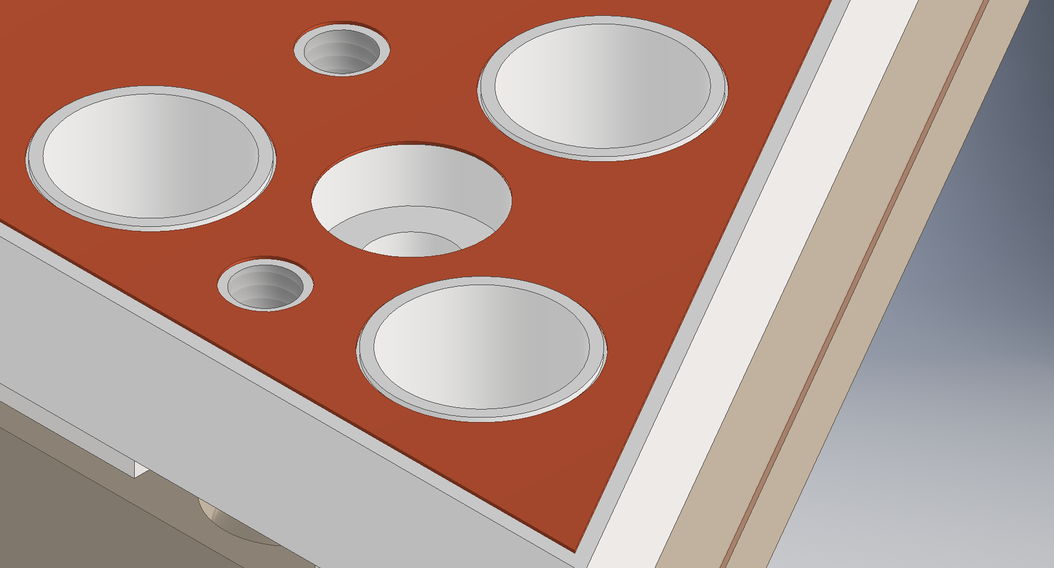
Prototype detector (2) : 180L prototype
ELCC
- Prefabricated style → easily to extend
- Number of channels : ~1000 ch
- Design is almost fixed
unit
DBD18 at Hilton Waikoloa village, Hawaii, 21 Oct 2018

Slide 43
Prototype detector (2) : 180L prototype
- Evaluation of energy resolution near the Q-value
- Now, constructing……
Cockcroft-Walton for HV
ELCC
Readout electronics
Pressure vessel
Field cage
DBD18 at Hilton Waikoloa village, Hawaii, 21 Oct 2018

Slide 44
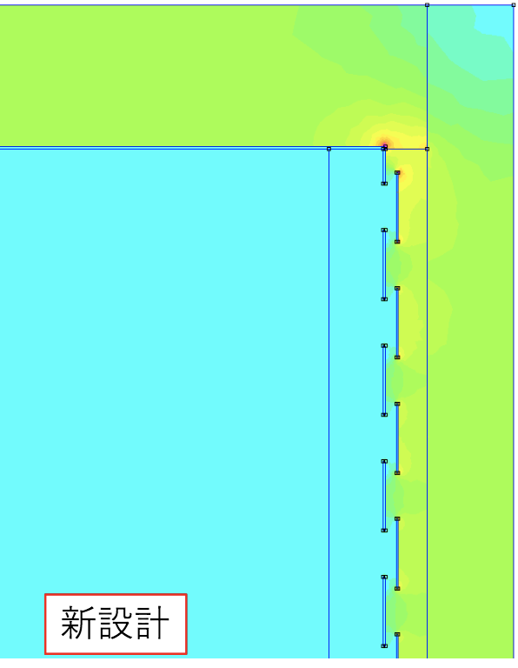
Prototype detector (2) : 180L prototype
Field cage
- Alignment drift field by strip electrodes
- Reflecting scintillation photons by PTFE
- Withstand discharge structure
- Uniformity of Field strength is checked by FEM simulation
- Now, testing with 10L prototype detector
PTFE
Electrode
Insulator
Electric field
Electric field simulation by FEM
DBD18 at Hilton Waikoloa village, Hawaii, 21 Oct 2018

Slide 45
Prototype detector (2) : 180L prototype
- Evaluation of energy resolution near the Q-value
- Now, constructing……
Cockcroft-Walton for HV
ELCC
Readout electronics
Pressure vessel
Field cage
DBD18 at Hilton Waikoloa village, Hawaii, 21 Oct 2018

Slide 46
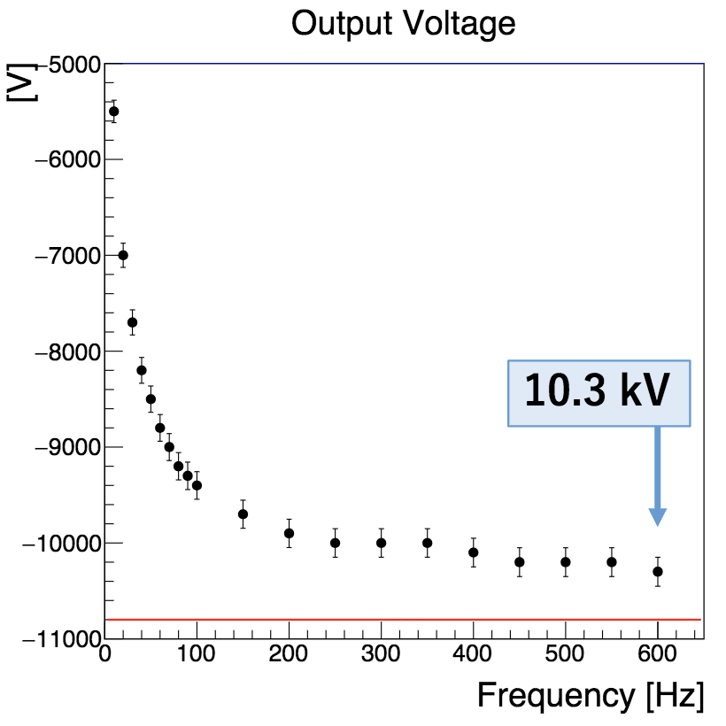
Prototype detector (2) : 180L prototype
Introduce low voltage into chamber and boost by Cockcroft-Wakton
inside the chamber to avoid discharge at feedthrough
- Low outgas due to Polyimide
- succeed to generate 10kV with a prototype
Input amplitude : 540 V
DBD18 at Hilton Waikoloa village, Hawaii, 21 Oct 2018

Slide 47
Prototype detector (2) : 180L prototype
- Evaluation of energy resolution near the Q-value
- Now, constructing……
Cockcroft-Walton for HV
ELCC
Readout electronics
Pressure vessel
Field cage
DBD18 at Hilton Waikoloa village, Hawaii, 21 Oct 2018

Slide 48
Prototype detector (2) : 180L prototype
Readout Electronics
- Readout waveforms of MPPC : 56 ch/board
- Two Flash ADCs to achieve wide dynamic range : 1 p.e ~ 10⁴p.e
- High Voltage supply to MPPCs (in the 0.2mV)
- Monitor MPPC gain constantly
→ adjust (feedback) gain in 0.25% accuracy
- Low cost
DBD18 at Hilton Waikoloa village, Hawaii, 21 Oct 2018

Slide 49
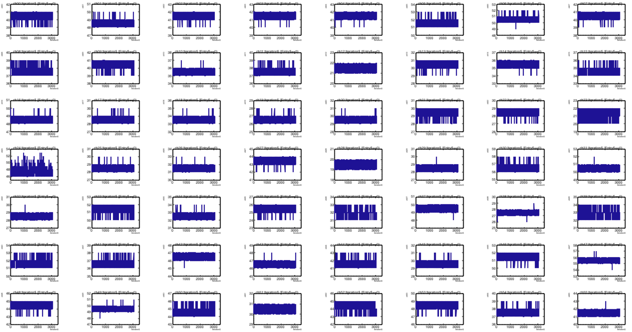
Prototype detector (2) : 180L prototype
Readout Electronics
- Succeed to readout waveform signals with both of ADCs
DBD18 at Hilton Waikoloa village, Hawaii, 21 Oct 2018

Slide 50
Contents
AXEL experiments
Prototype detector (1) : 10 L prototype
Prototype detector (2) : 180 L prototype
Future prospect
Summary
DBD18 at Hilton Waikoloa village, Hawaii, 21 Oct 2018

Slide 51
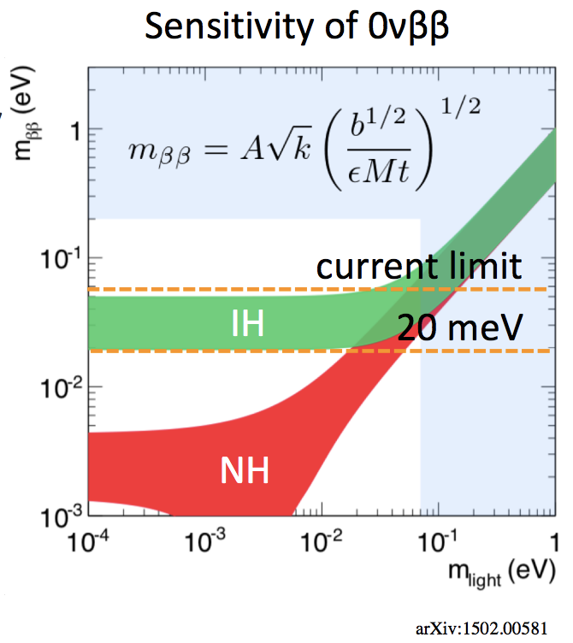
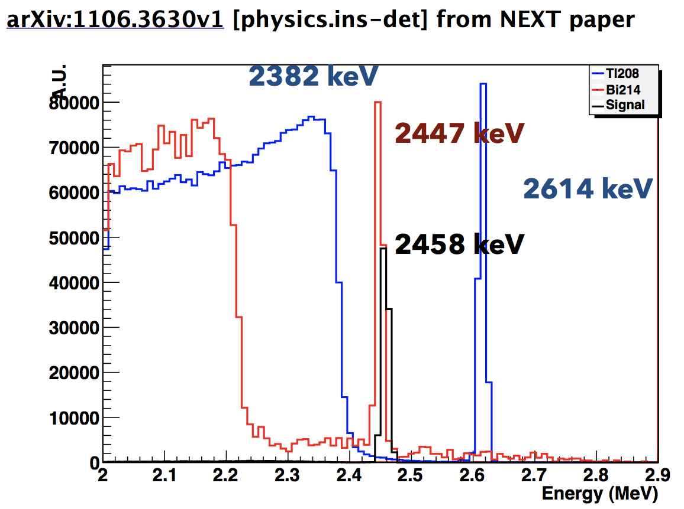
Future prospect
Sensitivity estimation for 1 ton detector
- Need to reach mββ = 20 meV
- Background free is required
- ²¹⁴Bi (2447 keV) is serious BG source
- Main source : Pressure vessel (~10 ton)
- Even if we use oxygen-free copper
2.9 ppt ²¹⁴Bi (cf. EXO-200)
→ 75 event/year for 1 ton detector
arXiv.1502.00581
DBD18 at Hilton Waikoloa village, Hawaii, 21 Oct 2018

Slide 52
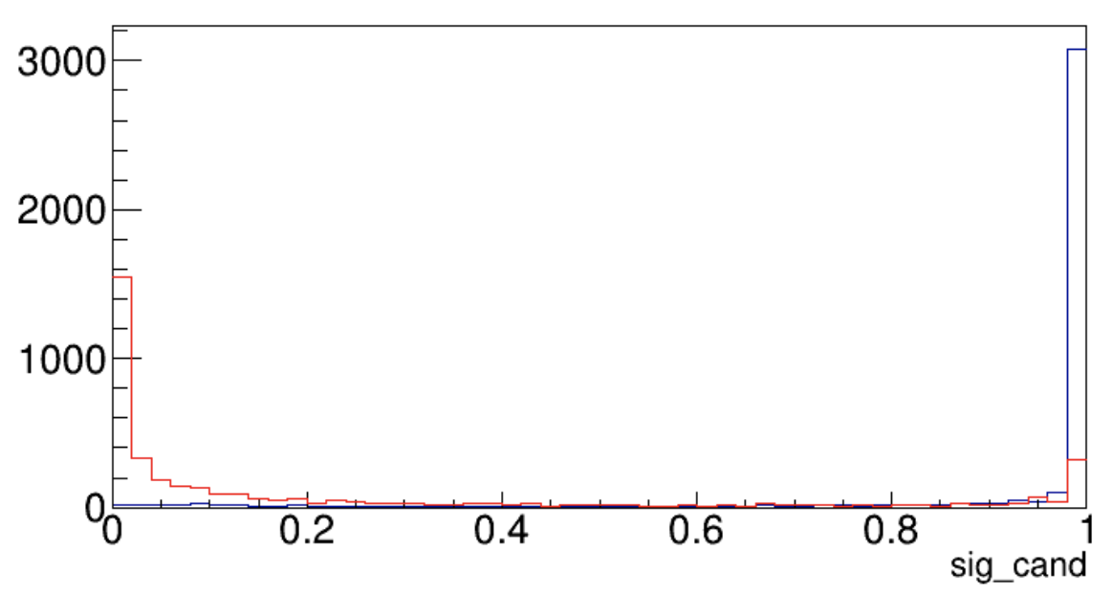
Future prospect
DBD18
21 Oct 2018
Topological information
- Deep Learning is one of the options
- Learning with simulation of 0νββ and gamma-ray
- Pitch of readout cell is variable to optimization (performance vs costs…)
- Signal efficiency : 41% : BG : 121 evt/yr → 3.2 evt/yr (1 ton Xe)
(assuming 10 tons of pressure vessel made of Oxygen-free Cu, 10mm-pitch readout)
- Estimated sensitivity : mββ = 32 meV (1 ton yr Xe, 10 mm-pitch)
model1_02
signal
Gamma(BG)

Slide 53
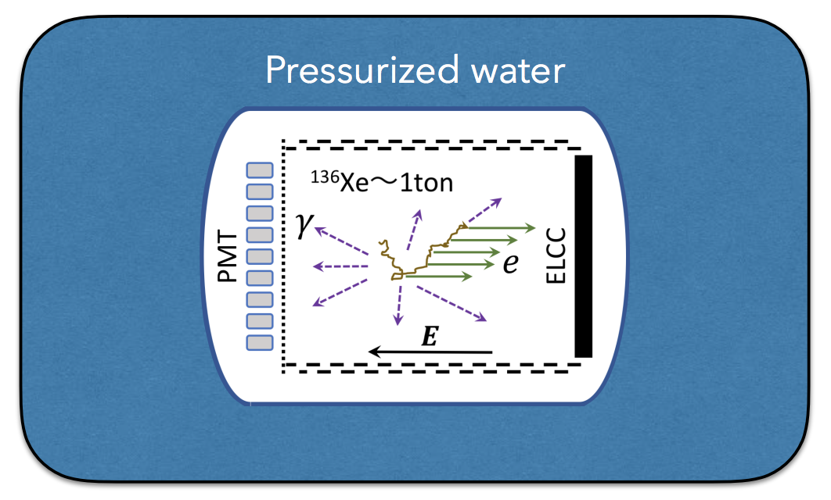
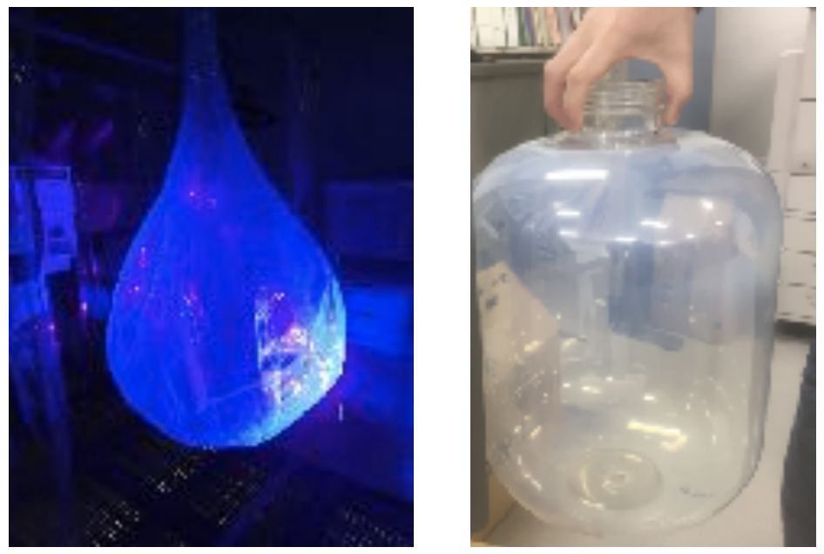
Future prospect
Further more…
- Pressurized water shield
- water Cherenkov can be used for muon veto
- thin pressure vessel to reduce mass → reduce ²¹⁴Bi BG
- Active shield vessel
- detects alpha and beta ray event of ²¹⁴Bi in the materials of vessel
Polyethylene Naphthalate
DBD18 at Hilton Waikoloa village, Hawaii, 21 Oct 2018

